Slide 1
Core Methods in Educational Data Mining
EDUC545-010 Spring2017

Slide 2
Discussion forums read-only for auditors
Who here is impacted?
For-credit students: are you OK with switching to Piazza?

Slide 3
RTFF

Slide 4
Introducing Prof. Alex Bowers
Top researcher in the world in using big data for educational leadership
All-around nifty guy

Slide 5
Thank you Alex!

Slide 6
RapidMiner Walkthrough
Any difficulties getting through the RapidMiner Walkthrough?

Slide 7
Assignment B1

Slide 8
Difficulties with TutorShop?

Slide 9
Difficulties with RapidMiner?

Slide 10
Any questions about k-Means in the homework?

Slide 11
Any questions about expectation maximization in the homework?

Slide 12
Any questions about agglomerative clustering in the homework?

Slide 13
Any other questions about the homework?

Slide 14
Any general questions about k-Means?

Slide 15
If there’s time

Slide 16
Let’s play with clustering a bit
Apply k-means using the following points and initial centroids
I need 5 volunteers!

Slide 17
+3
0
-3
time
0 1
pknow

Slide 18
+3
0
-3
time
0 1
pknow

Slide 19
+3
0
-3
time
0 1
pknow

Slide 20
+3
0
-3
time
0 1
pknow

Slide 21
+3
0
-3
time
0 1
pknow

Slide 22
Any comments on exercise?

Slide 23
Why
Is distortion/MSD good for choosing between randomized restarts
But bad for choosing cluster size?

Slide 24
Why
Isn’t cross-validated distortion/MSD good for choosing cluster size?
Why doesn’t cross-validation fix the issue?

Slide 25
What
Is the solution?

Slide 26
Is there a better way
To choose the number of clusters
Than just the adjusted fit?

Slide 27
Silhouette Analysis
An increasingly popular method for determining how many clusters to use (Rousseeuw, 1987; Kaufman & Rousseeuw, 1990)

Slide 28
Silhouette Analysis
Silhouette plot shows how close each point in a cluster is to points in adjacent clusters
Silhouette values scaled from -1 to 1
Close to +1: Data point is far from adjacent clusters
Close to 0: Data point is at boundary between clusters
Close to -1: Data point is closer to other cluster than its own cluster

Slide 29
Silhouette Formula
For each data point i
A(i) = average distance of i from all other data points in same cluster C
C* = cluster with lowest average distance of i from all other data points in cluster c*
B(i) = average dissimilarity of i from all other data points in cluster C*
$S\left(i\right)= \frac{B\left(i\right)−A(i)}{max⁡\{A\left(i\right), B(i)}$

Slide 30
Example from http://scikit-learn.org/ stable/auto_examples/cluster/ plot_kmeans_silhouette_analysis.html

Slide 31
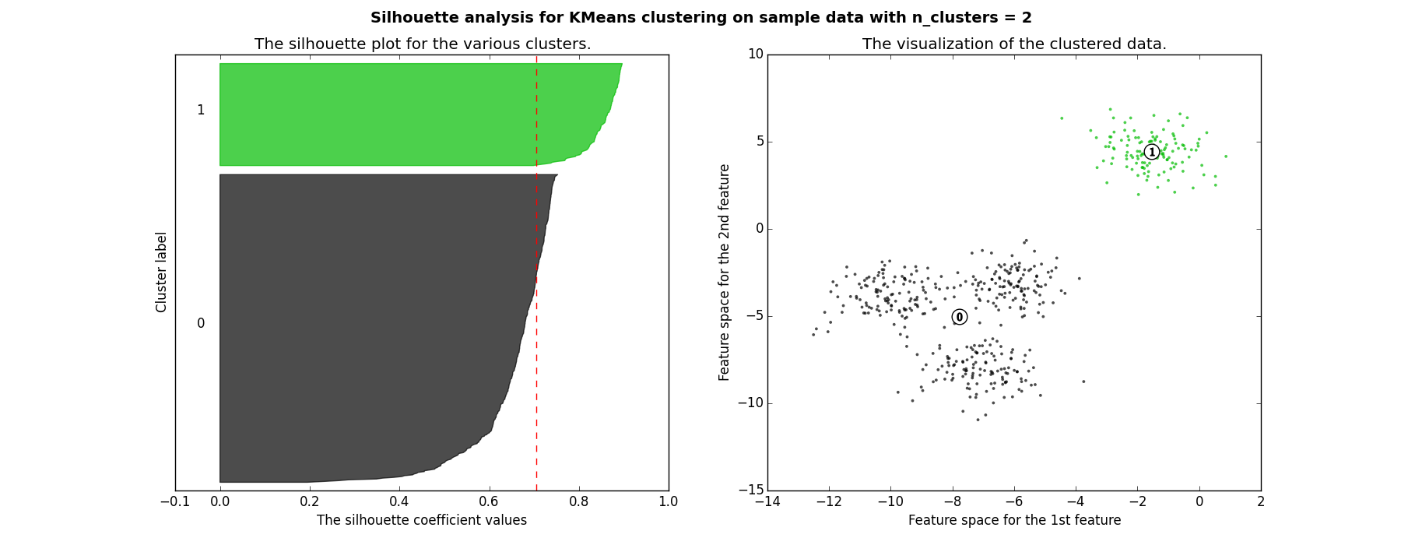
Good clusters

Slide 32
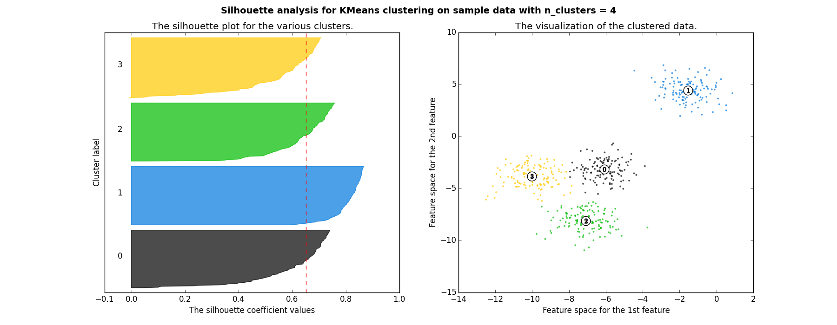
Good clusters

Slide 33
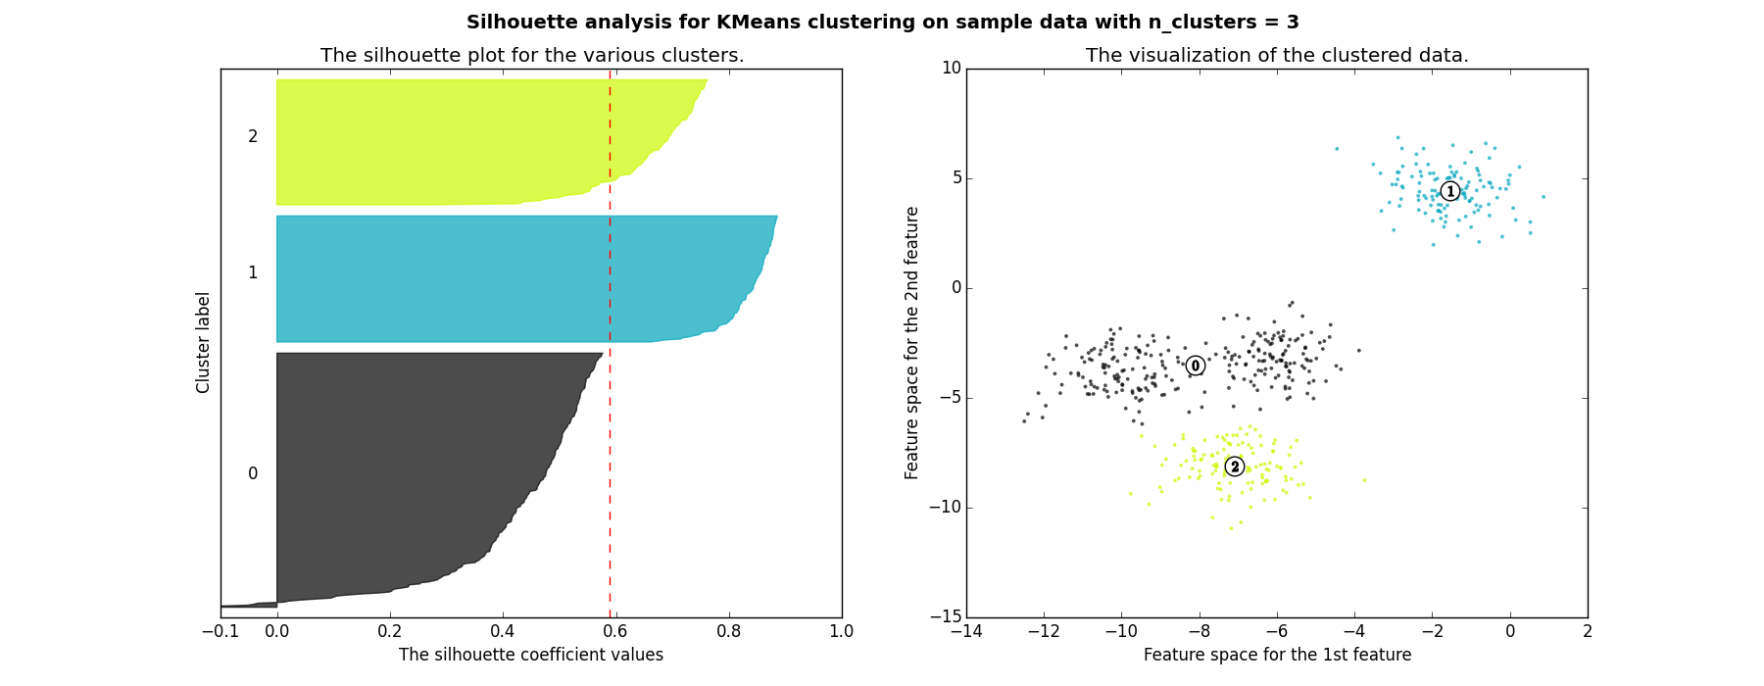
Bad clusters

Slide 34
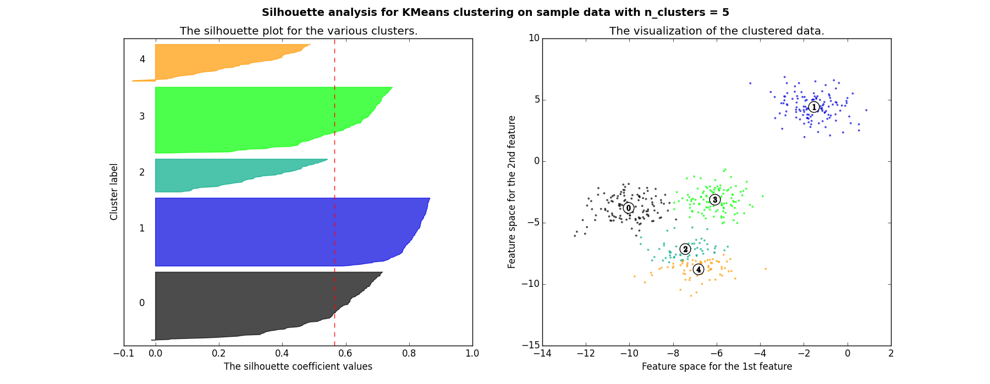
Bad clusters

Slide 35
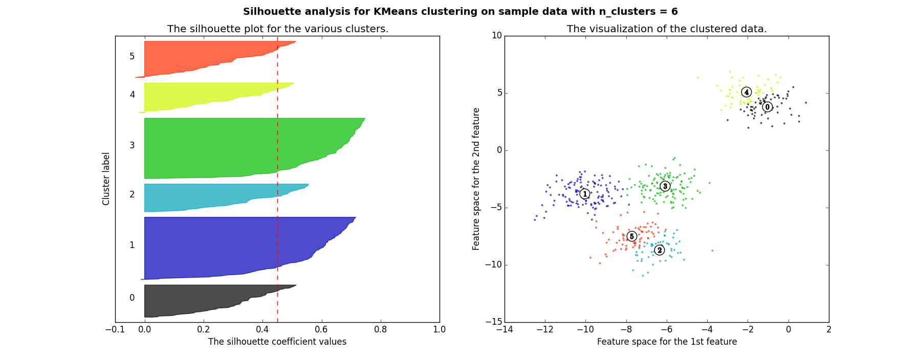
Bad clusters

Slide 36
So in this example
2 and 4 clusters are reasonable choices
3, 5, and 6 clusters are not good choices

Slide 37
Questions? Comments?

Slide 38
What are the advantages?
Of Gaussian Mixture Models

Slide 39
What are the advantages?
Of Gaussian Mixture Models
Why not use them all the time?

Slide 40
What are the advantages?
Of Spectral Clustering

Slide 41
What are the advantages?
Of Spectral Clustering
Why not use it all the time?

Slide 42
What are the advantages?
Of Hierarchical Clustering

Slide 43
What are the advantages?
Of Hierarchical Clustering
Why not use it all the time?

Slide 44
Clustering: Any Questions?

Slide 45
Factor Analysis .vs. Clustering
What’s the difference?

Slide 46
Factor Analysis: Any Questions?

Slide 47
What…
Are the general advantages of structure discovery algorithms (clustering, factor analysis)
Compared to supervised/prediction modeling methods?

Slide 48
What…
Are the general advantages of structure discovery algorithms (clustering, factor analysis)
Compared to supervised/prediction modeling methods?
What are the disadvantages?

Slide 49
Important point…
If you cluster in a well-known domain, you are likely to obtain well-known findings

Slide 50
Because of this…
Clustering is relatively popular
But somewhat prone to uninteresting papers in education research
Where usually a lot is already known
So be thoughtful…

Slide 51
Any other questions?

Slide 52
Assignment B2
Classification in Prediction
Due February 8

Slide 53
Next Class
Wednesday, February 1: Regression in Prediction
Readings
Baker, R.S. (2015) Big Data and Education. Ch. 1, V2.
Witten, I.H., Frank, E. (2011) Data Mining: Practical Machine Learning Tools and Techniques. Sections 4.6, 6.5. [on google drive]
Pardos, Z.A., Baker, R.S., San Pedro, M.O.C.Z., Gowda, S.M., Gowda, S.M. (2014) Affective states and state tests: Investigating how affect and engagement during the school year predict end of year learning outcomes. Journal of Learning Analytics, 1 (1), 107-128.

Slide 54
The End

