Slide 1
Core Methods in Educational Data Mining
EDUC545 Spring 2017

Slide 2
Data Used to Be
Dispersed
Hard to Collect
Small-Scale
Collecting sizable amounts of data required heroic efforts
Like we heard about from Alex Bowers last week

Slide 3
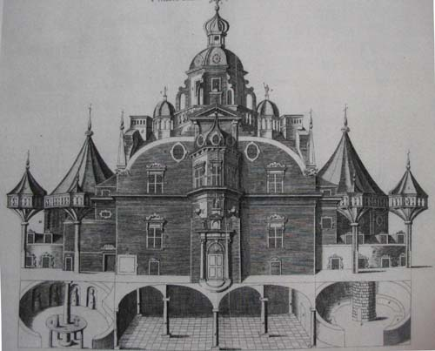
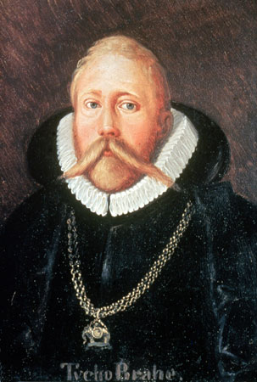
Tycho Brahe
Spent 24 years observing the sky from a custom-built castle on the island of Hven

Slide 4
Johannes Kepler
Had to take a job with Brahe to get Brahe’s data

Slide 5
Johannes Kepler
Had to take a job with Brahe to get Brahe’s data
Only got unrestricted access to data…

Slide 6
Johannes Kepler
Had to take a job with Brahe to get Brahe’s data
Only got unrestricted access to data… when Brahe died

Slide 7
Johannes Kepler
Had to take a job with Brahe to get Brahe’s data
Only got unrestricted access to data… when Brahe died
and Kepler stole the data and fled to Germany

Slide 8
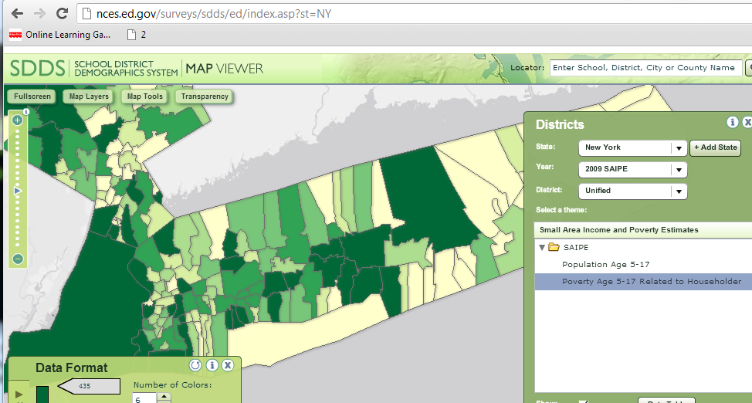
Data Today

Slide 9
Data Today

Slide 10
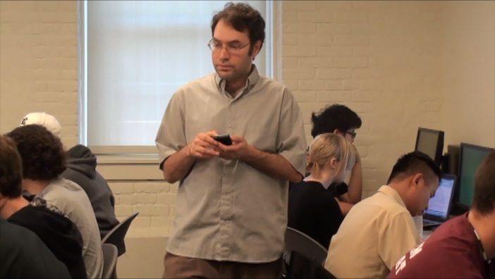
Data Today

Slide 11
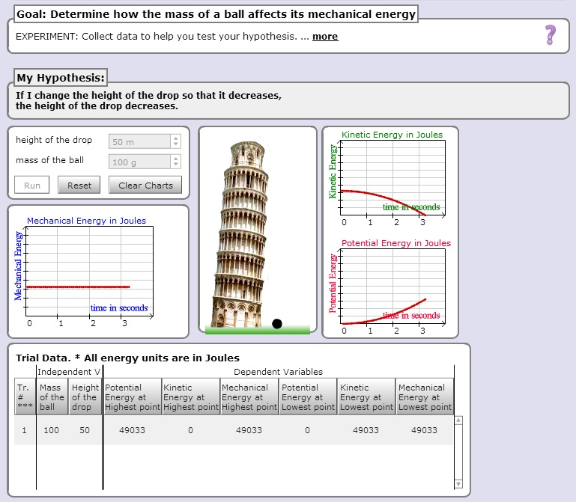
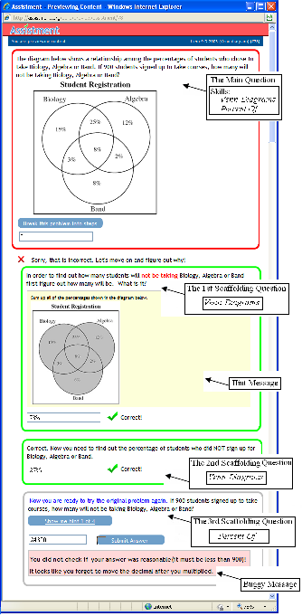
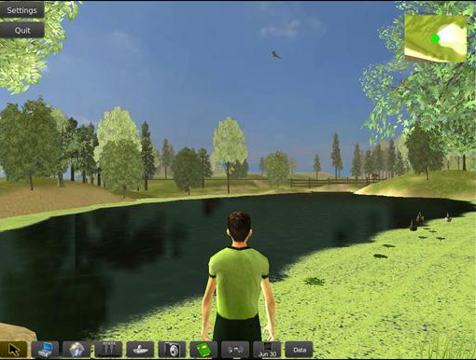
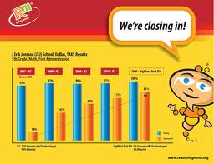
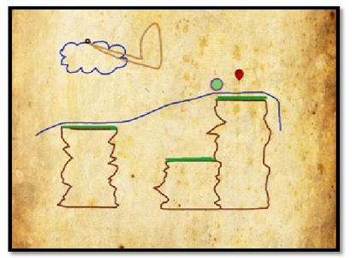
Data Today
Notes:
As more learning takes place within educational software and online learning environments of various types, it becomes much easier to gather very rich data on individual students’ learning and engagement within specific subjects. For example, a student might use a science simulation like the Inq-ITS, to learn science content and inquiry skills. Or they might learn scientific inquiry skill and content within a virtual environment like EcoMUVE. They might learn math skill in an action game like Zombie Division – the student has a set of weapons with numbers associated with them, a 2 for a sword, or a 5 for a gauntlet, and they can divide a skeleton if the weapon divides the number on the skeleton’s chest. Or they might learn math in a conceptual story-based learning environment like Reasoning Mind… or by doing math problems in a workbook-like environment like ASSISTments. All of these environments generate rich data streams that have been used in EDM analyses. And this kind of software in becoming more widespread every day. Systems like the Cognitive Tutor, or ASSISTments, or Reasoning Mind, are used by tens or hundreds of thousands of students, one or two days a week.

Slide 12
Student Log Data
*000:22:297 READY
.
*000:25:875 APPLY-ACTION
WINDOW; LISP-TRANSLATOR::AUTHORINGTOOL-TRANSLATOR,
CONTEXT; 3FACTOR-CROSS-XPL-4,
SELECTIONS; (GROUP3_CLASS_UNDER_XPL),
ACTION; UPDATECOMBOBOX,
INPUT; "Two crossover events are very rare.",
.
*000:25:890 GOOD-PATH
.
*000:25:890 HISTORY
P-1; (COMBOBOX-XPL-TRACE SIMBIOSYS),
.
*000:25:890 READY
.
*000:29:281 APPLY-ACTION
WINDOW; LISP-TRANSLATOR::AUTHORINGTOOL-TRANSLATOR,
CONTEXT; 3FACTOR-CROSS-XPL-4,
SELECTIONS; (GROUP4_CLASS_UNDER_XPL),
ACTION; UPDATECOMBOBOX,
INPUT; "The largest group is parental since crossovers are uncommon.",
.
*000:29:281 GOOD-PATH
.
*000:29:281 HISTORY
P-1; (COMBOBOX-XPL-TRACE SIMBIOSYS),
.
*000:29:281 READY
.
*001:20:733 APPLY-ACTION
WINDOW; LISP-TRANSLATOR::AUTHORINGTOOL-TRANSLATOR,
CONTEXT; 3FACTOR-CROSS-XPL-4,
SELECTIONS; (ORDER_GENES_OBS_XPL),
ACTION; UPDATECOMBOBOX,
INPUT; "The Q and q alleles have interchanged between the parental and SCO genotypes.",
.
*001:20:733 SWITCHED-TO-EDITOR
.
*001:20:748 NO-CONFLICT-SET
.
*001:20:748 READY
.
*001:32:498 APPLY-ACTION
WINDOW; LISP-TRANSLATOR::AUTHORINGTOOL-TRANSLATOR,
CONTEXT; 3FACTOR-CROSS-XPL-4,
SELECTIONS; (ORDER_GENES_OBS_XPL),
ACTION; UPDATECOMBOBOX,
INPUT; "The Q and q alleles have interchanged between the parental and DCO genotypes.",
.
*001:32:498 GOOD-PATH
.
*001:32:498 HISTORY
P-1; (COMBOBOX-XPL-TRACE SIMBIOSYS),
.
*001:32:498 READY
.
*001:37:857 APPLY-ACTION
WINDOW; LISP-TRANSLATOR::AUTHORINGTOOL-TRANSLATOR,
CONTEXT; 3FACTOR-CROSS-XPL-4,
SELECTIONS; (ORDER_GENES_UNDER_XPL),
ACTION; UPDATECOMBOBOX,
INPUT; "In the DCO group BOTH outer genes cross over so the interchanged gene is the middle one.",
.
*001:37:857 GOOD-PATH
Notes:
For example, as a student uses one of these interactive learning environments, the student will make hundreds of meaningful actions each hour – pausing and thinking before making an incorrect answer, asking for help, rapidly changing settings on a simulation, running away from a skeleton. When the data is logged, these behaviors provide us with incredibly rich detail about learning and engagement, that we can analyze.

Slide 13
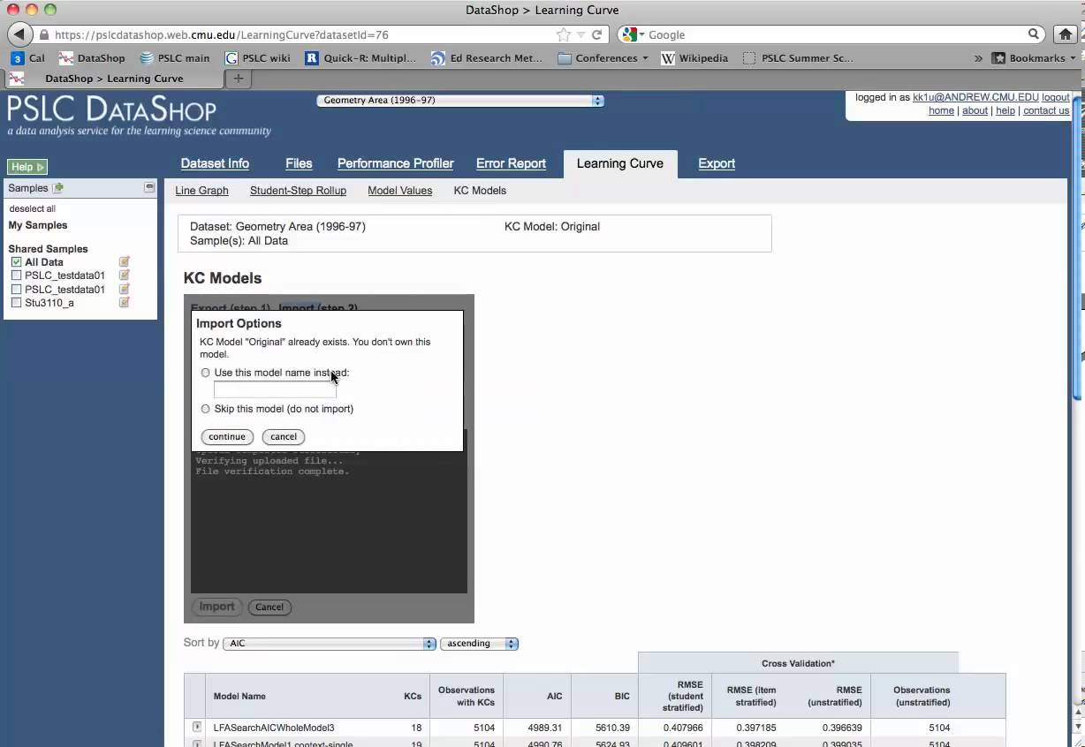
PSLC DataShop (Koedinger et al, 2008, 2010)
>250,000 hours of students using educational software within LearnLabs and other settings
>30 million student actions, responses & annotations

Slide 14
How much data is big data?

Slide 15
2004 and 2014
2004: I reported a data set with 31,450 data points. People were impressed.

Slide 16
2004 and 2014
2004: I reported a data set with 31,450 data points. People were impressed.
2014: A reviewer in an education journal criticized me for referring to 817,485 data points as “big data”.

Slide 17
What’s does it mean to call data “big data”?
Any thoughts?

Slide 18
Some definitions
“Big data” is data big enough that traditional statistical significance testing becomes useless
“Big data” is data too big to input into a traditional relational database
“Big data” is data too big to work with on a single machine

Slide 19
Questions? Comments?

Slide 20
Today’s Readings
First, a no-penalty-or-punishment survey question

Slide 21
Today’s Readings
Who read the Witten & Frank?
Who watched the BDE video?

Slide 22
Questions? Comments? Concerns?

Slide 23
What is a prediction model?

Slide 24
What is a regressor?

Slide 25
What are some things you might use a regressor for?
Bonus points for examples other than those in the BDE video

Slide 26
Let’s do an example
Numhints = 0.12*Pknow + 0.932*Time – 0.11*Totalactions
Skill pknow time totalactions numhints
COMPUTESLOPE 0.2 7 3 ?

Slide 27
Which of the variables has the largest impact on numhints? (Assume they are scaled the same)

Slide 28
However…
These variables are unlikely to be scaled the same!
If Pknow is a probability
From 0 to 1
And time is a number of seconds to respond
From 0 to infinity
Then you can’t interpret the weights in a straightforward fashion
What could you do?

Slide 29
Let’s do another example
Numhints = 0.12*Pknow + 0.932*Time – 0.11*Totalactions
Skill pknow time totalactions numhints
COMPUTESLOPE 0.2 2 35 ?

Slide 30
Is this plausible?

Slide 31
What might you want to do if you got this result in a real system?

Slide 32
Transforms
In the video, I talked about variable transforms
Who here has transformed a variable (for an actual analysis)?
What did you transform and why did you do it?

Slide 33
Variable Transformation: EDM versus statistics
Statistics: fit data better AND avoid violating assumptions
EDM: fit data better

Slide 34
Why don’t violations of assumptions matter in EDM?
At least not the way they do in statistics…

Slide 35
Interpreting Regression Models
Example from the video

Slide 36
Example of Caveat
Let’s graph the relationship between number of graduate students and number of papers per year

Slide 37
Data

Slide 38
Model
Number of papers = 4 + 2 * # of grad students - 0.1 * (# of grad students)²
But does that actually mean that (# of grad students)² is associated with less publication?
No!

Slide 39
Example of Caveat
(# of grad students)² is actually positively correlated with publications!
r=0.46

Slide 40
Example of Caveat
The relationship is only in the negative direction when the number of graduate students is already in the model…

Slide 41
How would you deal with this?
How can we interpret individual features in a comprehensive model?

Slide 42
Other questions, comments, concerns about lecture?

Slide 43
RapidMiner 5.3 exercise
Go to the course website and download
Sep10dataset.csv
Data on the probability that a student error is careless
Calculated as in (Baker, Corbett, & Aleven, 2008)
Try to predict from other variables

Slide 44
RapidMiner tasks
Build regressor to predict P(SLIP|TRIO)
Look at model goodness
Look at model
Look at actual data and refine model
Look at model goodness
Build flat cross-validation
Look at model goodness
Build student-level cross-validation
Look at model goodness

Slide 45
Questions? Comments? Concerns?

Slide 46
Questions about Basic HW 1?

Slide 47
Questions about Basic HW 2?

Slide 48
Reminders
You don’t have to do it perfectly, you just have to do it
If you run into trouble, feel free to email me or, better yet, use the discussion forum

Slide 49
Questions? Concerns?

Slide 50
Other questions or comments?

Slide 51
If there is time…
We will go back to the Ryan slides from clustering
If not, it’s nothing to worry about

Slide 52
Next Class
Wednesday, February 8
Classification Algorithms
Baker, R.S. (2015) Big Data and Education. Ch. 1, V3, V4.
Witten, I.H., Frank, E. (2011) Data Mining: Practical Machine Learning Tools and Techniques. Ch. 4.6, 6.1, 6.2, 6.4
Hand, D. J. (2006). Classifier technology and the illusion of progress. Statistical science, 21(1), 1-14.
Pardos, Z.A., Baker, R.S.J.d., Gowda, S.M., Heffernan, N.T. (2011) The Sum is Greater than the Parts: Ensembling Models of Student Knowledge in Educational Software. SIGKDD Explorations, 13 (2), 37-44.
Basic HW 2 due

Slide 53
The End

