Slide 1
Core Methods in Educational Data Mining
EDUC545 Spring 2017

Slide 2
Diagnostic Metrics -- HW
Any questions about any metrics?
Does anyone want to discuss any of the problems?

Slide 3
Diagnostic Metrics -- HW
When do you want to use fail-soft interventions?

Slide 4
Diagnostic Metrics -- HW
When do you not want to use fail-soft interventions?

Slide 5
Diagnostic Metrics -- HW
Q11
There’s been some debate on the forum as to what the right answer is
Let’s compute this together in Excel
Yes, you can do that

Slide 6
Textbook/Readings

Slide 7
Detector Confidence
Any questions about detector confidence?

Slide 8
Detector Confidence
What is a detector confidence value?

Slide 9
Detector Confidence
What are the pluses and minuses of making sharp distinctions at 50% confidence?

Slide 10
Detector Confidence
Is it any better to have two cut-offs?

Slide 11
Detector Confidence
How would you determine where to place the two cut-offs?

Slide 12
Cost-Benefit Analysis
Why don’t more people do cost-benefit analysis of automated detectors?

Slide 13
Detector Confidence
Is there any way around having intervention cut-offs somewhere?

Slide 14
Goodness Metrics

Slide 15
Exercise
 | Detector Academic Suspension | Detector No Academic Suspension
Data Suspension | 2 | 3
Data No Suspension | 5 | 140
What is accuracy?

Slide 16
Exercise
 | Detector Academic Suspension | Detector No Academic Suspension
Data Suspension | 2 | 3
Data No Suspension | 5 | 140
What is kappa?

Slide 17
Accuracy
Why is it bad?

Slide 18
Kappa
What are its pluses and minuses?

Slide 19
ROC Curve

Slide 20
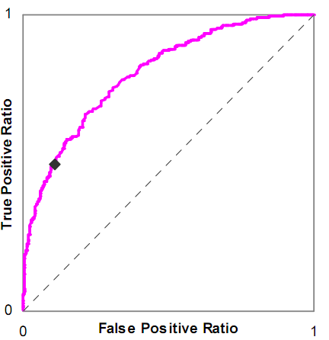
Is this a good model or a bad model?

Slide 21
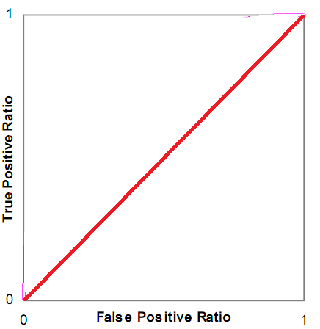
Is this a good model or a bad model?

Slide 22
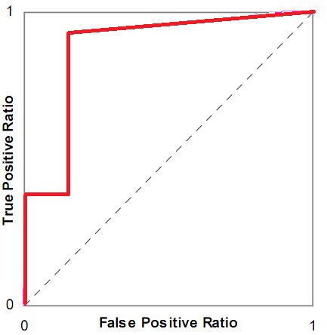
Is this a good model or a bad model?

Slide 23
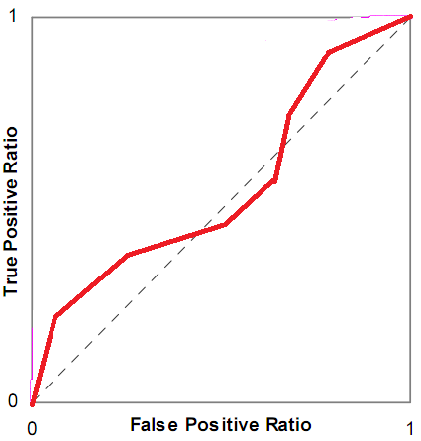
Is this a good model or a bad model?

Slide 24
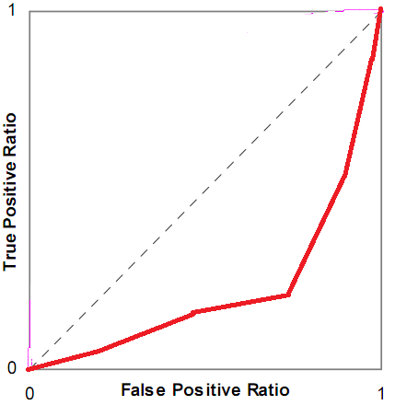
Is this a good model or a bad model?

Slide 25
ROC Curve
What are its pluses and minuses?

Slide 26
A’
What are its pluses and minuses?

Slide 27
Any questions about A’?

Slide 28
Precision and Recall
Precision = TP
TP + FP
Recall = TP
TP + FN

Slide 29
Precision and Recall
What do they mean?

Slide 30
What do these mean?
Precision = The probability that a data point classified as true is actually true
Recall = The probability that a data point that is actually true is classified as true

Slide 31
Precision and Recall
What are their pluses and minuses?

Slide 32
Correlation vs RMSE
What is the difference between correlation and RMSE?
What are their relative merits?

Slide 33
What does it mean?
High correlation, low RMSE
Low correlation, high RMSE
High correlation, high RMSE
Low correlation, low RMSE

Slide 34
AIC/BIC vs Cross-Validation
AIC is asymptotically equivalent to LOOCV
BIC is asymptotically equivalent to k-fold cv
Why might you still want to use cross-validation instead of AIC/BIC?
Why might you still want to use AIC/BIC instead of cross-validation?

Slide 35
AIC vs BIC
Any comments or questions?

Slide 36
LOOCV vs k-fold CV
Any comments or questions?

Slide 37
Other questions, comments, concerns about textbook?

Slide 38
Thoughts on the Knowles reading?

Slide 39
Thoughts on the Jeni reading?

Slide 40
Other questions or comments?

Slide 41
Next Class
Wednesday, March 1
Feature Engineering
Baker, R.S. (2014) Big Data and Education. Ch. 3, V3, V4, V5
Sao Pedro, M., Baker, R.S.J.d., Gobert, J. (2012) Improving Construct Validity Yields Better Models of Systematic Inquiry, Even with Less Information. Proceedings of the 20th International Conference on User Modeling, Adaptation and Personalization (UMAP 2012),249-260.
No HW due

Slide 42
The End

