Slide 1
Core Methods in Educational Data Mining
EDUC545 Spring 2017

Slide 2
Last Lecture
Slides 34-36

Slide 3
Textbook part 1

Slide 4
Pelanek example
W002V004v5
Who would like me to review this?

Slide 5
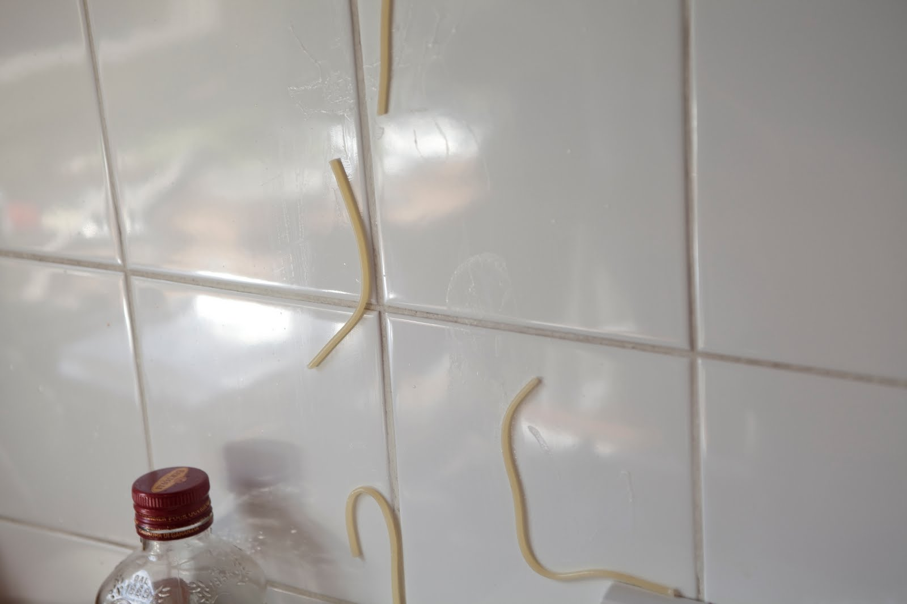
Feature Engineering
Not just throwing spaghetti at the wall and seeing what sticks

Slide 6
Construct Validity Matters!
Crap features will give you crap models
Crap features = reduced generalizability/more over-fitting
Nice discussion of this in the Sao Pedro paper

Slide 7
What’s a good feature?
A feature that is potentially meaningfully linked to the construct you want to identify

Slide 8
Baker’s feature engineering process
Brainstorming features
Deciding what features to create
Creating the features
Studying the impact of features on model goodness
Iterating on features if useful
Go to 3 (or 1)

Slide 9
What’s useful?
Brainstorming features
Deciding what features to create
Creating the features
Studying the impact of features on model goodness
Iterating on features if useful
Go to 3 (or 1)

Slide 10
What’s missing?
Brainstorming features
Deciding what features to create
Creating the features
Studying the impact of features on model goodness
Iterating on features if useful
Go to 3 (or 1)

Slide 11
How else could it be improved?

Slide 12
IDEO tips for Brainstorming
1. Defer judgment
2. Encourage wild ideas
3. Build on the ideas of others
4. Stay focused on the topic
5. One conversation at a time
6. Be visual
7. Go for quantity
http://www.openideo.com/fieldnotes/openideo-team-notes/seven-tips-on-better-brainstorming

Slide 13
Your thoughts?

Slide 14
Deciding what features to create
Trade-off between the effort to create a feature and how likely it is to be useful
Worth biasing in favor of features that are different than anything else you’ve tried before
Explores a different part of the space

Slide 15
General thoughts about feature engineering?

Slide 16
Activity

Slide 17
Special Rules for Today
Everyone Votes
Everyone Participates

Slide 18
Let’s look at some features used in real models

Slide 19
Let’s look at some features used in real models
Split into 6 groups
Take a sheet of features
Which features (or combinations) can you come up with “just so” stories for why they might predict the construct?
Are there any features that seem utterly irrelevant?

Slide 20
Each group
Tell us what your construct is
Tell us your favorite “just so story” (or two) from your features
Tell us which features look like junk
Everyone else: you have to give the feature a thumbs-up or thumbs-down

Slide 21
Textbook part 2

Slide 22
Automated Feature Generation
What are the advantages of automated feature generation, as compared to feature engineering?
What are the disadvantages?

Slide 23
Automated Feature Selection
What are the advantages of automated feature selection, as compared to having a domain expert decide? (as in Sao Pedro paper from Monday)
What are the disadvantages?

Slide 24
A connection to make

Slide 25
A connection to make
Correlation filtering
Eliminating collinearity in statistics
In this case, increasing interpretability and reducing over-fitting go together
At least to some positive degree

Slide 26
Outer-loop forward selection
What are the advantages and disadvantages to doing this?

Slide 27
Knowledge Engineering
What is knowledge engineering?

Slide 28
Knowledge Engineering
What is the difference between knowledge engineering and EDM?

Slide 29
Knowledge Engineering
What is the difference between good knowledge engineering and bad knowledge engineering?

Slide 30
Knowledge Engineering
What is the difference between (good) knowledge engineering and EDM?
What are the advantages and disadvantages of each?

Slide 31
How can they be integrated?

Slide 32
FCBF: What Variables will be kept? (Cutoff = 0.65)
What variables emerge from this table?
 | G | H | I | J | K | L | Predicted
G |  | .7 | .8 | .8 | .4 | .3 | .72
H |  |  | .8 | .7 | .6 | .5 | .38
I |  |  |  | .8 | .3 | .4 | .82
J |  |  |  |  | .8 | .1 | .75
K |  |  |  |  |  | .5 | .65
L |  |  |  |  |  |  | .42

Slide 33
Other questions, comments, concerns about textbook?

Slide 34
No Class Next Week
Spring Break

Slide 35
Next Class
Association Rule Mining. Guest lecture, Miguel Andres.
Wednesday, March 15
Baker, R.S. (2015) Big Data and Education. Ch. 5, V3.
Merceron, A., Yacef, K. (2008) Interestingness Measures for Association Rules in Educational Data. Proceedings of the 1st International Conference on Educational Data Mining,57-66.
Bazaldua, D.A.L., Baker, R.S., San Pedro, M.O.Z. (2014) Combining Expert and Metric-Based Assessments of Association Rule Interestingness. Proceedings of the 7th International Conference on Educational Data Mining

Slide 36
Special Request
Bring a print-out of your Assignment C2 solution to class on the day it’s due
In 2 weeks

Slide 37
The End

