Slide 1
Core Methods in Educational Data Mining
EDUC691 Spring 2019

Slide 2
Continuing with Feature Engineering

Slide 3
Baker’s feature engineering process
Brainstorming features
Deciding what features to create
Creating the features
Studying the impact of features on model goodness
Iterating on features if useful
Go to 3 (or 1)

Slide 4
What’s useful?
Brainstorming features
Deciding what features to create
Creating the features
Studying the impact of features on model goodness
Iterating on features if useful
Go to 3 (or 1)

Slide 5
What’s missing?
Brainstorming features
Deciding what features to create
Creating the features
Studying the impact of features on model goodness
Iterating on features if useful
Go to 3 (or 1)

Slide 6
How else could it be improved?

Slide 7
IDEO tips for Brainstorming
1. Defer judgment
2. Encourage wild ideas
3. Build on the ideas of others
4. Stay focused on the topic
5. One conversation at a time
6. Be visual
7. Go for quantity
http://www.openideo.com/fieldnotes/openideo-team-notes/seven-tips-on-better-brainstorming

Slide 8
Your thoughts?

Slide 9
Deciding what features to create
Trade-off between the effort to create a feature and how likely it is to be useful
Worth biasing in favor of features that are different than anything else you’ve tried before
Explores a different part of the space

Slide 10
General thoughts about feature engineering?

Slide 11
Automated Feature Generation
What are the advantages of automated feature generation, as compared to feature engineering?
What are the disadvantages?

Slide 12
Automated Feature Selection
What are the advantages of automated feature selection, as compared to having a domain expert decide? (as in Sao Pedro paper from Monday)
What are the disadvantages?

Slide 13
A connection to make

Slide 14
A connection to make
Correlation filtering
Eliminating collinearity in statistics
In this case, increasing interpretability and reducing over-fitting go together
At least to some positive degree

Slide 15
Outer-loop forward selection
What are the advantages and disadvantages to doing this?

Slide 16
Knowledge Engineering
What is knowledge engineering?

Slide 17
Knowledge Engineering
What is the difference between knowledge engineering and EDM?

Slide 18
Knowledge Engineering
What is the difference between good knowledge engineering and bad knowledge engineering?

Slide 19
Knowledge Engineering
What is the difference between (good) knowledge engineering and EDM?
What are the advantages and disadvantages of each?

Slide 20
How can they be integrated?

Slide 21
Clustering: Basic Assignment
Questions, Thoughts, Concerns?

Slide 22
Let’s play with clustering a bit
Apply k-means using the following points and initial centroids
I need 5 volunteers!

Slide 23
+3
0
-3
time
0 1
pknow

Slide 24
+3
0
-3
time
0 1
pknow

Slide 25
+3
0
-3
time
0 1
pknow

Slide 26
+3
0
-3
time
0 1
pknow

Slide 27
+3
0
-3
time
0 1
pknow

Slide 28
Any comments on exercise?

Slide 29
Any questions about k-Means?

Slide 30
Why
Is distortion/MSD good for choosing between randomized restarts
But bad for choosing cluster size?

Slide 31
Why
Isn’t cross-validated distortion/MSD good for choosing cluster size?
Why doesn’t cross-validation fix the issue?

Slide 32
What
Is the solution?

Slide 33
Is there a better way
To choose the number of clusters
Than just the adjusted fit?

Slide 34
Silhouette Analysis
An increasingly popular method for determining how many clusters to use (Rousseeuw, 1987; Kaufman & Rousseeuw, 1990)

Slide 35
Silhouette Analysis
Silhouette plot shows how close each point in a cluster is to points in adjacent clusters
Silhouette values scaled from -1 to 1
Close to +1: Data point is far from adjacent clusters
Close to 0: Data point is at boundary between clusters
Close to -1: Data point is closer to other cluster than its own cluster

Slide 36
Silhouette Formula
For each data point i
A(i) = average distance of i from all other data points in same cluster C
C* = cluster with lowest average distance of i from all other data points in cluster c*
B(i) = average dissimilarity of i from all other data points in cluster C*
$S\left(i\right)= \frac{B\left(i\right)−A(i)}{max⁡\{A\left(i\right), B(i)}$

Slide 37
Example from http://scikit-learn.org/ stable/auto_examples/cluster/ plot_kmeans_silhouette_analysis.html

Slide 38
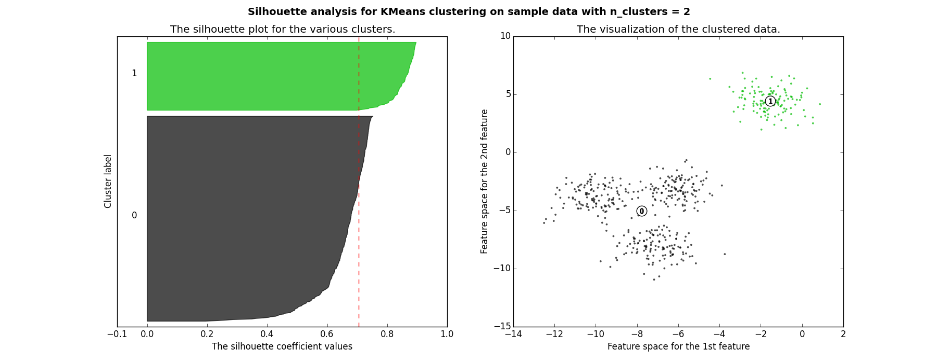
Good clusters

Slide 39
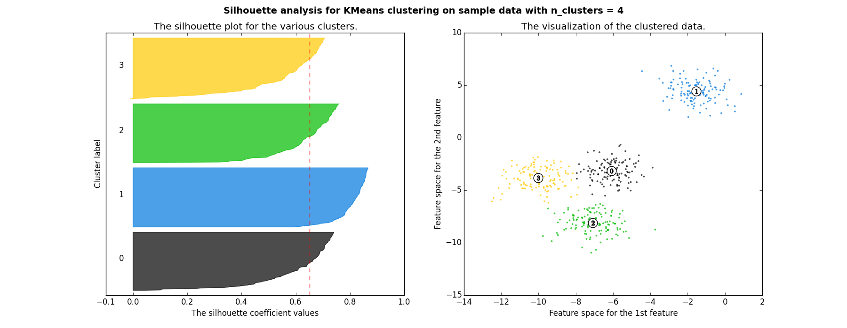
Good clusters

Slide 40
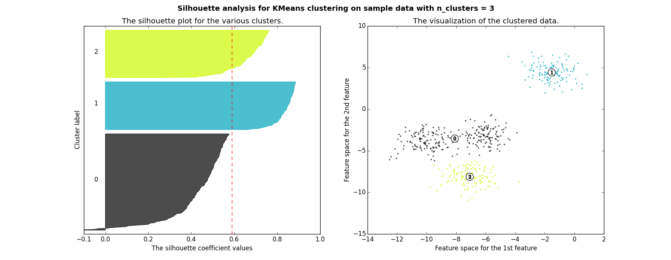
Bad clusters

Slide 41
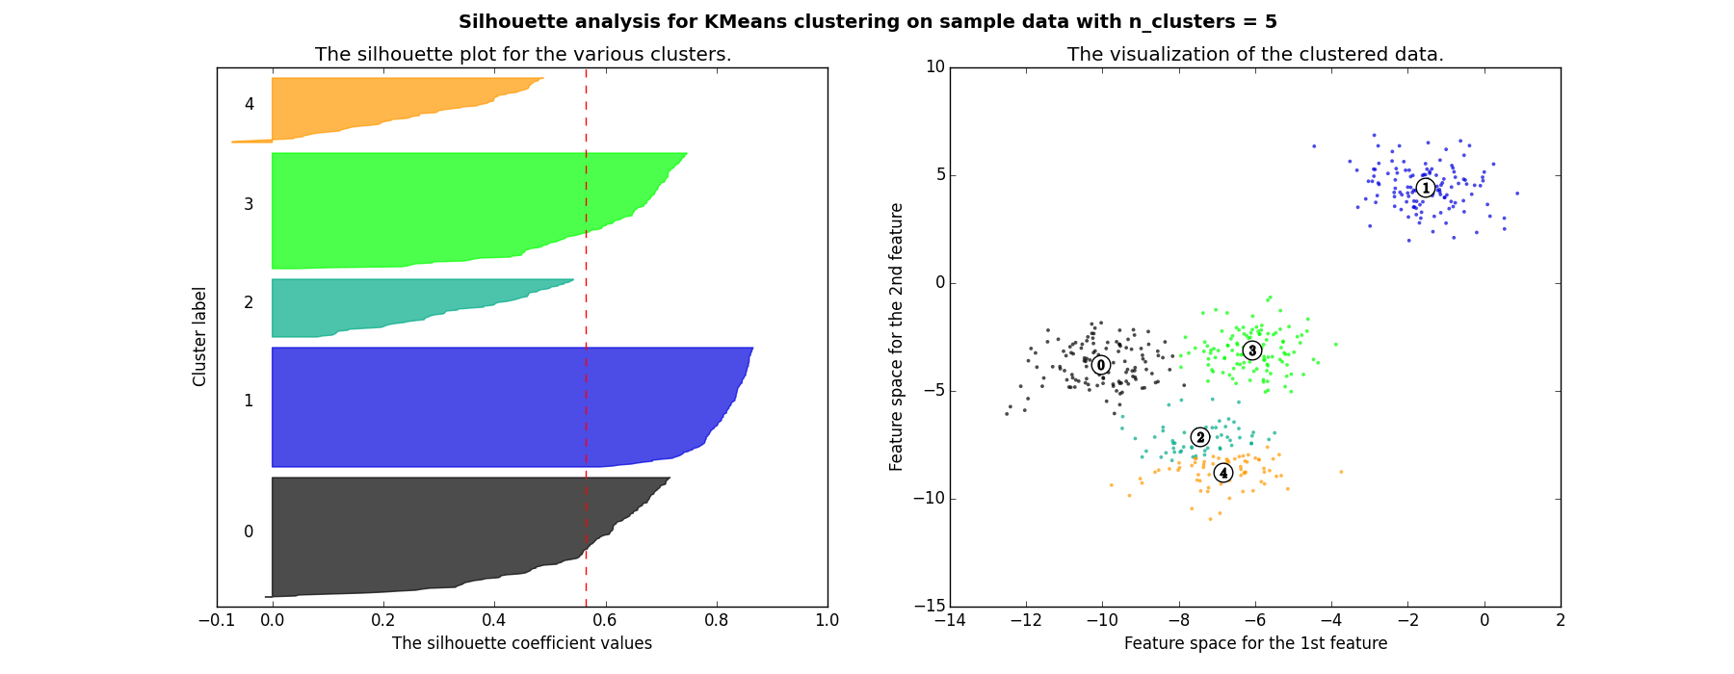
Bad clusters

Slide 42
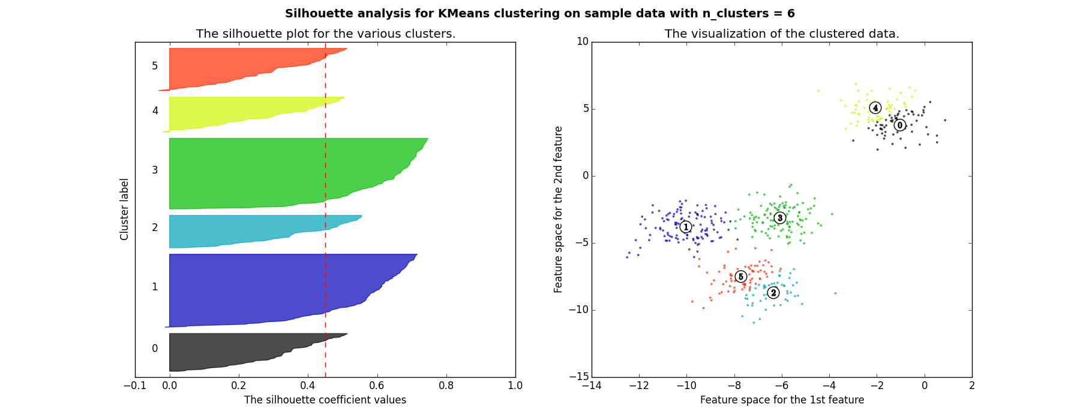
Bad clusters

Slide 43
So in this example
2 and 4 clusters are reasonable choices
3, 5, and 6 clusters are not good choices

Slide 44
Questions? Comments?

Slide 45
What are the advantages?
Of Gaussian Mixture Models

Slide 46
What are the advantages?
Of Gaussian Mixture Models
Why not use them all the time?

Slide 47
What are the advantages?
Of Spectral Clustering

Slide 48
What are the advantages?
Of Spectral Clustering
Why not use it all the time?

Slide 49
What are the advantages?
Of Hierarchical Clustering

Slide 50
What are the advantages?
Of Hierarchical Clustering
Why not use it all the time?

Slide 51
Clustering: Any Questions?

Slide 52
Factor Analysis .vs. Clustering
What’s the difference?

Slide 53
Factor Analysis: Any Questions?

Slide 54
What…
Are the general advantages of structure discovery algorithms (clustering, factor analysis)
Compared to supervised/prediction modeling methods?

Slide 55
What…
Are the general advantages of structure discovery algorithms (clustering, factor analysis)
Compared to supervised/prediction modeling methods?
What are the disadvantages?

Slide 56
Important point…
If you cluster in a well-known domain, you are likely to obtain well-known findings

Slide 57
Because of this…
Clustering is popular
But somewhat prone to uninteresting papers in education research
Where usually a lot is already known
So be thoughtful…

Slide 58
Any other questions?

Slide 59
Next Class
Association Rule and Sequential Pattern Mining
Wednesday, March 27
Baker, R.S. (2018) Big Data and Education. Ch. 7, V1, V2, V3, V4, V5.
Baker, R.S. (2018) Big Data and Education. Ch. 5, V3, V4.
Merceron, A., Yacef, K. (2008) Interestingness Measures for Association Rules in Educational Data. Proceedings of the 1st International Conference on Educational Data Mining,57-66.
Bazaldua, D.A.L., Baker, R.S., San Pedro, M.O.Z. (2014) Combining Expert and Metric-Based Assessments of Association Rule Interestingness. Proceedings of the 7th International Conference on Educational Data Mining.
Kinnebrew, J. S., Loretz, K. M., & Biswas, G. (2013). A contextualized, differential sequence mining method to derive students' learning behavior patterns. JEDM-Journal of Educational Data Mining, 5(1), 190-219.

Slide 60
The End

