Slide 1
An Inappropriately Brief Introduction to Frequentist Statistics
Ryan Baker
Images in this talk are drawn from the web heavily, under the fair use clause

Slide 2
Note
There are many topics I’m not covering here
I am not using all the terminology that a stats course would use
I will refer to many advanced topics that I won’t discuss in detail today, so that you know where to look further
I am not covering anything in real detail
A single lecture is no substitute for a statistics class
Caveat emptor
It may, however, make some things in data mining clearer
And give you ideas about what to look up and learn in the future

Slide 3
Key Topics
Z
Violations of normality
T
F
Linear models
Chi-squared

Slide 4
Z

Slide 5
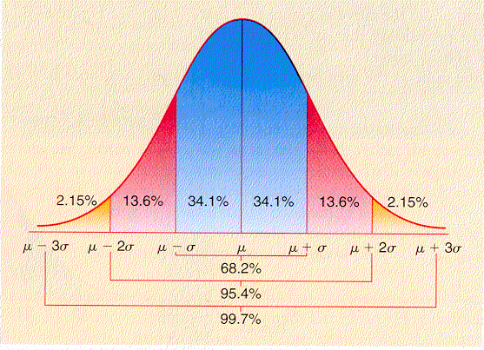
Z (the “normal curve”) (“the Gaussian distribution”)

Slide 6
Z (the “normal curve”) μ = 0, σ = 1
-3 -2 -1 0 +1 +2 +3

Slide 7
Two-sample Z test
You have two groups, and a value for each member of each group
You want to know if the values are significantly different for the two groups
M₁ – M₂
sqrt(SE₁² + SE₂²)
Z =

Slide 8
Two-sample Z test
Take your Z value
Find the corresponding location along the normal curve; the proportion of the area beyond that is your “p value”

Slide 9
What does a p value mean?
It is the probability that, if there really were no effect/no difference
You could still obtain the results you saw, by chance
Note: NOT the same as “the probability your results were due to chance”

Slide 10
What’s the difference?
Imagine the following proposition:
If I am Superman, there is a 90% chance I am wearing blue underwear

Slide 11
What’s the difference?
Imagine the following proposition:
If I am Superman, there is a 90% chance I am wearing blue underwear
Not the same as
If I am wearing blue underwear, there is a 90% chance that I am Superman

Slide 12
Two-tailed test
For “two-tailed” tests, multiply p by 2
Essentially means that you are looking at the probability of seeing the magnitude of difference you saw, in either direction
Unless you would literally ignore a result going in the opposite direction, you should ALWAYS use a two-tailed test for a two-tailed distribution
Any respectable statistics package and most unrespectable ones will do this for you automatically

Slide 13
Z (the “normal curve”) μ = 0, σ = 1
Z=1.96 -> p=0.05 for two- tailed test
-3 -2 -1 0 +1 +2 +3

Slide 14
p=0.05
It is convention to refer to p<=0.05 as “statistically significant”
It is convention to refer to p from 0.06 to 0.11 as “marginally significant”
It is convention to refer to p>0.11 as “not statistically significant”
These are convention, not an absolute rule
Although you wouldn’t know that from the reviewers at some journals!

Slide 15
p=0.05
Don’t ever say “Group A did better than group B, though it was not statistically significant, p=0.79.”
You will not get good reviews

Slide 16
One-sample Z-test
You have a data set
You want to determine whether the data set is significantly different than a value
The applications of this are real (and frequent in my research) but somewhat obscure
Simple Example: You want to know if a class’s average gain score was significantly different than 0
Trickier Example: You want to know if an affect transition probability is significantly different than 0, where a value of 0 means chance

Slide 17
One-sample Z test
M₁ – V
sqrt(SE₁²)
Z =

Slide 18
One-sample Z test
M₁ – 0.5
sqrt(SE₁²)
Z =

Slide 19
Z: Key limitaitons
Assumes that your data set is infinite in size

Slide 20
Z: Key limitaitons
Assumes that your data set is infinite in size
I work with big data sets, but I’ve never seen a data set that is infinite in size

Slide 21
Z: In practice
Totally OK for N>120
Really not OK ever for N<30
30<N<120 – Judgment call
In most cases, if N<120, use a t-test or F-test
More on this in a minute
That said, if a t-test or F-test is *feasible* (and it is for most analyses), use them even if N>120
It’s mathematically almost exactly the same thing
Clueless reviewers won’t complain

Slide 22
Why the Z statistic is important
It is more flexible than any other statistic
You can take any p-value and reverse-convert it to a Z value
You can add or subtract Z values involving different data sets using Stouffer’s test, and get a Z value
Z₁ + Z₂ Z₁ – Z₂
sqrt(2) sqrt(2)
Znew =
Znew =

Slide 23
Because of this…
The Z statistic is used in a large number of highly complex analyses, such as meta-analysis and detector comparison

Slide 24
Violations of normality
Z tests assume that your data is approximately normally distributed
When this is not true, it is called a “violation of normality”
There are tests you can do to check if this is a problem

Slide 25
Violations of normality
This issue applies to t, F, and Chi-squared too!

Slide 26
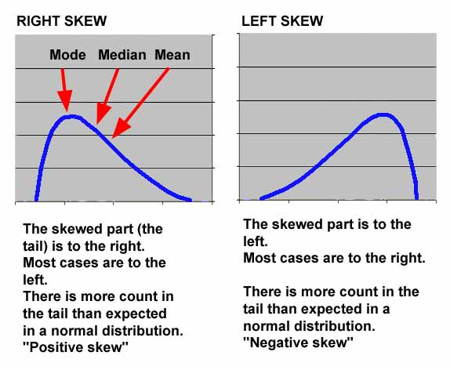
Skew

Slide 27
Skew
Not a huge problem
You can usually transform the data by taking the logarithm or exponentiating, to cure this
There are “tests of skewness” that can provide guidelines on whether you ought to be doing this

Slide 28
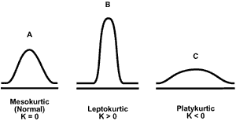
Kurtosis

Slide 29
Kurtosis
Platykurtic data isn’t a big problem
Leptokurtic data is a big problem
Poisson Regression (df=1) is the answer

Slide 30
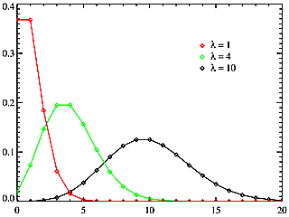
Poisson distribution

Slide 31
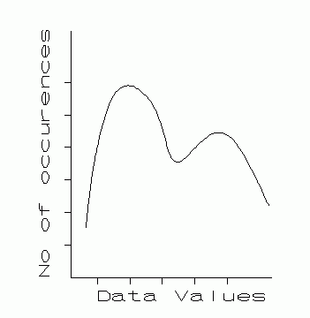
Bimodal Distribution

Slide 32
Bimodal Distribution
Can be dealt with by fitting the data as a function of two normal curves

Slide 33
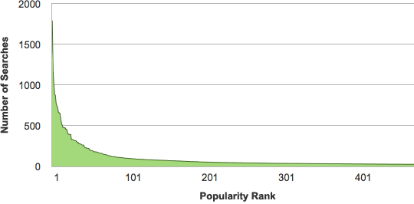
Zipf distribution

Slide 34
Zipf distribution
Common in data sets involving correlated choices
Population of cities, Popularity of books
Relatively rare in educational data
Possible to use Poisson Regression

Slide 35
t

Slide 36
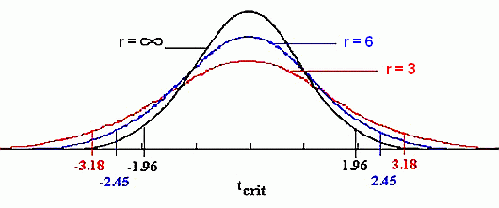
t distribution

Slide 37
t
N= infinity → t = Z
N> 120 → t almost equals Z
30<N<120 → t is lower than Z
N<30 → t is much lower than Z
(When picking a t distribution, you actually use N-1, the degrees of freedom)

Slide 38
Why does this matter?
Using Z instead of t will give you a lower p value
Your result looks statistically significant
When it really isn’t

Slide 39
Two-sample t test (often just called “t test”)
You have two groups, and a value for each member of each group
You want to know if the values are significantly different for the two groups

Slide 40
Two-sample t test (often just called “t test”)
There’s approximately a quadrillion ways to write this formula

Slide 41
Note
Usually, S is computed as the standard deviation of both groups, pooled together
In rare cases where the two groups have very different standard deviations, S is computed separately for each group and then pooled
There are tests to check for this, but just eyeball your data first

Slide 42
Independence Assumption
t (and Z for that matter) assume that the data points are independent
e.g. there is no important factor connecting some but not all of your points to each other within a group
Example of violation of independence:
You have 1000 data points from 20 students

Slide 43
Independence Assumption
If you have non-independent data
Either average within each student
Or do an F-test with a student-level term
Not all types of non-independence matter equally…
If you have data from 10 classrooms, data is non-independent at this level too
But this is sometimes ignored in analysis when there’s not an a priori reason to believe the class matters
You can take class-level variables into account, if it seems to matter, by using an F-test with a class-level term, or by setting up a Hierarchical Linear Model

Slide 44
Why does it matter?
The degrees of freedom assume independence between data points
If you violate independence, you will appear to have a bigger data set
Which will lower p and increase the probability of getting statistical significance when the effect is not really statistically significant

Slide 45
The paired t-test
A special test for when you have two values for each student (or other type of organizing data), and you want to find whether one value is significantly higher than the other
Example: Do students do better on the post-test than on the pre-test?

Slide 46
F

Slide 47
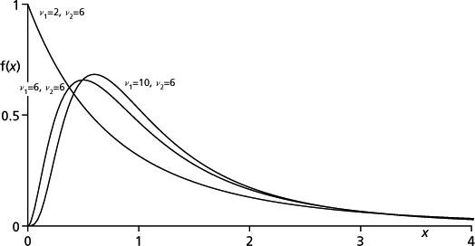
F distribution

Slide 48
What is F?
First of all, F has two types of degrees of freedom
“Numerator” degrees of freedom – corresponds to the number of factors in your model
“Denominator” degrees of freedom – corresponds to the number of data points, minus the number of factors, minus 1

Slide 49
What is F?
If your model has 1 factor
Then the F distribution is exactly equal to the t distribution, squared

Slide 50
What is F?
Unlike Z and t, F cannot have negative values (look at it)
Thus F is always a one-tailed test (look at the function)
Don’t multiply your p values by 2!

Slide 51
Why would you use the F test?
You can include multiple factors
Makes it possible to
Test for multiple factors at the same time (is factor A still significant, if factor B is in the model?)
Address non-independence by including a student term

Slide 52
ANOVA
“Analysis of variance”
A way of seeing how much of the variance in your dependent variable is explained by your explanatory/independent variables
When people say “F test”, they usually mean ANOVA

Slide 53
Things you can test for
Is the overall model better than chance?
Given a model with factors A and B (or A,B,C…), is factor D a statistically significant predictor when already controlling for the other factors?
Called an extra-sum-of-squares F-test – will be explained momentarily

Slide 54
ANOVA
When you test a model using ANOVA
Not going to go into the math today, stats classes usually devote multiple lectures to that
You will get output that looks like

Slide 55
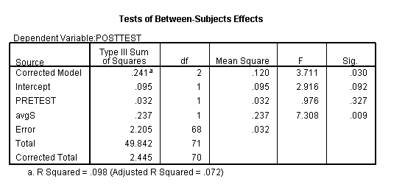
Overall model
Individual factors
Overall model fit (more on this later)
Not a preferred stat anymore

Slide 56
Linear models

Slide 57
Linear correlation (Pearson’s correlation)
r(A,B) =
When A’s value changes, does B change in the same direction?
Assumes a linear relationship

Slide 58
What is a “good correlation”?
1.0 – perfect
0.0 – none
-1.0 – perfectly negatively correlated
In between – depends on the field

Slide 59
What is a “good correlation”?
1.0 – perfect
0.0 – none
-1.0 – perfectly negatively correlated
In between – depends on the field
In physics – correlation of 0.8 is weak!
In education – correlation of 0.3 is good

Slide 60
Some correlations
Gaming the system and learning – around -0.35
Off-task behavior and learning – around -0.1
Amount of smoking and lifespan – around -0.3

Slide 61
Why are small correlations OK in education?
Lots and lots of factors contribute to just about any dependent measure

Slide 62
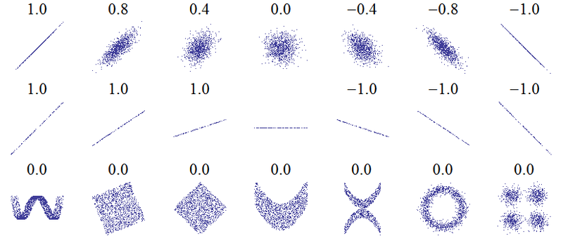
Examples of correlation values

Slide 63
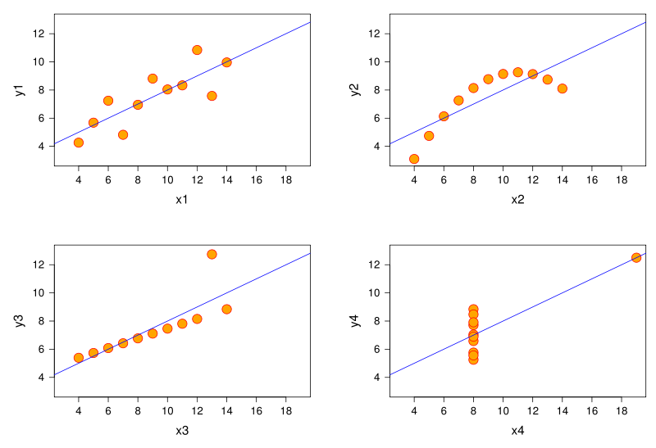
Same correlation, different functions (Anscombe’s Quartet)

Slide 64
Non-Linear correlation (Spearman’s correlation)
Close variant of Pearson that captures relationships better when relationship is non-linear or has outliers
Captures how monotonic relationship is, doesn’t care about individual values beyond their rank-order

Slide 65
Famous slogan
“Correlation is not causation”
If A and B are strongly correlated, it can mean
A
B
C
A
B
A
B

Slide 66
r²
The correlation, squared
Also a measure of what percentage of variance in dependent measure is explained by a model
If you are predicting A with B,C,D,E
r² is often used as the measure of model goodness rather than r (depends on the community)
Remember the output earlier

Slide 67
Partial correlation
The correlation between A and B, controlling for C, is the partial correlation
Important when C is predictive of both A and B

Slide 68
Statistical Significance
It is very feasible to compute whether a linear correlation is statistically significantly different than chance
Several formulas, a couple of the easiest are on the inside cover of Rosenthal & Rosnow, 1991
Not required for this class, but nice to have!

Slide 69
Linear Regression
Finds a linear model (a line) relating one or more independent variables (A, B, C, D…) to a dependent variable (Y)

Slide 70
Linear Regression
Let’s say our dependent variable Y is student post-test score
Let’s say we want to model it as a function of the pre-test score -- A

Slide 71
Linear Regression
Y = α₀ + α₁A
Examples Y = 0 + 1A

Slide 72
Linear Regression
Y = α₀ + α₁A
Examples Y = 0.1 + 1A

Slide 73
Linear Regression
Y = α₀ + α₁A
Examples Y = -0.1 + 1A

Slide 74
Linear Regression
Y = α₀ + α₁A
Examples Y = 0 + 2A

Slide 75
Linear Regression
Y = α₀ + α₁A
Examples Y = 0 + 0.5A

Slide 76
Linear Regression
Y = α₀ + α₁A
Examples Y = 0.2 + 0.5A

Slide 77
In Linear Regression
The values of α₀ and α₁ are selected to get the closest fit between the model and the data
Goodness of fit, during fitting, typically defined as “the sum of squared residuals” – a residual is the distance between a point and the prediction for that point
Goodness of fit after fitting usually assessed with r²

Slide 78
In Linear Regression
Possible to have many independent variables
Y = α₀ + α₁A + α₂B + α₃C + α₄D + α₅E

Slide 79
In This Case
It is typical to plot the relationship between the predicted variable and the model prediction

Slide 80
Is a model significant?
Determined with an F test

Slide 81
Is a specific parameter in a model significant?
Determined with an Extra-Sum-of-Squares F test
Looks at Sum of Squared Residuals (SSR) both with and without that parameter
If the SSR drops enough with that extra parameter, then the parameter is statistically significant

Slide 82
Chi-squared (χ²)

Slide 83
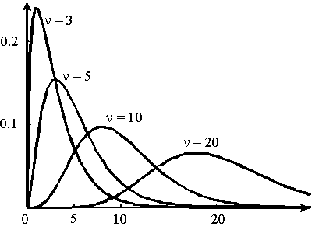
Chi-squared distribution

Slide 84
Chi-squared
Like t, has a number of degrees of freedom
Chi-squared (df = 1) is Z, squared
Assumes normality, so the same limitations on N apply – not appropriate for very small N
Convention – only use if N>30
Chi-squared is one-tailed
By far, the most common Chi-squared test is the df=1 Chi-Squared Test of the Difference Between Independent Proportions

Slide 85
Example
 | Population A | Population B
Non-Bored | 72 | 85
Bored | 28 | 15
Are these two proportions statistically significantly different?

Slide 86
The end
Today, we have gone through a lot of methods coming from frequentist statistics
This overview should be considered insufficient by any reasonable person
Nonetheless, I hope that it was useful to you
To learn more, take an introductory statistics course

