Slide 1
Core Methods in Educational Data Mining
EDUC6191 Fall 2023

Slide 2
Diagnostic Metrics -- HW
Any questions about any metrics?
Does anyone want to discuss any of the problems?

Slide 3
Diagnostic Metrics -- HW
What’s a fail-soft intervention?

Slide 4
Diagnostic Metrics -- HW
When do you want to use fail-soft interventions?

Slide 5
Diagnostic Metrics -- HW
When do you not want to use fail-soft interventions?

Slide 6
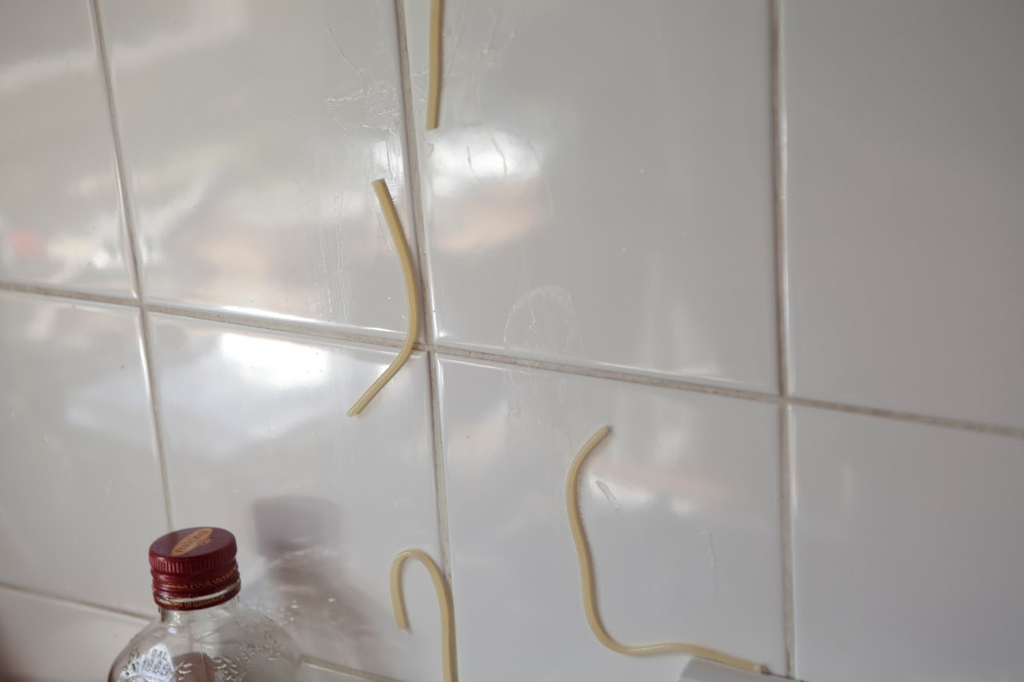
Feature Engineering
Not just throwing spaghetti at the wall and seeing what sticks

Slide 7
Feature Engineering
What is feature engineering?

Slide 8
Feature Engineering (Slater et al., 2020)
“the construction of contextual and relevant features from system log data”

Slide 9
Construct Validity Matters!
Low-quality features will give you low-quality models
Low-quality features = reduced generalizability/more over-fitting
Detailed discussion of this in the Sao Pedro paper

Slide 10
What’s a good feature?
A feature that is potentially meaningfully linked to the construct you want to identify

Slide 11
Baker’s feature engineering process
Brainstorming features
Deciding what features to create
Creating the features
Studying the impact of features on model goodness
Iterating on features if useful
Go to 3 (or 1)

Slide 12
What’s useful here, and why?
Brainstorming features
Deciding what features to create
Creating the features
Studying the impact of features on model goodness
Iterating on features if useful
Go to 3 (or 1)

Slide 13
Is anything missing?
Brainstorming features
Deciding what features to create
Creating the features
Studying the impact of features on model goodness
Iterating on features if useful
Go to 3 (or 1)

Slide 14
How else could it be improved?

Slide 15
IDEO tips for Brainstorming
1. Defer judgment
2. Encourage wild ideas
3. Build on the ideas of others
4. Stay focused on the topic
5. One conversation at a time
6. Be visual
7. Go for quantity
http://www.openideo.com/fieldnotes/openideo-team-notes/seven-tips-on-better-brainstorming

Slide 16
Any thoughts?
1. Defer judgment
2. Encourage wild ideas
3. Build on the ideas of others
4. Stay focused on the topic
5. One conversation at a time
6. Be visual
7. Go for quantity
http://www.openideo.com/fieldnotes/openideo-team-notes/seven-tips-on-better-brainstorming

Slide 17
Deciding what features to create
Trade-off between the effort to create a feature and how likely it is to be useful
Worth biasing in favor of features that are different than anything else you’ve tried before
Explores a different part of the space

Slide 18
General thoughts about feature engineering?

Slide 19
Slater et al (2020) paper
Iterative feature engineering

Slide 20
Slater et al (2020) paper
Conduct Feature Engineering
Build Model
Test Model
If model good enough, END
Qualitatively Study Model Errors
Go to 2

Slide 21
Slater et al (2020) caveat
Should test end result on totally new data (which this paper didn’t yet do)

Slide 22
Slater et al (2020) paper
Questions? Comments?

Slide 23
SMOTE for Class Imbalance
Including Sha et al. paper
Any questions?

Slide 24
Synthetic Data Generation/Augmentation with LLMs
Including Cochran et al. paper
Comments? Questions?

Slide 25
Hyperparameter Tuning
Any questions?

Slide 26
Knowledge Engineering
What is knowledge engineering?

Slide 27
Knowledge Engineering
What is the difference between knowledge engineering and EDM?

Slide 28
Knowledge Engineering
What is the difference between good knowledge engineering and bad knowledge engineering?

Slide 29
Knowledge Engineering
What is the difference between (good) knowledge engineering and EDM?
What are the advantages and disadvantages of each?

Slide 30
How can they be integrated?

Slide 31
Other questions, comments, concerns about video topics?

Slide 32
Let’s look at some features used in real models

Slide 33
Let’s look at some features used in real models
Split into groups of in just a minute
Thursday section
Get into groups of 3.
Those online – we’ll put you in breakout rooms, use that group number
In-person – count off group numbers starting with number of breakout rooms + 1
Tuesday section
We’ll put you in breakout rooms, use that group number
Download list of features from course schedule
“Extra Materials for Class”
Use list of features for your group number (at very beginning of each page)
Which features (or combinations) can you come up with “just so” stories for why they might predict the construct?
Are there any features that seem utterly irrelevant?

Slide 34
Groups 1 and 7
1: Tell us what your construct is
1,7: Tell us your favorite “just so story” from your features
7,1: Tell us about one feature that looks like junk
Everyone else: you have to give the feature a yay or boo (chat window for those online)

Slide 35
Groups 2 and 8
2: Tell us what your construct is
2,8: Tell us your favorite “just so story” from your features
8,2: Tell us about one feature that looks like junk
Everyone else: you have to give the feature a yay or boo (chat window for those online)

Slide 36
And so on…
3 & 9
4 & 10
5 & 11
6 & 12

Slide 37
Comments? Questions?

Slide 38
Next classes
October 5 & 10 October 5 will be virtual (you can come here in person but I will be on-screen)
Network Analysis
Creative: Feature Engineering Due October 9
October 12 & 14 Guest lecturer Oct 12: Joyce Zhang Bayesian Knowledge Tracing
Basic: SNA Due October 16
October 19 & 21 Everything at its normal time and place Logistic Knowledge Tracing
Basic: BKT Due October 23

Slide 39
The End

