Slide 1
Core Methods in Educational Data Mining
EDUC 6191 Fall 2024

Slide 2
Any questions about the basic assignment on clustering?

Slide 3
Knowledge Structure Discovery

Slide 4
Knowledge Structure Discovery
From generic structure discovery (clustering, factor analysis) to specific structure discovery (knowledge structures)

Slide 5
Any lingering questions about clustering or factor analysis?

Slide 6
Q-Matrix (Tatsuoka, 1983; Barnes, 2005)
 | Skill1 | Skill2 | Skill3 | Skill4
Item1 | 1 | 0 | 0 | 0
Item2 | 1 | 1 | 0 | 0
Item3 | 1 | 0 | 1 | 0
Item4 | 0 | 0 | 0 | 1
Item5 | 0 | 0 | 1 | 1
Item6 | 0 | 1 | 0 | 0

Slide 7
Example
 | Add | Subtract | Multiply | Divide
7 + 3 + 2 | 1 | 0 | 0 | 0
7 + 3 - 2 | 1 | 1 | 0 | 0
(7 + 3) * 2 | 1 | 0 | 1 | 0
7 / 3 / 2 | 0 | 0 | 0 | 1
7 * 3 / 2 | 0 | 0 | 1 | 1
7 - 3 - 2 | 0 | 1 | 0 | 0

Slide 8
Get into groups of 3
Create a q-matrix for the following tasks from an English intensive course
Listen to this conversation at the registrar’s office and answer questions about it
Read this passage about the history of the university and summarize it
Fill in the blanks in this sentence with correct grammar
Write a short essay on your experience taking the bus in Philadelphia
Identify the synonyms and antonyms in this list
Listen to this news report on the mayoral election and identify the main ideas
Read and interpret this graph on the composition of the US congress
Complete this sentence with appropriate vocabulary words
Just 15 minutes for this task

Slide 9
First group
Please present your list of skills

Slide 10
Other groups
How did your list of skills differ?

Slide 11
Each group
What was your count of skills?
Please average your skills per item – what was the average number of skills per item?

Slide 12
Such different q-matrices
How would we decide which one was best?

Slide 13
Questions? Comments?

Slide 14
What are the consequences of getting a knowledge mapping wrong?

Slide 15
Automated model discovery (from scratch)
What are some ways to do this?

Slide 16
Automated model discovery (from scratch)
What are some ways to do this?
PCA/Factor Analysis
Barnes’s method
NNMF
DKVMN/KQN
What situation does each apply in?

Slide 17
Automated model discovery (from scratch)
What are the advantages and disadvantages of those approaches?

Slide 18
Knowledge Structure Discovery
Why would someone want to discover the knowledge structure automatically, rather than doing it by hand?

Slide 19
Hand development and refinement
What are the advantages and disadvantages of this type of approach?

Slide 20
Hybrid approach: Learning Factors Analysis
Does anyone remember this from the lecture?

Slide 21
Hybrid approach: LFA
What are the advantages and disadvantages?

Slide 22
What does a spike in a learning curve mean?

Slide 24
Questions or comments?

Slide 25
More advanced forms of structure

Slide 26
Partial Order Knowledge Spaces (Desmarais et al., 1996, 2006)
Postulate relationships between items
Mastery of one item is prerequisite to mastery of another item

Slide 27
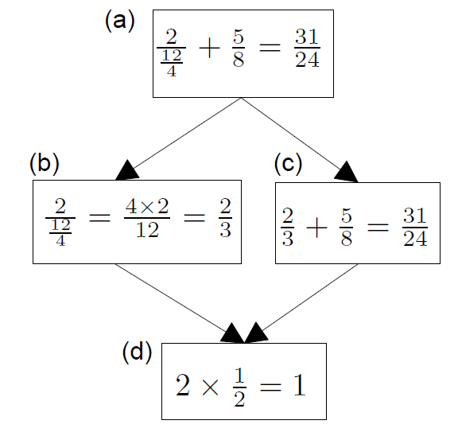
Example (Desmarais et al., 2006)
B does not inform us about C
If student succeeds at C, they will succeed at D;
D is prerequisite to C

Slide 28
Extension to skills
POKS can be extended rather easily to use skills (interchangeable items) rather than items

Slide 29
Questions about POKS?

Slide 30
What are the relative benefits of using a q-matrix versus a knowledge space?

Slide 31
Bayesian Networks
Less restricted set of models that also infer relationships between skills and items, and between skills
Can infer more complicated relationships between material than the very restricted set of relationships modeled in POKS
Can infer {skill-skill, item-item, skill-item} relationships at the same time
Can integrate very diverse types of information
That extra flexibility can lead to over-fitting (cf. Desmarais et al., 2006)

Slide 32
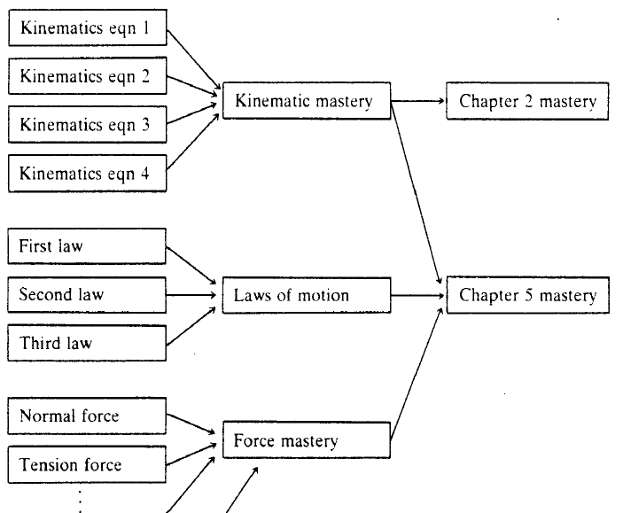
Martin & VanLehn (1995)

Slide 33
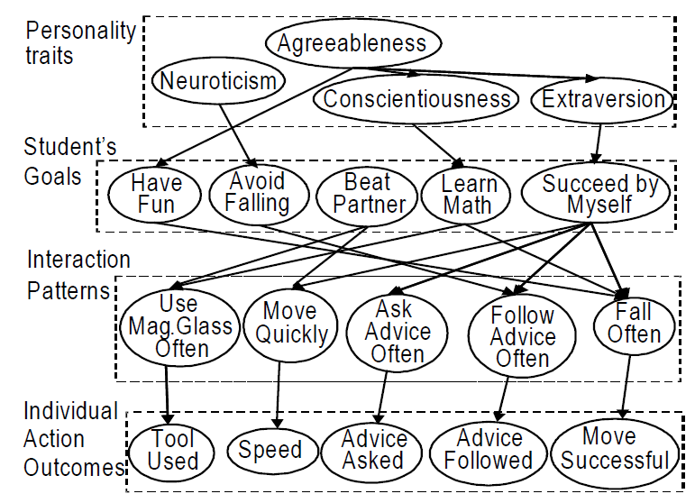
Conati et al., 2009

Slide 34
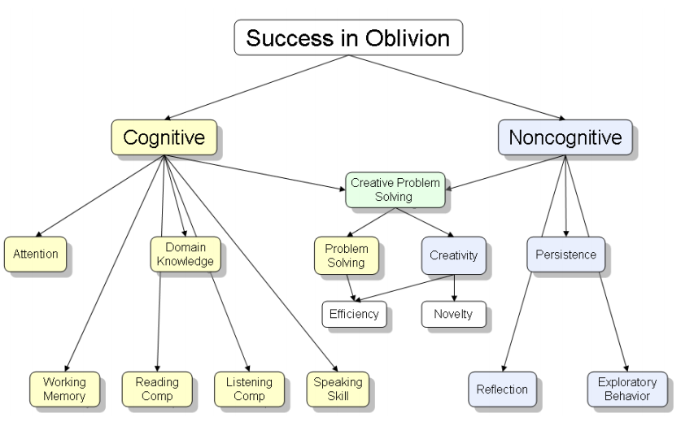
Shute et al., 2009

Slide 35
What are the trade-offs
Between Knowledge Spaces
And Bayes Nets
?

Slide 36
Comments? Questions?

Slide 37
KnowEdu paper
Uses NN on text to extract concepts from curriculum standards
Uses association rules on performance data to find candidate prerequisite structure between them
Comments? Questions?

Slide 38
Any questions on upcoming creative assignment?

Slide 39
Last comments or questions for today?

Slide 40
The End

