Slide 1
Core Methods in Educational Data Mining
EDUC 6191 Fall 2024

Slide 2
CA4
Any questions?

Slide 3
CA4
Task: Use LLMs to build a prediction model that detects if students are commenting on the process in their peer feedback when evaluating other students’ math solutions.
E.g. “I like how you had 20 then subtracted 12 and got 8”.
Goal: #BeatZhangetal.

Slide 4
CA4
Who here used LLMs to improve the input to the model (e.g. data augmentation, providing context)?
Post “input” in the chat
Improvement in model performance?

Slide 5
CA4
Who here used LLMs to obtain inferences?
Post “inferences” in the chat
Improvement in model performance?

Slide 6
CA4
Who here used a different approach to leverage LLMs to build the model?

Slide 7
CA4
Any prompt engineering strategies that you found particularly helpful in completing CA4?

Slide 8
Comments? Questions?

Slide 9
Reinforcement Learning

Slide 10
Reinforcement Learning
Can anyone define Reinforcement Learning? (Doesn’t have to be the same as an official definition)

Slide 11
Reinforcement Learning: A Definition
“In reinforcement learning (RL), the goal is for an agent to learn a policy π—a mapping from states to actions or probability distributions over actions—that incurs high reward (Sutton and Barto, 1998). The policy specifies for each state what action the agent should take.” (Doroudi et al., 2018)

Slide 12
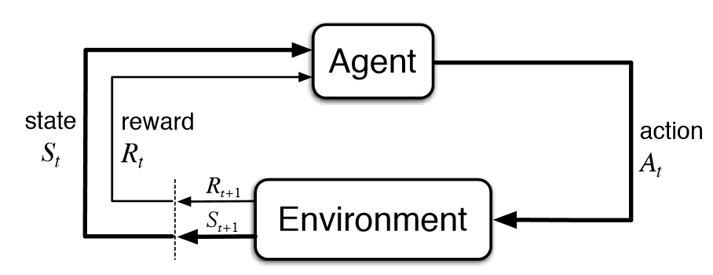
Key Terms
state
action
reward
transition
Notes:
action is initiated/carried out by the agent. transition is the change of state (in the environment)

Slide 13
Reinforcement Learning
How is reinforcement learning different than everything else we have studied this semester?
Notes:
ML: You train a model to do certain things
RL: you train a model to learn to decide what to do based on rewards

Slide 14
Multi-arm bandit
What does a multi-arm bandit try to figure out?

Slide 15
Multi-arm bandit
What does a multi-arm bandit try to figure out?
Which policy of a set it should use, based on reward
No contextual or temporal effects
Notes:
Reward is only related to the action. All rewards are independent from each other and of each factors. No contextual or temporal effects

Slide 16
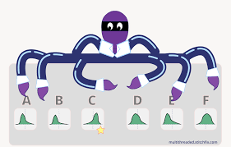
Exploration and Exploitation
If things are working as expected, how does a multi-armed bandit use each of these over time?
Notes:
the agent will start off by exploring, and then gives priority to actions that have higher expected values of rewards. it will never stop explore.

Slide 17
When would you want to use it?
In the real world

Slide 18
Questions? Comments?

Slide 19
Contextual multi-arm bandit
What is the difference between a contextual multi-arm bandit and a regular multi-arm bandit?

Slide 20
Contextual multi-arm bandit
What is the difference between a contextual multi-arm bandit and a regular multi-arm bandit?
Now there’s context
So the algorithm tries to figure out what action to use in a given context

Slide 21
What are some contextual factors that would be relevant
For deciding what activity a math tutoring system should provide?

Slide 22
What are some contextual factors that would be relevant
For deciding which lesson to give a student next, in an online course?

Slide 23
Questions? Comments?

Slide 24
Non-stationary bandit
What is the difference between a non-stationary bandit and a regular multi-arm bandit?

Slide 25
Non-stationary bandit
What is the difference between a non-stationary bandit and a regular multi-arm bandit?
The reward might be changing over time

Slide 26
What are some educational examples where reward function could shift?

Slide 27
Markov Decision Process (MDP)
How are MDPs different than bandits?

Slide 28
Markov Decision Process (MDP)
How are MDPs different than bandits?
They assume that the environment can be in one of several states
Reward for action depends on state
They need to learn
Reward for each state
Transition probabilities between states based on actions it takes

Slide 29
Can you give some examples
In an intelligent tutoring system, what might be the student’s state, that would cause the tutoring system to choose a different teaching strategy?

Slide 30
A simple MDP
I am a monkey.
It is either raining or sunny.
I can pick mangos or attack tourists.
My actions do not affect the state.
Transition(Rainy->Sunny | Attack) = 0.3
Transition(Rainy->Sunny | Pick) = 0.3
Transition(Sunny->Rainy| Attack) = 0.4
Transition(Sunny->Rainy | Pick) = 0.4
Reward (Sunny, Attack) = 0.8 Reward(Sunny, Pick) = 0.6
Reward (Rainy, Attack) = 0.1 Reward(Rainy, Pick) = 0.4

Slide 31
A simple MDP
I am a monkey.
Tourists are careless or vigilant.
I can pick mangos or attack tourists.
Transition(Careless->Vigilant| Attack) = 0.9
Transition(Careless->Vigilant | Pick) = 0.05
Transition(Vigilant->Careless| Attack) = 0.01
Transition(Vigilant->Careless | Pick) = 0.1
Reward (Vigilant, Attack) = 0.1 Reward(Vigilant, Pick) = 0.3
Reward (Careless, Attack) = 0.95 Reward(Careless, Pick) = 0.6

Slide 32
A simple MDP
I am a monkey.
Tourists are careless or vigilant.
I can pick mangos or attack tourists.
Transition(Careless->Vigilant| Attack) = 0.9
Transition(Careless->Vigilant | Pick) = 0.05
Transition(Vigilant->Careless| Attack) = 0.01
Transition(Vigilant->Careless | Pick) = 0.1
Reward (Vigilant, Attack) = 0.1 Reward(Vigilant, Pick) = 0.3
Reward (Careless, Attack) = 0.95 Reward(Careless, Pick) = 0.6
Short-term, it is better to attack when careless
Notes:
instant reward: attack has higher reward, which is the function itself (0.95 is greater than 0.3, 0.6)
long-term. once attack, there’s high prob that the tourist will change careless to vigilant (0.9), and when tourist is vigilant, pick (not attack) has better reward

Slide 33
A simple MDP
I am a monkey.
Tourists are careless or vigilant.
I can pick mangos or attack tourists.
Transition(Careless->Vigilant| Attack) = 0.9
Transition(Careless->Vigilant | Pick) = 0.05
Transition(Vigilant->Careless| Attack) = 0.01
Transition(Vigilant->Careless | Pick) = 0.1
Reward (Vigilant, Attack) = 0.1 Reward(Vigilant, Pick) = 0.3
Reward (Careless, Attack) = 0.95 Reward(Careless, Pick) = 0.6
Short-term, it is better to attack when careless
But long-term, it is actually better to pick even when careless
And MDPs can be set up to take this into account in selecting a policy!

Slide 34
A simple MDP
I am a monkey.
Tourists are careless or vigilant.
I can pick mangos or attack tourists.
Transition(Careless->Vigilant| Attack) = 0.9
Transition(Careless->Vigilant | Pick) = 0.05
Transition(Vigilant->Careless| Attack) = 0.01
Transition(Vigilant->Careless | Pick) = 0.1
Reward (Vigilant, Attack) = 0.1 Reward(Vigilant, Pick) = 0.3
Reward (Careless, Attack) = 0.95 Reward(Careless, Pick) = 0.6
Short-term, it is better to attack when careless
But long-term, it is actually better to pick even when careless
If only the monkeys I (Ryan) met in Bali agreed with this logic…

Slide 35
Why that’s so
Transition(Careless->Vigilant| Attack) = 0.9
Transition(Careless->Vigilant | Pick) = 0.05
Transition(Vigilant->Careless| Attack) = 0.01
Transition(Vigilant->Careless | Pick) = 0.1
Reward (Vigilant, Attack) = 0.1 Reward(Vigilant, Pick) = 0.3
Reward (Careless, Attack) = 0.95 Reward(Careless, Pick) = 0.6
Start: Careless. Strategy: Pick, Pick, Pick.
Reward = 0.6+ 0.05*0.3+0.95*0.6+ 0.05*0.1*0.6+0.05*0.9*0.3 + 0.95*0.95*0.6+0.95*0.05*0.3 Reward = 0.6+0.02+0.57+0.01 +.5 = 1.7

Slide 36
Why that’s so
Transition(Careless->Vigilant| Attack) = 0.9
Transition(Careless->Vigilant | Pick) = 0.05
Transition(Vigilant->Careless| Attack) = 0.01
Transition(Vigilant->Careless | Pick) = 0.1
Reward (Vigilant, Attack) = 0.2 Reward(Vigilant, Pick) = 0.3
Reward (Careless, Attack) = 0.95 Reward(Careless, Pick) = 0.6
Start: Careless. Strategy: Attack, Pick, Pick.
Reward = 0.95+ 0.9*0.3+0.1*0.6+ 0.9*0.1*0.6+0.9*0.9*0.3 + 0.1*0.1*0.6+0.1*0.9*0.3 Reward = 0.95 + 0.33 + 0.3 + 0.03 = 1.6

Slide 37
Questions? Comments?

Slide 38
Why the monkeys in Bali don’t take this into account
Because they are Finite-Horizon MDPs
They know that if they are the first monkey to attack me, they will achieve their reward and never see me again
Some other later monkey will receive the penalty

Slide 39
DALL-E 3’s rendition of my Prof. Baker’s trauma
Please create a realistic photo of a monkey attacking a tourist by jumping on them, in a tropical rainforest.
There are beautiful misty mountains in the background. Please adjust the image to make the tourist a
middle-aged man with glasses and graying hair.

Slide 40
Delayed and Immediate Rewards
Rewards can be
Short-term/immediate
Long-term (but same reward signal)
Delayed (inherently delayed signal)

Slide 41
Delayed and Immediate Rewards
Rewards can be
Short-term/immediate
Get mango now
Long-term (but same reward signal)
Maximum mangos over time
Delayed (inherently delayed signal)
Impact on Balinese tourism economy

Slide 42
Consideration of Rewards Over Time (Q-Learning, Deep Q-Learning)
Adds a discounting factor for future rewards, as certainty is lower

Slide 43
Questions? Comments?

Slide 44
Break into groups
Come up with a simple MDP for some real-world problem in education (no monkeys, please)
What is your problem?
What is the reward? Is it short-term or long-term?
What are the actions?
What are the states?
Can you create
A simple state transition diagram
A table of rewards for each state/acton

Slide 45
Let’s go over your MDPs

Slide 46
POMDPs (Partial-Order MDPs)
What’s the difference between a POMDP and an MDP?

Slide 47
POMDPs (Partial-Order MDPs)
What’s the difference between a POMDP and an MDP?
We cannot directly observe the state
Need to estimate the state based on observation
Notes:
MDP assumes perfect information. rewards for each possible state.
POMDP uses a neural network to estimate the state
reward: past tense
value: expected accumulated reward

Slide 48
Which tourist looks more vigilant?

Slide 49
Questions? Comments?

Slide 50
(Ju et al., 2020)
Students used intelligent tutoring system
True reward: pre-post test gains
Proxy:
142 features of student performance at action-by-action level
Neural network used to predict pre-post test gains from features
Changes in predicting pre-post test gains used as proxy reward
Policies induced using proxy rewards and Deep Q-Network
Any questions?

Slide 51
Bassen et al. (2020)
“Introduction to Linear Algebra” online mini-course for Amazon.com employees
3 skills
4 activities per skill
Video explanations
Written descriptions
Worked examples
Assessment questions
RL used to sequence (and skip) activities

Slide 52
Bassen et al. (2020)
Higher rate of course completion for RL than linear or self-directed
Learners completed course with much less content for RL than other conditions

Slide 53
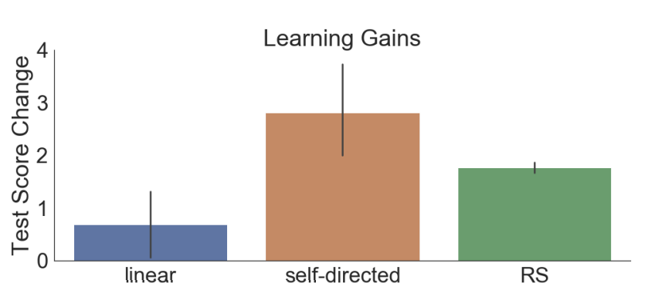
Bassen et al. (2020)
Higher learning gains for RL than linear
Strong appearance of lower learning gains for RL than self-directed
Graph looks significant based on error bars
But paper claims p>0.05 (exact p value not given)

Slide 54
Questions? Comments?

Slide 55
Final Questions about RL?

Slide 56
Final Questions about anything?

Slide 57
That’s It
EDUC 6123 Big Data, Education, and Society
Spring 2024, In-person and online sections (last chance to take course with Professor Baker at Penn)
Thank you for a great semester!

