Slide 1
Core Methods in Educational Data Mining
EDUC6191 Fall 2024

Slide 2
Questions about Basic HW 1?

Slide 3
Reminders: basic assignments
You don’t have to do it perfectly, you just have to do it
You will NOT be penalized for using hints (appropriately)
If you run into trouble, post to the discussion forum

Slide 4
Note: basic assignments
If it tells you to show your work, put in a couple characters there
We do not expect you to show your work
This is a glitch and we’re trying to fix it – thanks for your understanding

Slide 5
Reminder: class time
In some semesters, the video textbook is a little out of date
In those semesters, we use class time to lecture
But this semester, the video textbook is reasonably up to date
So we will use class time to discuss, answer questions, etc.

Slide 6
What this means
Bring questions

Slide 7
Exercise on your own
Do not raise your hand or tell me the answer
Who watched all the assigned videos?

Slide 8
Exercise on your own
Do not raise your hand or tell me the answer
Who watched all the assigned videos?
If you didn’t do this, you missed the key content for the week!
Even more important than coming to class

Slide 9
Let’s get warmed up

Slide 10
What is big data?

Slide 11
Some definitions
“Big data” is data big enough that traditional statistical significance testing becomes useless
“Big data” is data too big to input into a traditional relational database
“Big data” is data too big to work with on a single machine

Slide 12
A moving target
2004: I reported a data set with 31,450 data points. People were impressed.
2014: A reviewer in an education journal criticized me for referring to 817,485 data points as “big data”.

Slide 13
Not just big but open is important
More and more educational data sets can be accessed by the public
The EDM Society even runs an annual best open data set competition (see previous winners)
Very different than how things used to be

Slide 14
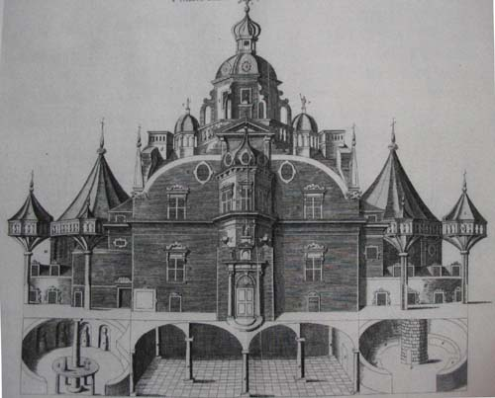
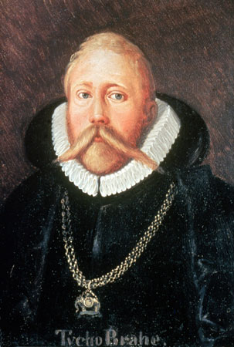
Tycho Brahe
Spent 24 years observing the sky from a custom-built castle on the island of Hven

Slide 15
Johannes Kepler
Had to take a job with Brahe to get Brahe’s data

Slide 16
Johannes Kepler
Had to take a job with Brahe to get Brahe’s data
Only got unrestricted access to data…

Slide 17
Johannes Kepler
Had to take a job with Brahe to get Brahe’s data
Only got unrestricted access to data… when Brahe died

Slide 18
Johannes Kepler
Had to take a job with Brahe to get Brahe’s data
Only got unrestricted access to data… when Brahe died
and Kepler stole the data and fled to Germany

Slide 19
What are the types of EDM method?

Slide 20
What are the types of EDM method?
According to Baker (any version)
Top-level first

Slide 21
What type of method are each of these? (According to Baker)
Classification
Regression
Correlation Mining
Factor Analysis
Domain Structure Discovery
Network Analysis
Clustering
Association rule mining
Sequential pattern mining
Latent Knowledge Estimation
Causal data mining

Slide 22
Today
Prediction Modeling
Classic Categories
Classification
Binary Classification
Regression
Density Estimation
Contemporary Categories
Sequential Classifiers
Next Token Prediction
Matrix Classifiers

Slide 23
What do each of these predict?
Prediction Modeling
Classic Categories
Classification
Binary Classification
Regression
Density Estimation
Contemporary Categories
Sequential Classifiers
Next Token Prediction
Matrix Classifiers

Slide 24
Can you give me an application of these?
Prediction Modeling
Classic Categories
Classification
Binary Classification
Regression
Density Estimation
Contemporary Categories
Sequential Classifiers
Next Token Prediction
Matrix Classifiers

Slide 25
Density Estimator
Predicts a probability density function
Not used much in education
Used more in other domains

Slide 26
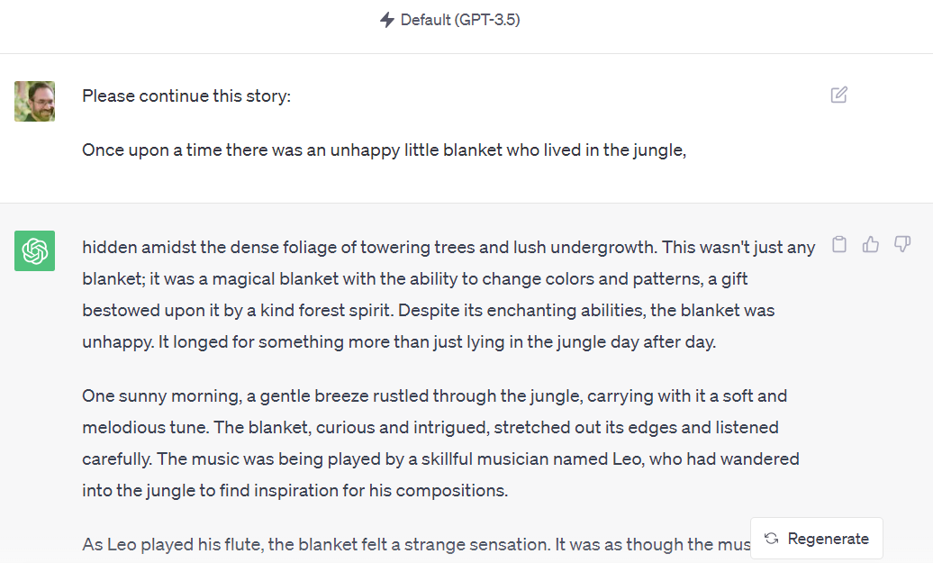
Next token prediction
Famously, in large language models

Slide 27
Matrix prediction
Predicting a 2x2 or multi-dimensional matrix from
Part of the matrix
A sentence

Slide 28
Can you give me any examples of this?
Predicting a 2x2 or multi-dimensional matrix from
Part of the matrix
A sentence

Slide 29
DALL-E 2
"Teddy bears working on new AI research underwater with 1990s technology"

Slide 30
Transformer/Foundation Models
Who here can tell us what a transformer model/foundation model is?

Slide 31
Transformer/Foundation Models
Some examples
ChatGPT
DALL-E 2 or StableDiffusion or MidJourney
Claude
Gemini
MathBERT

Slide 32
Raise Your Hands Who has used each of these?
ChatGPT
DALL-E 2 or StableDiffusion or MidJourney
Claude
Gemini
MathBERT

Slide 33
Questions? Comments?

Slide 34
The videos discussed a range of algorithms
Linear Regression
Regression Trees
Logistic Regression (a classifier!)
Decision Trees
Random Forest (Bagging)
XGBoost (Boosting)
Neural Networks/Recurrent Neural Networks
What Transformer/Foundation Models are built on

Slide 35
Questions or comments about any of these?

Slide 36
Has anyone
Used any classification algorithms outside the set discussed/recommended in the videos?
Say more?

Slide 37
A practical question

Slide 38
Should you
Pick one algorithm that seems really appropriate?
Run every algorithm that will actually run for your data?
Something in between?

Slide 39
Our typical lab practice
Pick a small number of algorithms that
Have worked on past similar problems
Fit different kinds of patterns from each other

Slide 40
Is it really the algorithm?
Or is it the data you put into it?
We’ll come back to this in the Feature Engineering lecture

Slide 41
Interpreting Regression Models
Let’s quickly review the example from the video

Slide 42
Example of Caveat
Let’s graph the relationship between number of graduate students and number of papers per year

Slide 43
Data

Slide 44
Model
Number of papers = 4 + 2 * # of grad students - 0.1 * (# of grad students)²
But does that actually mean that (# of grad students)² is associated with less publication?
No!

Slide 45
Example of Caveat
(# of grad students)² is actually positively correlated with publications!
r=0.46

Slide 46
Example of Caveat
The relationship is only in the negative direction when the number of graduate students is already in the model…
In other words, the second feature is in the context of the first feature.

Slide 47
Questions? Comments?

Slide 48
What is Algorithmic Bias?

Slide 49
Algorithmic Bias: Classical Definition
Biased computer systems “systematically and unfairly discriminate against individuals or groups of individuals in favor of others.
(Friedman & Nissenbaum, 1996)

Slide 50
Algorithmic Bias: Working Definition
Cases where model performance is substantially better or worse across mutually exclusive groups, separated by non-malleable factors
(Baker & Hawn, 2022)

Slide 51
Why does algorithmic bias happen?

Slide 52
Why does algorithmic bias matter?

Slide 53
Why is it still rare to check for algorithmic bias?

Slide 54
What are some paradigms and metrics to evaluate algorithmic bias?
Notes:
See Ch.2, V7

Slide 55
Lots of paradigms and metrics for algorithmic bias
Most of the time, people in our field just check for difference in model success at making predictions (which is the Separation paradigm of algorithmic bias)
Compute AUC ROC for each group, and then compare
for example, see Zhang et al., (2022) in next week’s reading (Ch.1, V5)
We will also discuss AUC ROC next week
Here are more examples that evaluate algorithmic bias in education (the wiki page)
Why?

Slide 56
Comments? Questions?

Slide 57
Explainable and Interpretable AI
What’s the difference?

Slide 58
Explainable AI
AI where the reasons for a specific prediction can be explained to a human

Slide 59
Interpretable AI
AI where the process leading to predictions can be understood by a human

Slide 60
AI Methods for Explainable AI
Contribution of predictor
How much worse does the model do without the predictor?
What proportion of models within an ensemble contain the predictor? (This is what Random Forest uses)
The average of the predictor’s contribution to the final prediction in all possible scenarios (SHAP values)

Slide 61
AI Methods for Explainable AI
Sensitivity analysis
If we change each of the predictors, which predictor changes most impact the prediction? (LIME)
Which predictor values cannot change, or the prediction would change? (CEM)
What are the smallest changes to predictors that would change the prediction? (DiCE)

Slide 62
AI Methods for Explainable AI
Layer-wise relevance propagation (LRP)
Take the result and run neural network backwards
Which specific predictors/values stay the same as the original data?

Slide 63
Questions? Comments?

Slide 64
Can you…
Come up with a scenario where one or more of these explainability approaches is a clear good choice?
What’s the scenario? Which explainability approach?

Slide 65
The use of demographic variables
Should models use demographic variables as predictors?
Deho et al (2022)
Minimal impact on predictive goodness
Baker et al. (in press)
Reduces actionability and can reinforce prejudice

Slide 66
Not done with prediction models
3: Behavior & Affect Modeling
4: Diagnostic Metrics
5: Feature Engineering & Tweaking Towards Optimality

Slide 67
Any last questions or comments?

Slide 68
Next classes
September 12
Behavior and Affect Detection
Basic: Classifier Due September 11
September 19
Diagnostic Metrics
Creative: Behavior Detection Due September 18
September 26
Feature Engineering and Distillation
Basic: Diagnostic Metrics Due September 25

Slide 69
The End

