Slide 1
Core Methods in Educational Data Mining
EDUC6191 Fall 2024

Slide 2
The Homework
Let’s discuss Creative Assignment 1
Questions? Comments? Observations?

Slide 3
Tools for CA1
Python?
Anything else?

Slide 4
Anything clever?
Does anyone have
Something clever they did and want to share?
Something clever they didn’t do but want to discuss?
A concern about how to do this right?

Slide 5
What matters?
What could you do to get better model performance?
(Without doing something invalid)

Slide 6
A word on data dictionaries
It is a good thing to thoroughly understand your variables
It is a good thing to want to thoroughly understand your variables

Slide 7
A word on data dictionaries
In university classes, you will often get excellent descriptions of the data (when it’s not simply made up)
In the real world, outside of national public databases, data dictionaries will often be low-quality or even non-existent
In the real world, variable names will be incomprehensible or – worse yet -- wrong

Slide 8
What could you do?
What are some strategies to use when you get poorly-described data from someone?
Hint: “Ask them to go and write a better data dictionary” almost never works even if you pay them for it

Slide 9
Questions? Comments? Concerns?

Slide 10
CA2
Any questions?

Slide 11
Textbook/Readings

Slide 12
Detector Confidence
First, any questions about detector confidence?

Slide 13
Detector Confidence
What is a detector confidence value?

Slide 14
Detector Confidence
What are the pluses and minuses of making sharp distinctions at 50% confidence?

Slide 15
Detector Confidence
Are there real-world cases where it makes sense to have two cut-offs?

Slide 16
Detector Confidence
How would you determine where to place the two cut-offs?

Slide 17
Detector Confidence
Is there any way around having intervention cut-offs somewhere?

Slide 18
Goodness Metrics

Slide 19
Exercise
 | Detector Academic Suspension | Detector No Academic Suspension
Data Suspension | 2 | 3
Data No Suspension | 5 | 140
What is accuracy?

Slide 20
Exercise
 | Detector Academic Suspension | Detector No Academic Suspension
Data Suspension | 2 | 3
Data No Suspension | 5 | 140
What is kappa?

Slide 21
Accuracy
Why is it bad?

Slide 22
Kappa
What are its pluses and minuses?

Slide 23
ROC Curve

Slide 24
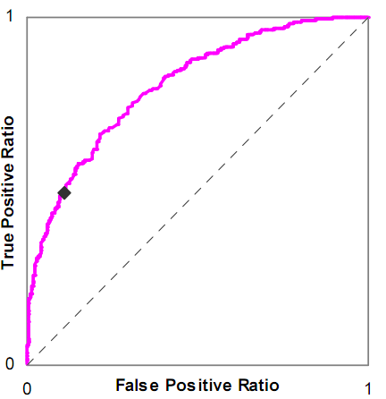
Is this a good model or a bad model?

Slide 25
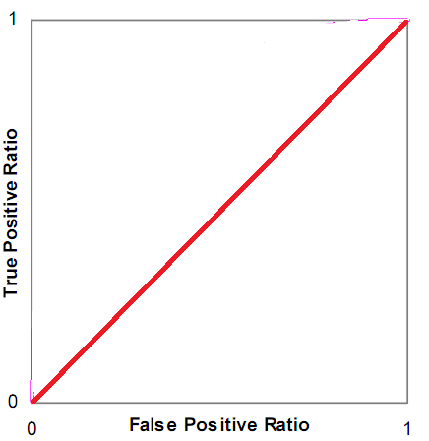
Is this a good model or a bad model?

Slide 26
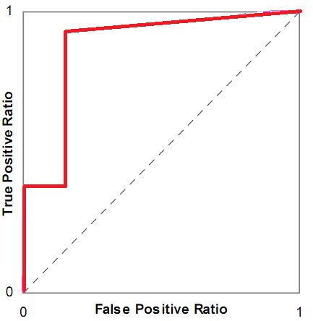
Is this a good model or a bad model?

Slide 27
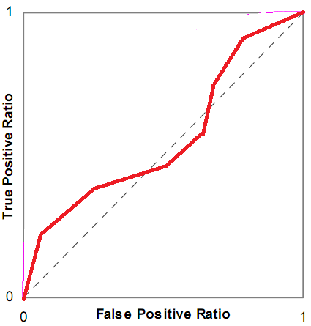
Is this a good model or a bad model?

Slide 28
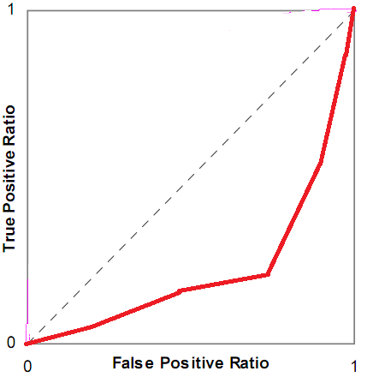
Is this a good model or a bad model?

Slide 29
ROC Curve
What are its pluses and minuses?

Slide 30
AUC ROC
What are its pluses and minuses?

Slide 31
Any questions about AUC ROC?

Slide 32
Precision and Recall
Precision = TP
TP + FP
Recall = TP
TP + FN

Slide 33
Precision and Recall
What do they mean?

Slide 34
What do these mean?
Precision = The probability that a data point classified as true is actually true
Recall = The probability that a data point that is actually true is classified as true

Slide 35
Precision and Recall
What are their pluses and minuses?

Slide 36
Risk Ratio: Exercise
Our model detects a student will drop out
If the model says they will drop out, they are 75% likely to drop out
If the model says they won’t drop out, they are 25% likely to drop out

Slide 37
Risk Ratio: Exercise
Our model’s prediction uses as a feature whether they were suspended from school
If they were suspended from school, they are 20% likely to drop out
If they were never suspended, they are 15% likely to drop out

Slide 38
Risk Ratio
Any questions about risk ratio?

Slide 39
Correlation vs RMSE
What is the difference between correlation and RMSE?
What are their relative merits?

Slide 40
What does it mean?
High correlation, low RMSE
Low correlation, high RMSE
High correlation, high RMSE
Low correlation, low RMSE

Slide 41
AIC/BIC vs Cross-Validation
AIC is asymptotically equivalent to LOOCV
BIC is asymptotically equivalent to k-fold cv
Why might you still want to use cross-validation instead of AIC/BIC?
Why might you still want to use AIC/BIC instead of cross-validation?

Slide 42
AIC vs BIC
Any comments or questions?

Slide 43
LOOCV vs k-fold CV
Any comments or questions?

Slide 44
Other questions, comments, concerns about textbook?

Slide 45
Thoughts on the Kitto reading?

Slide 46
Kitto et al.’s warnings
Warning 1. For some educational scenarios, reporting improvement in algorithmic performance is insufficient as a form of validation.
Warning 2. Being able to report upon a metric does not mean that you should use it, either in the tool, or in reporting its worth.
Warning 3. Feedback should not necessarily be set at the same resolution that the analytics make possible.
Warning 4. Overemphasising computational accuracy is likely to delay the adoption of LA tools that could already be used productively.

Slide 47
Do you agree?
Warning 1. For some educational scenarios, reporting improvement in algorithmic performance is insufficient as a form of validation.
Warning 2. Being able to report upon a metric does not mean that you should use it, either in the tool, or in reporting its worth.
Warning 3. Feedback should not necessarily be set at the same resolution that the analytics make possible.
Warning 4. Overemphasising computational accuracy is likely to delay the adoption of LA tools that could already be used productively.

Slide 48
Kitto et al.’s suggestion
Once the analytics is embedded in an appropriate learning design we can see that its purpose is to provide enough scaffolding to “start a conversation” between the student and the analytics-driven feedback, or between peers.
What are the pluses and minuses of this framing?

Slide 49
Thoughts on the Jeni reading?

Slide 50
Other questions or comments?

Slide 51
Powers (2012)
“The idea of looking for a single best measure to choose between classifiers is wrongheaded.”
Why would Powers say this? Why is this idea mostly ignored in practice?

Slide 52
Last comments or questions?

