Slide 1
Core Methods in Educational Data Mining
EDUC6191 Fall 2024

Slide 2
Diagnostic Metrics -- HW
Any questions about any metrics?
Does anyone want to discuss any of the problems?

Slide 3
Diagnostic Metrics -- HW
What’s a fail-soft intervention?

Slide 4
Diagnostic Metrics -- HW
When do you want to use fail-soft interventions?

Slide 5
Diagnostic Metrics -- HW
When do you not want to use fail-soft interventions?

Slide 6
Finishing up from last class…

Slide 7
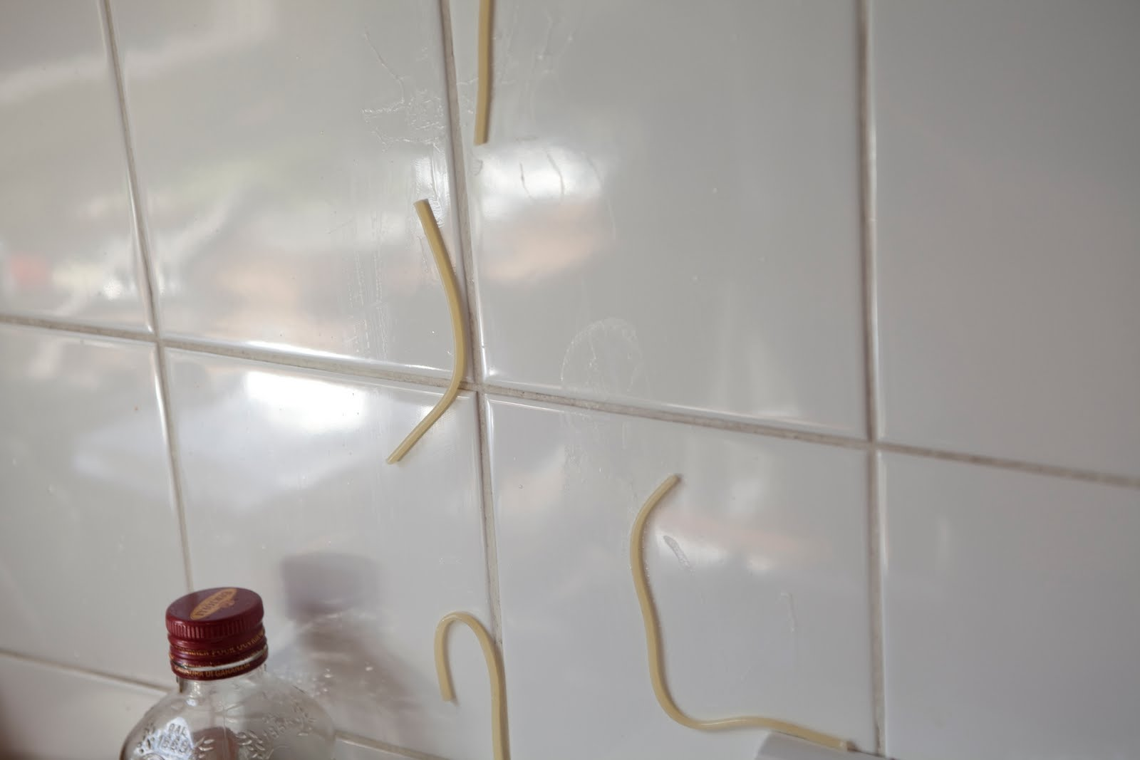
Feature Engineering
Not just throwing spaghetti at the wall and seeing what sticks

Slide 8
Feature Engineering
What is feature engineering?

Slide 9
Feature Engineering (Slater et al., 2020)
“the construction of contextual and relevant features from system log data”

Slide 10
Construct Validity Matters!
Low-quality features will give you low-quality models
Low-quality features = reduced generalizability/more over-fitting
Detailed discussion of this in the Sao Pedro paper

Slide 11
What’s a good feature?
A feature that is potentially meaningfully linked to the construct you want to identify

Slide 12
What’s a good feature?
A feature that is potentially meaningfully linked to the construct you want to identify
You can tell a “just so” story about it
A hypothesized (perhaps unjustified) causal account

Slide 13
What’s a good feature?
A feature that is potentially meaningfully linked to the construct you want to identify
You can tell a “just so” story about it
“School suspensions can predict high school dropout because they can reinforce alienation from the educational environment.”
“Slow actions can be used to infer off-task behavior because they can indicate that the student has stopped using the software.”

Slide 14
Baker’s feature engineering process
Brainstorming features
Deciding what features to create
Creating the features
Studying the impact of features on model goodness
Iterating on features if useful
Go to 3 (or 1)

Slide 15
What’s useful here, and why?
Brainstorming features
Deciding what features to create
Creating the features
Studying the impact of features on model goodness
Iterating on features if useful
Go to 3 (or 1)

Slide 16
Is anything missing?
Brainstorming features
Deciding what features to create
Creating the features
Studying the impact of features on model goodness
Iterating on features if useful
Go to 3 (or 1)

Slide 17
How else could it be improved?

Slide 18
IDEO tips for Brainstorming
1. Defer judgment
2. Encourage wild ideas
3. Build on the ideas of others
4. Stay focused on the topic
5. One conversation at a time
6. Be visual
7. Go for quantity
http://www.openideo.com/fieldnotes/openideo-team-notes/seven-tips-on-better-brainstorming

Slide 19
Any thoughts?
1. Defer judgment
2. Encourage wild ideas
3. Build on the ideas of others
4. Stay focused on the topic
5. One conversation at a time
6. Be visual
7. Go for quantity
http://www.openideo.com/fieldnotes/openideo-team-notes/seven-tips-on-better-brainstorming

Slide 20
Deciding what features to create
Trade-off between the effort to create a feature and how likely it is to be useful
Worth biasing in favor of features that are different than anything else you’ve tried before
Explores a different part of the space

Slide 21
Slater et al (2020) paper
Iterative feature engineering

Slide 22
Slater et al (2020) paper
Conduct Feature Engineering
Build Model
Test Model
If model good enough, END
Qualitatively Study Model Errors
Go to 2

Slide 23
Slater et al (2020) caveat
Should test end result on totally new data (which this paper didn’t yet do)

Slide 24
Slater et al (2020) paper
Questions? Comments?

Slide 25
General thoughts about feature engineering?

Slide 26
To learn more…
Take EDUC 6190 Feature Engineering

Slide 27
Let’s look at some features used in real models

Slide 28
Let’s look at some features used in real models
Split into groups of in just a minute
We’ll put you in breakout rooms, use that group number
Download list of features from course schedule
“Extra Materials for Class”
Use list of features for your group number (at very beginning of each page)
Which features (or combinations) can you come up with “just so” stories for why they might predict the construct?
Are there any features that seem utterly irrelevant?

Slide 29
Group 1
Tell us what your construct is
Tell us your favorite “just so story” from your features
Tell us about one feature that looks like junk
Everyone else: you have to give the feature a yay or boo (chat window)

Slide 30
Group 2
Tell us what your construct is
Tell us your favorite “just so story” from your features
Tell us about one feature that looks like junk
Everyone else: you have to give the feature a yay or boo (chat window for those online)

Slide 31
And so on…
3
4
5
6

Slide 32
Thoughts? Comments? Questions?

Slide 33
SMOTE for Class Imbalance
Any questions?

Slide 34
Synthetic Data Generation/Augmentation with LLMs
Including Cochran et al. paper
Comments? Questions?

Slide 35
Hyperparameter Tuning
Any questions?

Slide 36
Knowledge Engineering
What is knowledge engineering?

Slide 37
Knowledge Engineering
What is the difference between knowledge engineering and EDM?

Slide 38
Knowledge Engineering
What is the difference between good knowledge engineering and bad knowledge engineering?

Slide 39
Knowledge Engineering
What is the difference between (good) knowledge engineering and EDM?
What are the advantages and disadvantages of each?

Slide 40
How can they be integrated?

Slide 41
Other questions, comments, concerns about video topics?

Slide 42
Comments? Questions?

Slide 43
The End

