Slide 1
Core Methods in Educational Data Mining
EDUC6191 Fall 2024

Slide 2
Basic Assignment: SNA
Any questions? Comments?

Slide 3
Knowledge Inference and BKT

Slide 4
What is the Goal of Knowledge Inference?

Slide 5
What is the Goal of Knowledge Inference?
Measuring what a student knows at a specific time
Measuring what relevant knowledge components a student knows at a specific time

Slide 6
Why is it useful to measure student knowledge?

Slide 7
Key assumptions of BKT
Assess a student’s knowledge of skill/KC X
Based on a sequence of items that are scored between 0 and 1
Classically 0 or 1, but there are variants that relax this
Where each item corresponds to a single skill
Where the student can learn on each item, due to help, feedback, scaffolding, etc.

Slide 8
Key assumptions of BKT
Each skill has four parameters
From these parameters, and the pattern of successes and failures the student has had on each relevant skill so far
We can compute
Latent knowledge P(Ln)
The probability P(CORR) that the learner will get the item correct

Slide 9
Key assumptions of BKT
Two-state learning model
Each skill is either learned or unlearned
In problem-solving, the student can learn a skill at each opportunity to apply the skill
A student does not forget a skill, once he or she knows it

Slide 10
Model Performance Assumptions
If the student knows a skill, there is still some chance the student will slip and make a mistake.
If the student does not know a skill, there is still some chance the student will guess correctly.

Slide 11
Comments? Questions?

Slide 12
Classical BKT
Not learned
p(T)
Learned
p(L₀)
p(G)
1-p(S)
correct
correct
Two Learning Parameters
p(L₀) Probability the skill is already known before the first opportunity to use the skill in problem solving.
p(T) Probability the skill will be learned at each opportunity to use the skill.
Two Performance Parameters
p(G) Probability the student will guess correctly if the skill is not known.
p(S) Probability the student will slip (make a mistake) if the skill is known.

Slide 13
Comments? Questions?

Slide 14
BKT Example
Would anyone like to see me run through a BKT example?

Slide 15
Example
P(L₀) = 0.3, P(T) = 0.1, P(S) = 0.4, P(G) = 0.2
Actual | P(L_{n-1}) | P(L_{n-1}|actual) | P(L_{n})
0
1
1

Slide 16
Questions? Comments?

Slide 17
Parameter Fitting
Picking the parameters that best predict performance on next attempt
Any questions or comments on this?

Slide 18
Overparameterization
BKT is thought to be overparameterized (Beck et al., 2008)
Which means there are multiple sets of parameters that can fit any data

Slide 19
Degenerate Space (Pardos et al., 2010)

Slide 20
Parameter Constraints Proposed
Beck
P(G)+P(S)<1.0
Baker, Corbett, & Aleven (2008):
P(G)<0.5, P(S)<0.5
Corbett & Anderson (1995):
P(G)<0.3, P(S)<0.1
Your thoughts?

Slide 21
Does it matter what algorithm you use to select parameters?
EM better than CGD
Chang et al., 2006 ΔA’= 0.05
CGD better than EM
Baker et al., 2008 ΔA’= 0.01
EM better than BF
Pavlik et al., 2009 ΔA’= 0.003, ΔA’= 0.01
Gong et al., 2010 ΔA’= 0.005
Pardos et al., 2011 Δ RMSE= 0.005
Gowda et al., 2011 ΔA’= 0.02
BF better than EM
Pavlik et al., 2009 ΔA’= 0.01, ΔA’= 0.005
Baker et al., 2011 ΔA’= 0.001
BF better than CGD
Baker et al., 2010 ΔA’= 0.02

Slide 22
Are these the same thing?
Predicting performance on next attempt
Inferring latent knowledge

Slide 23
What are some alternate ways to assess
Whether a model is successful at inferring latent knowledge

Slide 24
What are some alternate ways to assess
Whether a model is successful at inferring latent knowledge
Why aren’t those approaches used more often?

Slide 25
Questions? Comments?

Slide 26
What are some possible uses of BKT?
Both the P(Ln) estimates
And the other parameters it produces

Slide 27
BKT: Extended uses

Slide 28
BKT: Extended uses
Conditionalizing P(T)
Does help help? (Beck et al., 2008)
Which content is most effective? (Baker et al., 2018)

Slide 29
BKT: Extended uses
Moment-by-moment learning estimation (calculating P(T) in specific step)
Which moment-by-moment learning curves are associated with more robust learning? (Baker et al., 2013)
What behaviors predict “eureka” moments (Moore et al., 2015)
Which types of content are associated with more learning? (Slater et al., 2016)

Slide 30
BKT: Extended uses
Detecting carelessness (contextual slip) (calculating P(S) in specific step)
Predicts test score (Pardos et al., 2014), college enrollment (San Pedro et al., 2013), job several years later (Almeda & Baker, 2020)

Slide 31
BKT: Extended uses
Transfer assessment (adding P(T) from other skills)
Used to study relationship between skills (Sao Pedro et al., 2014)
Including in graduate students learning research skills across several years (Kang et al., 2022)

Slide 32
Comments? Questions?

Slide 33
Why is BKT used so much?
Newer algorithms “perform better”
i.e. they are more accurate at predicting future correctness
And yet, BKT is used at scale much more often than any other algorithm
Why?
What are BKT’s virtues?

Slide 34
A Key Factor
BKT is actually just as good as other methods at determining when students reach mastery
The core use of knowledge tracing models in real-world systems

Slide 35
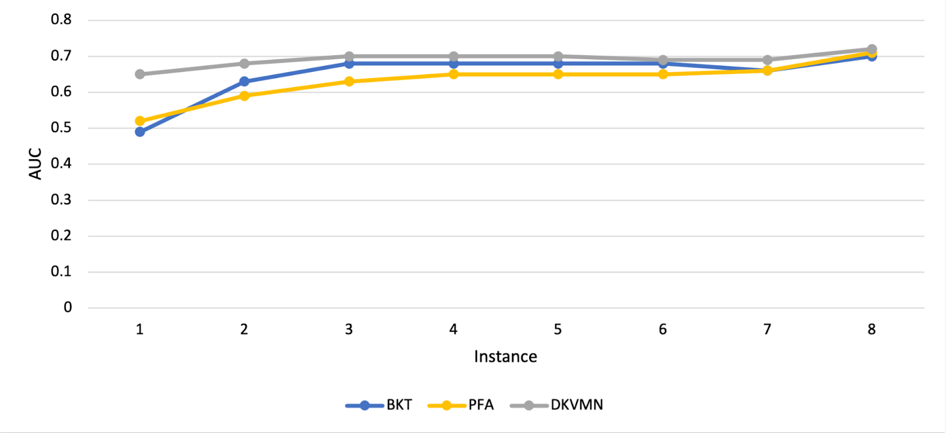
A Key Factor
Most of the difference in performance between BKT and DKVMN (an upcoming lecture) is in the first attempt on a new skill

Slide 36
A Key Factor
In particular, there’s essentially no benefit to DKVMN after several attempts on a skill (about the point where students often reach mastery, if they didn’t already know skill)

Slide 37
Comments? Questions?

Slide 38
Last Comments? Questions?

Slide 39
The End

