Slide 1
Core Methods in
Educational Data Mining
EDUC 6191
Fall 2024

Slide 2
Basic Assignment
Any questions or comments about this week’s basic assignment?

Slide 3
BKT
Any questions about BKT in general?

Slide 4
Logistic Knowledge Tracing (LKT)
(Pavlik et al., 2021)
A broad framework for knowledge tracing models based on logistic regression

Slide 5
Performance Factors Analysis (PFA)
(Pavlik et al., 2009)
The first version of LKT
(Well, there was LFA/AFM but it really doesn’t count – was not usable in a running learning system)

Slide 6


PFA

Slide 7
What do each of these parameters mean?

Slide 8
Performance Factors Analysis
What are the important differences in assumptions between PFA and BKT?
What does PFA offer that BKT doesn’t?
What does BKT offer that PFA doesn’t?

Slide 9
How Does PFA
Represent when the student learns from an opportunity to practice?
As opposed to just better predicted performance because you’ve gotten it right

Slide 10
How Does PFA
Represent when the student learns from an opportunity to practice?
As opposed to just better predicted performance because you’ve gotten it right
Is it ρ ?
Is it average of ρ and γ?

Slide 11
What do each of these mean?
When might you legitimately get them?
ρ < 0
γ < ρ
γ < 0

Slide 12
Degeneracy in PFA
(Maier et al., 2021)
Three degenerate cases
  γ < 0
  γ < ρ
  γ = ρ = 0

Slide 13
Degeneracy in PFA
(Maier et al., 2021)
Three degenerate cases
  γ < 0
  γ < ρ
  γ = ρ = 0
One seemingly degenerate (but not) case
4. ρ > 0
“It is worth noting that a fourth case when ρ > 0 -- is not degenerate, due to the multiple functions the parameters perform in PFA. In this case, the rate of learning the skill may outweigh the evidence of lack of student knowledge that an incorrect answer provides. So long as γ > ρ, a positive ρ is conceptually acceptable.”

Slide 14
Comments? Questions?

Slide 15
β Parameters
Pavlik proposes three different β Parameters
  Item
  Item-Type
  Skill
Result in different number of parameters
  And greater or lesser potential concern about over-fitting
What are the circumstances where you might want item versus skill?

Slide 16
Addressing Degeneracy
(Maier et al., 2021)
Simply bound γ and ρ
Does not reduce model performance substantially (just like BKT)

Slide 17
Causes of Degeneracy
(Maier et al., 2021)
If β is used at the Skill or Item-Type level
And the learning system moves students from easier to harder items within a “skill”
Then γ < 0.
If items are tagged with multiple skills, collinearity between skills could produce degenerate parameters.

Slide 18
Comments? Questions?

Slide 19
Compensatory or Conjunctive?
Compensatory
Conjunctive
Which do you think would be better?
∏

Slide 20
Compensatory or Conjunctive?
Compensatory
Conjunctive
Compensatory fits data better for PFA (Maier et al., 2021)
Oddly, conjunctive was better for BKT (Pardos et al. 2008)
∏

Slide 21
Is PFA used in the real world?
Yes, but by far fewer learning systems than BKT
Maier et al. (2021) discuss its use in Reveal Math 1

Slide 22
Using PFA in the real world
One key in real-world use is handling rare skills, which can impact model inferences on common skills as well
  Because PFA is used in cases with items tagged to multiple skills
(Maier et al., 2021) handle this by creating a “catch all” skill for rare skills
Using average parameters from all common skills also works

Slide 23
Other questions, comments, concerns about PFA?

Slide 24
Beyond PFA

Slide 25
PFA-Decay and R-PFA
Discussed in the lecture
Weight actions further back in order less strongly
Very minor improvements in performance prediction
Any questions or comments?

Slide 26
LKT
Creates a general framework for variants of PFA

Slide 27
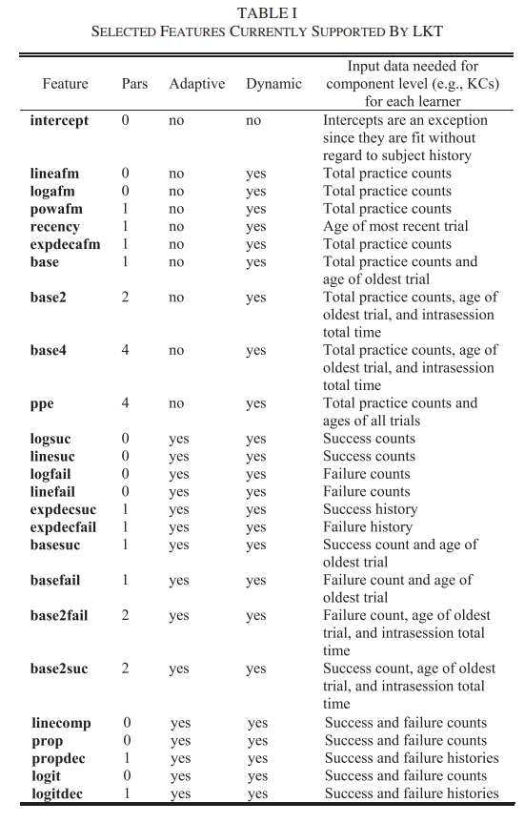

Slide 28
Comments? Questions?

Slide 29
LKT
Surprising omission: actual time in seconds
Particularly surprising because of Pavlik’s other work using actual time in student modeling (Pavlik & Anderson, 2005)

Slide 30
Comparison of variants
6 data sets in variety of systems and domains
Models that represent forgetting in some fashion typically perform better
  Stronger effects for facts than skills
  Previous Cognitive Science models that looked at decay also focused on facts (e.g. ACT-R, MCM)

Slide 31
Comments? Questions?

Slide 32
Algorithms that fit student-level term
A lot of other logistic regression algorithms for student knowledge modeling out there
One important category that I have not discussed in detail is algorithms that fit a student-level ability term
  Classic IRT
  AFM/LFA
  DASH/DAS3H

Slide 33
Algorithms that fit student-level term
Fitting a student-level ability term leads to better fits to performance
What is the big drawback to including a student-level ability term?

Slide 34
Algorithms that fit student-level term
When an algorithm does this, it typically can’t be used in real time
The student-level term is fit using all the student’s data
This means that the student’s future is used to predict their past
Thus, the model can only be used after the fact

Slide 35
Algorithms that fit student-level term
This can still be useful for analysis
But papers that compare algorithms that fit a student-level term using future data to algorithms that don’t do this…
Should be up-front about this
And not all such papers are

Slide 36
Exception
There are IRT variants that build up estimates of student ability over time
  TIRT (Wilson et al., 2016)
  ELO (Klinkenberg & Straatameier, 2011; Pelanek, 2014)
These can be used in real-time

Slide 37
Questions? Comments?

Slide 38
Final Comments or Questions?

Slide 39
The End

