Slide 1
Foundations of Teaching and Learning
November 1, 2021

Slide 2
Any questions about essay due Nov 15?

Slide 3
21st Century
Many say that the 21st Century will center around different skills or competencies than the 19th or 20th Centuries

Slide 4
21st-Century Competencies and Skills
What are some key competencies and skills to be successful in the 21st century? (Your own thoughts, first)

Slide 5
Computational Thinking
What is computational thinking?

Slide 6
Computational Thinking
all “aspects of designing systems, solving problems, and understanding human behaviors” (Wing, 2006)
“Wing argued that understanding the world computationally gives a particular lens to understanding problems and contributing to their solutions. Computational thinking — while often strictly associated with computer science — actually is better understood as extending computer science principles to other disciplines in order to help break down the elements of any problem, determine their relationship to each other and the greater whole, and then devise algorithms to arrive at an automated solution. ” (Kafai & Burke, 2013)

Slide 7
Ito et al. (2013)/ NAS(2012)
Splits 21st Century Skills into Cognitive, Intrapersonal and Interpersonal

Slide 8
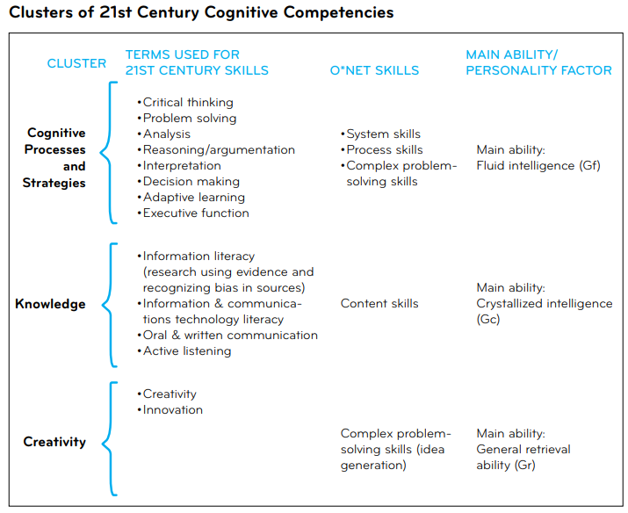

Slide 9
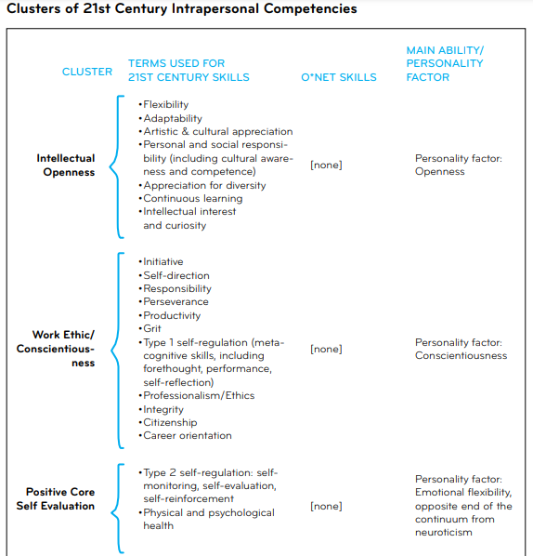

Slide 10
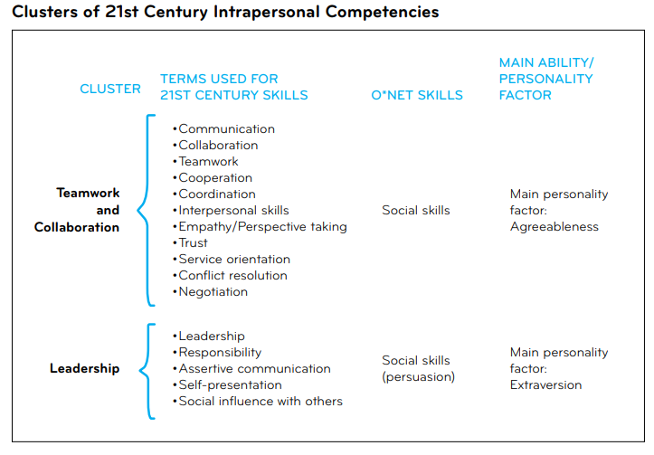

Slide 11
Any questions about what any of these are?

Slide 12
Which of these are most important?

Slide 13
How do we help students develop them?

Slide 14
What are some ways you (or your kids) learned 21st–century skills
Out-of-school

Slide 15
What are some ways you (or your kids) learned 21st–century skills
In-school

Slide 16
How could these have been connected by teachers?
In-school & out-of-school

Slide 17
Connected learning (Ito et al., 2013)
“Connected learning is socially embedded, interest-driven, and oriented toward expanding educational, economic or political opportunity. It is realized when a young person is able to pursue a personal interest or passion with the support of friends and caring adults, and is in turn able to link this learning and interest to academic achievement, career success or civic engagement.”

Slide 18
Thoughts? Comments?

Slide 19
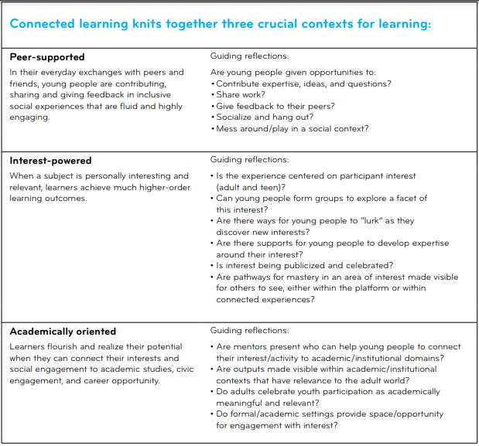

Slide 20
Thoughts? Comments?

Slide 21
How does a teacher in this paradigm work with
Students with different purposes
Students with different interests
Students with different personal networks
?

Slide 22
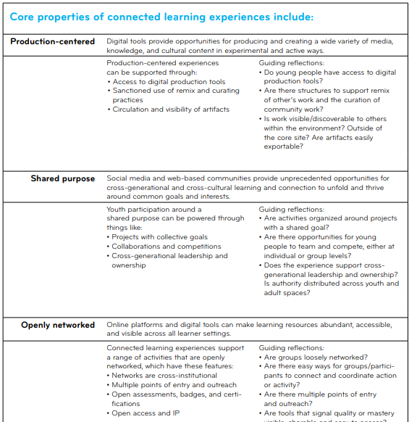

Slide 23
Thoughts? Comments?

Slide 24
How do we help students
Develop their personal networks?

Slide 25
How do we help students
Develop their personal networks?
Develop weak ties?

Slide 26
How do we help students
Develop their personal networks?
Develop weak ties?
Develop high network betweenness?

Slide 27
How do we help students
Develop their personal networks?
Develop weak ties?
Develop high network betweenness?
Develop advice networks?

Slide 28
Is network centrality the same as popularity?

Slide 29
Thoughts/comments?

Slide 30
Learning Computational Thinking (Kafai & Burke, 2013)
#1. A shift from code to applications.
#2. A shift from tools to communities.
#3. A shift from creating “from scratch” to creating via “remix.”
“…a social turn, moving from a predominantly individualistic view of technology to one that includes a greater focus on the underlying sociological and cultural dimensions in learning programming and reconceptualizing computational thinking as computational participation.”

Slide 31
Thoughts? Comments?

Slide 32
If there’s time
Breakout room activity
Choose a 21st-century skill from the list earlier
Design an activity to promote that 21st-century skill
You could use connected learning but you don’t have to

Slide 33
Observations from the activity?

Slide 34
Final thoughts/comments?

Slide 35
Upcoming Classes
11/12: Identity and Culture
11/15: Essay due
11/19: Motivation and Engagement
11/24: <Optional> Constructionism

