Slide 1
Foundations of Teaching and Learning
November 24, 2021

Slide 2
Any questions about the 4th assignment?

Slide 3
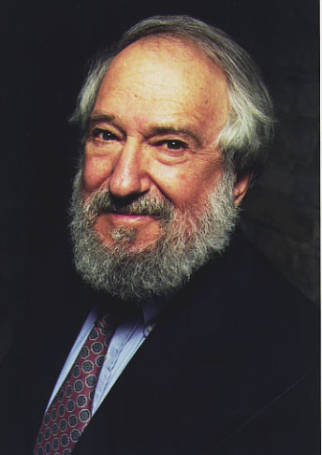
Seymour Papert
Founder and leading theorist of constructionism

Slide 4
What is constructivism?

Slide 5
What is constructivism?
The idea that knowledge is not simply passively acquired, but is actually constructed by the learner.

Slide 6
What is constructionism?

Slide 7
What is constructionism?
“Constructionism—the N word as opposed to the V word—shares constructivism’s connotation of learning as ‘building knowledge structures’ irrespective of the circumstances of the learning. It then adds the idea that this happens especially felicitously in a context where the learner is consciously engaged in constructing a public entity, whether it’s a sand castle on the beach or a theory of the universe.” -- Papert

Slide 8
Do you agree that
Learning occurs especially felicitously in a context where the learner is consciously engaged in constructing a public entity, whether it’s a sand castle on the beach or a theory of the universe?

Slide 9
Do you agree that
Learning occurs especially felicitously in a context where the learner is consciously engaged in constructing a public entity, whether it’s a sand castle on the beach or a theory of the universe?
Why would this be the case?

Slide 10
Hay & Barab add
“Thus, constructionism (e.g., the construction of a Logo program) allows learners to develop their own reasoned interpretations of their interactions with the world. Perhaps more important, constructionist learning environments allow learners to share and collaboratively reflect on these cognitive artifacts.”

Slide 11
Your thoughts?

Slide 12
Who here sees themselves as a constructionist?

Slide 13
Defining constructionism
“But in saying all this I must be careful not to transgress the basic tenet shared by the V and the N forms: If one eschews pipeline models of transmitting knowledge in talking among ourselves as well as in theorizing about classrooms, then one must expect that I will not be able to tell you my idea of constructionism. Doing so is bound to trivialize it. Instead, I must confine myself to engage you in experiences (including verbal ones) liable to encourage your own personal construction of something in some sense like it. Only in this way will there be something rich enough in your mind to be worth talking about.” -- Papert

Slide 14
Who here thinks that Papert makes a really nice point here?

Slide 15
Who here thinks that Papert makes a really nice point here?
If so why?

Slide 16
Who here thinks that this is utter hogwash?

Slide 17
Who here thinks that this is utter hogwash?
If so why?

Slide 18
Buchanan and McKeon’s Framework
HOLISTIC
EXISTENTIALIST
ESSENTIALIST
ENTITATIVE

Slide 19
Are there…
Other valid scientific or educational concepts which are either not amenable to definition?
Or that are more productive to identify than define?

Slide 20
Affective states
Boredom, frustration, engaged concentration
Much of the recent work on these constructs is based on researchers noting when students engage in these behaviors, without defining them
Inter-rater reliability is used rather than an agreed definition
Is this bad science?

Slide 21
Affective states
Boredom, frustration, engaged concentration
Much of the recent work on these constructs is based on researchers noting when students engage in these behaviors, without defining them
Inter-rater reliability is used rather than an agreed definition
Is this bad science?
Is it the same thing as Papert’s lack of fondness for definitions, or is it something different?

Slide 22
Are open-ended activities the best way to learn to program?

Slide 23
Carver & Klahr, 1988
Compared students using LOGO in a constructionist fashion to students using LOGO combined with explicit instruction on debugging
Found that students who received instruction were better at debugging, both in LOGO and in debugging travel directions

Slide 24
Schwartz & Bransford (1998)
Compared students who engaged in discovery learning around variance in mathematics and then received instruction on standard deviation learned better than
Students who either engaged in discovery learning or received instruction alone

Slide 25
What is STEAM learning?

Slide 26
What is STEAM learning?
“STEAM… uses Science, Technology, Engineering, the Arts, and Mathematics as access points for guiding student inquiry, dialogue, and critical thinking.”

Slide 27
Will STEAM and Maker Spaces
Have a more durable impact on education than constructionism did?
Or for that matter, the earlier movement of “shop class”, which was eliminated in most American schools over the last decade?

Slide 28
Scratch
Who here has used scratch (either as a student or an instructor)?
What did you think of the experience?

Slide 29
Some questions
What are the benefits to having kids design games rather than playing games that others have designed?

Slide 30
Some questions
Do open-ended activities motivate and interest kids in a way that is durable and life-changing?

Slide 31
Some questions
What is the view of constructionism on the role of experts and teachers? Is this the best way to leverage expertise?

Slide 32
Some questions
Mitch Resnick’s research group is called Lifelong Kindergarten
Should all learning be like kindergarten?

Slide 33
How would a constructionist teach a class on constructionism?
How would it be different than today’s class?

Slide 34
Upcoming Classes
12/3: Effective Learning Strategies
12/10: Emotions and Learning
12/17: Social Factors that Mediate Learning
12/20: Final Paper due

