Slide 1
Foundations of Teaching and Learning
September 17, 2021

Slide 2
Opening Thoughts and Questions About the Readings?

Slide 3
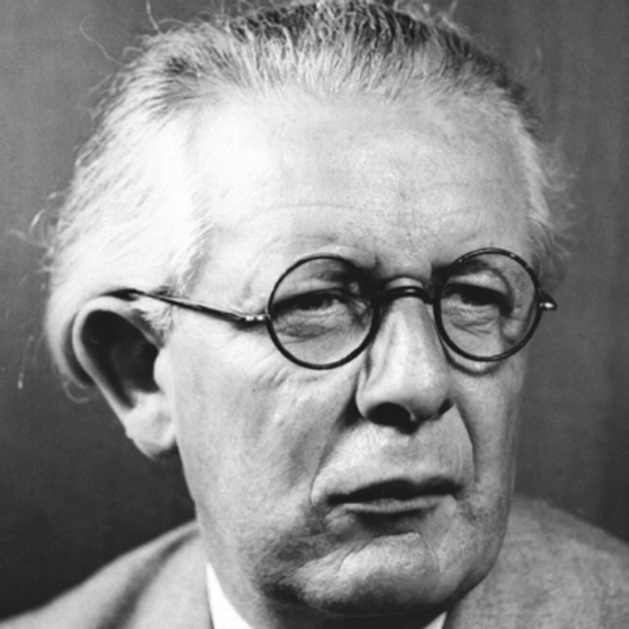
Jean Piaget
Key theoretician of cognitive development

Slide 4
Jean Piaget
Key theoretician of cognitive development
Key thinker for constructivism

Slide 5
Jean Piaget
Key theoretician of cognitive development
Key thinker for constructivism
Strange dad

Slide 6
What was Piaget’s key research population

Slide 7
What are the benefits of studying your own children?

Slide 8
What are the limitations of studying your own children?

Slide 9
Scientists’ children may be atypical
https://www.youtube.com/watch?v=T8BOd8yD3I8

Slide 10
First in a line of…
Educational psychologists who studied and sometimes influenced their own children
Bob Siegler and John Anderson story

Slide 11
What were Piaget’s Stages of Cognitive Development?

Slide 12
Piagetian Stages
Sensorimotor (birth to 2 years): sensory (simple input) with motor (simple output) reflexive interaction with phenomenon like seeing and grasping copying; accomplishments include object permanence and representational thought
Preoperational (2 to 7 years): development of mental representations and language, communication is often egocentric (limited to one’s own perspective)
Concrete operational (7 to 12 years): development of logical thinking using concrete objects, development of the idea of conservation, can take other people’s perspectives
Formal operational (12 to adult): second order relations or analogous reasoning begins, development of abstract thinking about concepts like justice, inner peace, development of systematic thinking
This slide courtesy of Yasmin Kafai

Slide 13
Are these stages (and their timing) set in stone?
Can there be partial or continuous development?

Slide 14
Are these stages (and their timing) set in stone?
Can there be partial or continuous development?
Can children acquire a stage (in part or completely) earlier than Piaget says?

Slide 15
Are these stages (and their timing) set in stone?
Can there be partial or continuous development?
Can children acquire a stage (in part or completely) earlier than Piaget says?
Are these stages universal worldwide?

Slide 16
Should we use Piaget’s theory to time when children learn topics?

Slide 17
Personal Story
When I was 8 years old, my dad gave me a TRS-80 computer and a programming manual, and I taught myself to program it with his help. As part of this, I learned some simple boolean Algebra.

Slide 18
Personal Story
When I was 8 years old, my dad gave me a TRS-80 computer and a programming manual, and I taught myself to program it with his help. As part of this, I learned some simple boolean Algebra.
In college, when I mentioned this in class, the professor stated that this was impossible -- no 8 year old could ever learn algebra.

Slide 19
Personal Story
When I was 8 years old, my dad gave me a TRS-80 computer and a programming manual, and I taught myself to program it with his help. As part of this, I learned some simple boolean Algebra.
In college, when I mentioned this in class, the professor stated that this was impossible -- no 8 year old could ever learn algebra.
But it turns out he was wrong -- (Gavin et al., 2007), for example, reports on deployment of algebra education in 3rd-grade gifted classes.

Slide 20
Let’s go to breakout rooms
For 10 minutes
Discuss amongst yourselves
What is useful to education from Piaget’s model of the stages of development?

Slide 21
What are some key take-aways from your discussion?

Slide 22
Was 10 minutes enough?
For future class session planning

Slide 23
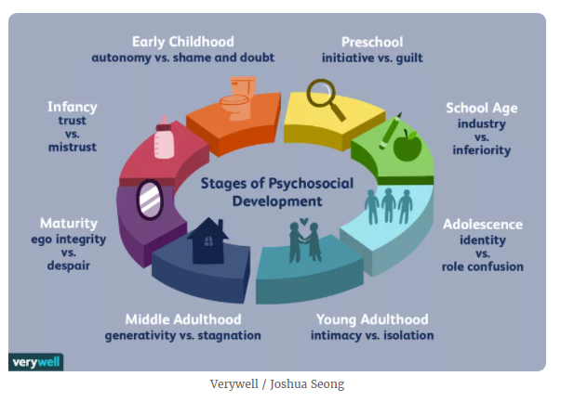
Another key stage-based model Erikson (1974)

Slide 24
Thoughts? Comments?

Slide 25
What is a schema?

Slide 26
What is a schema?
“A cohesive, repeatable action sequence possessing component actions that are tightly interconnected and governed by a core meaning.”

Slide 27
Examples of Schemas
A bird has wings and flies

Slide 28
Examples of Schemas
A bird has wings and flies
Where might this schema break down?

Slide 29
Examples of Schemas
When you go to a restaurant you look at a menu, order food, eat it, pay, leave

Slide 30
Examples of Schemas
When you go to a restaurant you look at a menu, order food, eat it, pay, leave
Where might this schema break down?

Slide 31
What are some other examples of schemas?

Slide 32
Disequilibrium
The uncomfortable feeling you get when you obtain new information that you can’t fit into your schemas, and have to adjust a schema

Slide 33
Assimilation and accommodation
Assimilation – trying to fit new knowledge into already existing schema
Accommodation – constructing a new schema to organize information that cannot be assimilated into existing schemas

Slide 34
Assimilation
“Oh, that’s a *dog*”

Slide 35
Accomodation
“I guess cats don’t need to have fur?”

Slide 36
Can you give recent examples of Assimilation and Accommodation
From your own lives?

Slide 37
What is constructivism?

Slide 38
What is constructivism?
The idea that knowledge is not simply passively acquired, but is actually constructed by the learner.

Slide 39
However, common knowledge is possible
Within Piaget, the learner can acquire concepts that are conceptually identical to concepts that other people have (aka signs).
Among some "constructionists", particularly seen in Carol Strohecker's writing, the concepts acquired by different people are fundamentally incomparable and irreducible.

Slide 40
Important note
Constructivism and constructionism aren’t the same thing
We won’t be discussing constructionism this semester, but important to keep in mind if you come across it in other classes

Slide 41
Piaget on Education and Pedagogy
Central to Piaget’s methods of education is the notion of activity versus passive or intuitive methods
• Focus should be on the process and not the end results
• Advocates the use of concrete teaching aids
• Stresses the notion of learning by doing which he equates to experimentation
• Teacher is a guide for the student to construct his/her own understanding
• Children come with already existing mental structures that need to be revealed and understood
• Students need to be helped to think about their own thinking
This slide courtesy of Yasmin Kafai
Notes:
Read passage on p. 704

Slide 42
Thoughts and comments on this?

Slide 43
Other thoughts and comments for today?

Slide 44
Upcoming Classes
9/24: Vygotsky
Vygotsky book needed for this class
10/1: Instructionism
10/8: Dewey
Dewey book needed for this class

