Slide 1
Foundations of Teaching and Learning
October 8, 2021

Slide 2
Sample prospectuses and papers
Go to canvas
Look at modules
It’s the last one

Slide 3
Sample prospectuses and papers
When you review Basom and Tsichiderer, you will note that they are very different from each other
Despite both involving Piaget
One hews very close to Piaget, the other explores out further
Both are fine! Both got great grades!

Slide 4
What they have in common
A clear problem they are trying to solve
A clear primary thinker they identify
Clear connection to that thinker’s ideas
Explicit quotation is fine but not required
Clear argumentation and reasoning

Slide 5
What they have in common
Good writing with minimal writing errors
If writing is an issue for you, try Grammarly and/or the writing center
Extensive citation to other writings beyond core thinker
Not required!
Not turned in late

Slide 6
What they have in common
Clear and concise prospectus
Brief outline recommended but not required

Slide 7
Questions? Concerns?

Slide 8
Remember
I am available for meetings to discuss your prospectus or papers
You can send me drafts for comment
Must be minimum of one week before due date to guarantee comments before due date
One student last year sent me a draft 6 hours before the due date – not going to get you early comments

Slide 9
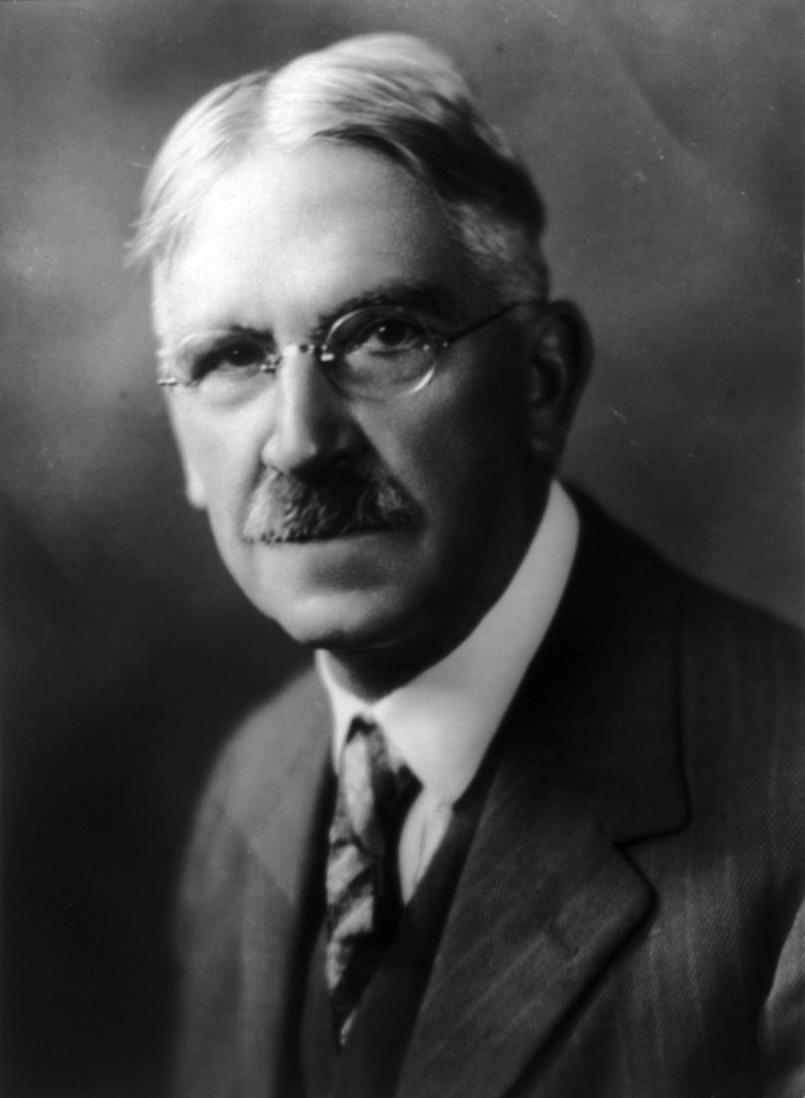
John Dewey
No relation to the Dewey Decimal System

Slide 10
John Dewey
Widely respected in schools of education, particularly in the USA and China, where he lived for two years and gave over 200 lectures
See the giant “Dewey head” on the 4th floor here in GSE, for instance

Slide 11
John Dewey
Arguably, much less influential on schools in both countries than one might expect
We’ll discuss his ideas and possible reasons for his relatively light influence today

Slide 12
Dewey sets up a strong contrast
Traditional schools
Progressive schools

Slide 13
Let’s construct a matrix together to represent this difference
Yes, another matrix, sorry

Slide 14
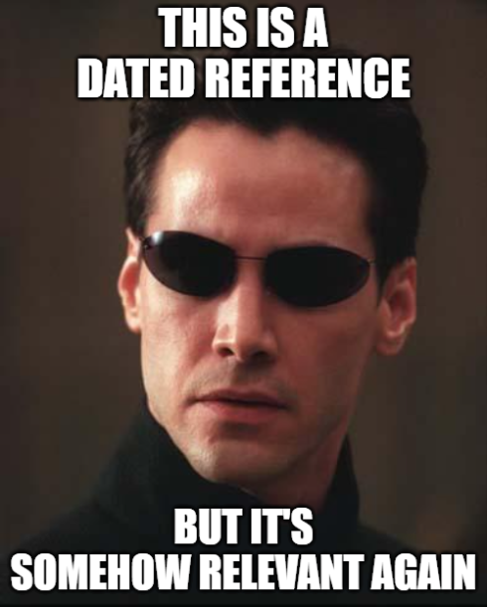

Slide 15
Let’s construct a matrix together to represent this difference
Let’s start with traditional schools
What are the attributes of traditional schools, according to Dewey?

Slide 16
aaa
bbb

Slide 17
Let’s construct a matrix together to represent this difference
Let’s start with traditional schools
What are the attributes of traditional schools, according to Dewey?
What are the contrasts to these, seen in progressive schools?

Slide 18
aaa
bbb

Slide 19
Which type of school would you rather you had learned in?
Traditional school
Progressive school
Why?

Slide 20
One interesting note
When Dewey talks about making the most of one’s current life
He isn’t saying that the future doesn’t matter (as we discussed on the forum this week)
Dewey also states that the goal of designing experiences is to increase openness to and readiness for new experiences

Slide 21
What’s the difference?
Increase openness to and readiness for new experiences
Prepare for a remote future
What contexts might each make sense in?

Slide 22
What is the principle of continuity?

Slide 23
What is the principle of continuity?
All experiences affect all future experiences
All experiences are carried forward and influence future experiences and decisions

Slide 24
What is the principle of interaction?

Slide 25
What is the principle of interaction?
Each person’s present experience is determined by the interaction between
That person’s past experiences
The present situation

Slide 26
Continuity and Interaction
Those of you who have been teachers or tutors, can you give examples of how a student’s past has influenced their experience in your class?

Slide 27
Continuity and Interaction
Those of you who have not been teachers or tutors, can you give examples of how an experience you had in a past class influenced your future experiences?

Slide 28
Dewey states
“Enforced quiet and acquiescence prevent pupils from disclosing their real natures… They put seeming before being… They place a premium upon preserving the outward appearance of attention, decorum, and obedience… The ideal aim of education is creation of power of self-control. But the mere removal of external control is no guarantee for the production of self-control.”

Slide 29
Questions
Why is self-control important?
How do we create it, if not through the internalization of norms (Vygotsky) or through the application of the correct stimuli in the correction situations (Skinner) or punishment (Cooper)?

Slide 30
Dewey’s answer
“It is, then, a sound instinct which identifies freedom with power to frame purposes and to execute or carry into effect purposes so framed. Such freedom is in turn identical with self-control; for the formation of purposes and the organization of means to execute them are the work of intelligence… There is, I think, no point in the philosophy of progressive education which is sounder than its emphasis upon the importance of the participation of the learner in the formation of the purposes which direct his activities in the learning process, just as there is no defect in traditional education greater than its failure to secure the active co-operation of the pupil in construction of the purposes involved in his studying.”

Slide 31
Is self-selection of purpose sufficient to create self-control?

Slide 32
Are all purposes good?
Dewey gives an example of a burglar

Slide 33
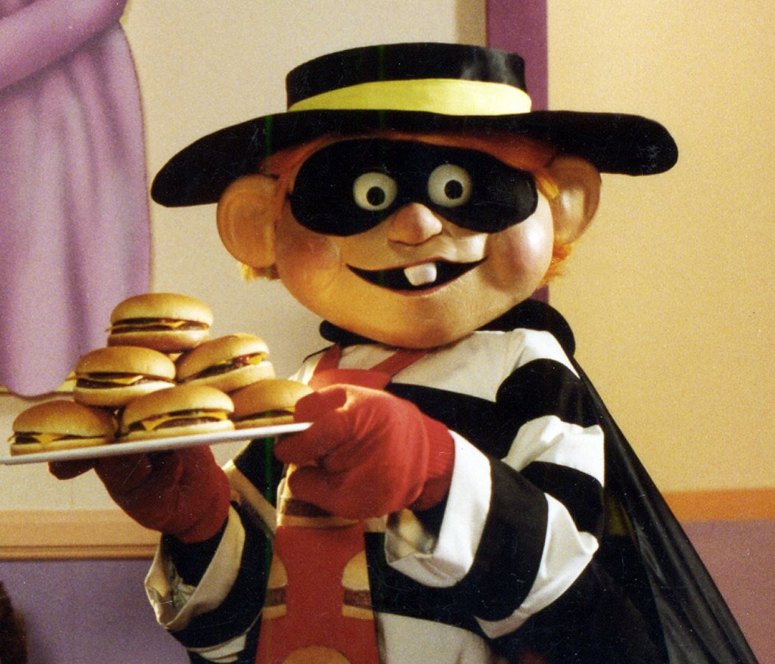
Are all purposes good?
Dewey gives an example of a burglar

Slide 34
Are all purposes good?
Dewey posits that growth is not simply becoming expert in any goal or purpose, but growing in general

Slide 35
Are all purposes good?
The example of discouraging someone from becoming an expert burglar is somewhat obvious
But there are less obvious directions that may, in the long-term, hold back or harm a student or those around him/her
How does a teacher, or a society, choose what directions to encourage?

Slide 36
Are schools typically progressive today?

Slide 37
Are schools typically progressive today?
Why not?
Should we try to change that? How could we?

Slide 38
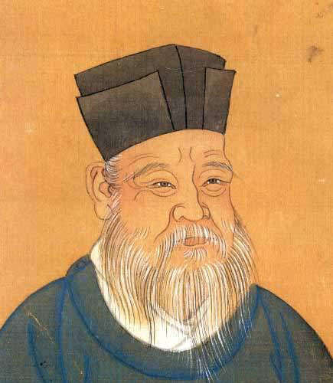
Zhu Xi (as discussed in Tan)
Important neo-Confucian thinker
Argued against high-stakes exams

Slide 39
Zhu Xi
Critiqued the overemphasis of high-stakes exams and the educational system, focused on memorization and literary composition, that test preparation led to
Exams as just one aspect of a total plan oriented towards the self-transformation of the learner

Slide 40
Characteristics of Zhu Xi’s educational programme
Experiential learning
Personal inquiry
Mindful reading

Slide 41
Experiential learning
Learning by doing in everyday tasks and human interactions
Directs the students’ attention to self-development and personal fulfilment in everyday life
Education should provide a structured, social and reflective setting for learners to learn to regulate their physical, emotional, mental and social selves within social activities
Obtain ‘direct understanding’ of one’s activities over time so that the student can perform them ethically for the rest of their lives

Slide 42
Experiential learning: 5 Functions
Providing a structured context for the learner to develop oneself through rituals (social-interactional norms)
Guarding against moral temptations and behaviours
Immersing in ethical communities that promote moral education
Disciplining one’s physical-emotional selves
Motivating one to cultivate oneself

Slide 43
Personal inquiry
A commitment to learn where one firmly establishes a will to study the character and acts of sages
Students in higher learning are ‘conscious authors of our own cultivation’
Moral self-cultivation to manifest the brightness of human nature by removing selfish desires and feelings
The intended end is to transform oneself so that one’s heart-mind and conduct are in congruent with the principles/standards that should govern it
Need to exert personal effort to analyse a given situation so as to understand how principles should be applied in that setting

Slide 44
Mindful reading
Reading the classics
“Generally speaking, in reading through a text, one should recite the words as if they were coming out of one’s own mouth. Then, as one continues to give them thoughtful reflection, the ideas will seem to be coming from one’s own mind-and-heart. At that point one has truly gotten it [for one’s self]”

Slide 45
How does Zhu Xi relate to Vygotsky?
What in Zhu Xi connects into Vygotsky’s ideas?

Slide 46
How does Zhu Xi relate to Dewey?
Where would they agree and disagree?

Slide 47
Other thoughts about Zhu Xi?

Slide 48
Upcoming Classes
10/15: Socio-Cultural
10/18: Theoretical Paper Prospectus Due
10/22: Freire and Ladson-Billings
10/29: Adaptive Learning Systems

