Slide 1
Foundations of Teaching and Learning
December 10, 2021

Slide 2
Engagement and Disengagement
Cognitive
Behavioral
Affective
(Fredricks et al., 2004)

Slide 3
Affective Engagement
Multiple paradigms
Basic emotions (Ekman, etc.)
Cognitive Appraisal and Emotions (OCC)
Two-dimensional model (Russell)
Academic emotions (Pekrun, D’Mello, Graesser, etc.)

Slide 4
Ekman’s Basic Emotions
Anger
Fear
Sadness
Disgust
Enjoyment
Surprise

Slide 5
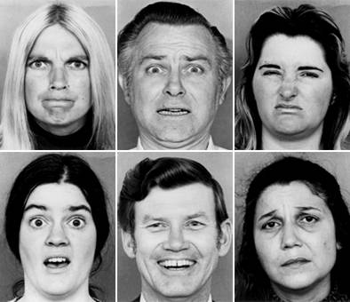
Basic Emotions, Presented by Actors

Slide 6
Ekman’s Claim
The basic emotions are culturally universal

Slide 7
Nelson & Russell (2013)
Emotion recognition is not universal across cultures
It is generally higher when people are shown pictures of exaggerated emotional expressions rather than real emotions

Slide 8
Elfenbein & Ambady (2002)
Emotion recognition accuracy is higher when emotions are expressed and recognized by member of same cultural group
Effect is reduced when groups have more exposure to each other

Slide 9
Baker et al. (2019)
Classroom recognition of student emotion -- BROMP protocol
Harder to achieve inter-rater reliability when one researcher is not of same nationality as students
Every BROMP coder who successfully reached certification was of same nationality as students or had been married to or soon married someone of same nationality as students

Slide 10
Comments? Questions?

Slide 11
Academic Emotions Paradigm
The affect that is relevant to study differs based on the context of research, and the research questions
Affect that is relevant during learning is different than the affect that is relevant in other situations

Slide 12
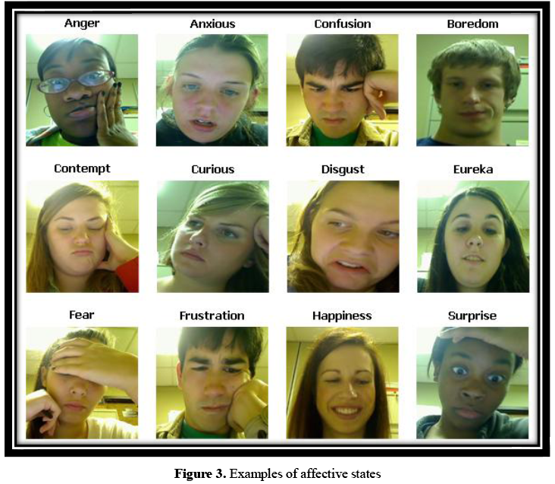
Image From D’Mello

Slide 13
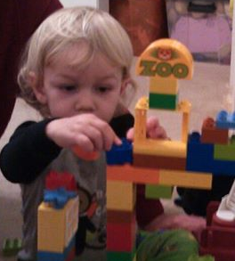
Engaged Concentration

Slide 14
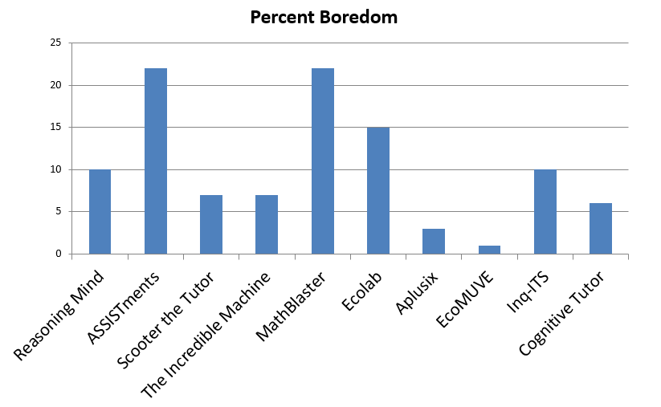
Considerable variation in affective engagement by context

Slide 15
Affective Engagement and outcomes
Boredom associated with
Lower exam grades (Rodrigo et al., 2009)
Lower course grades (Pekrun et al., 2010)
Lower standardized exam score (Pardos et al., 2014)
Lower probability of college attendance several years later (San Pedro et al., 2013)

Slide 16
Affective Engagement and outcomes
Engaged concentration associated with
Higher exam grades (Rodrigo et al., 2009)
Higher standardized exam score (Pardos et al., 2014)
Higher probability of college attendance several years later (San Pedro et al., 2013)
Better life outcomes, when considered as part of Csikszentmihalyi’s (1990) construct of flow

Slide 17
Comments? Questions?

Slide 18
Clore & Ortony model
Also referred to as OCC model (Ortony, Clore, & Collins, 1988)
“According to this theory, emotions derive from cognitive appraisal of the current situation, which consists of events, agents, and objects. The outcome of the appraisal depends on how the situation fits with one’s goals and preferences.” – Conati & Maclaren, 2002

Slide 19
Key Difference From Ekman
Emotional appraisal is not automatic but involves complex cognitive processing and categorization
Which however seems automatic because it is so ingrained
Some physiological components of emotion precede cognition, but cognition is necessary for determining which affective state emerges

Slide 20
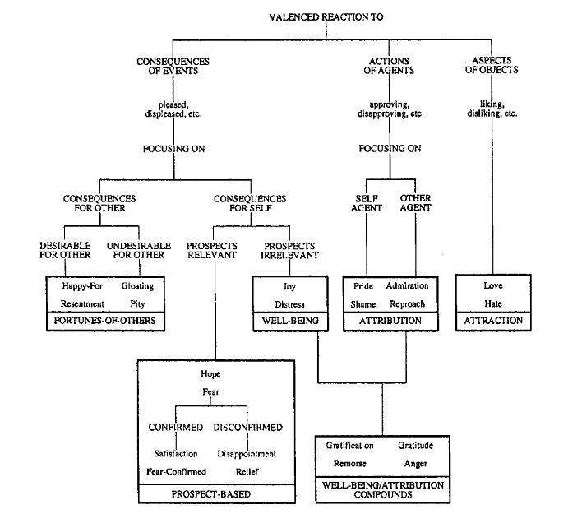

Slide 21
Key Difference From Other Paradimgs
Emotions are not unitary but hierarchical
Opposite emotions (positive, negative) come from the same processes
Love, Hate
Pride, Shame

Slide 22
Comments? Questions?

Slide 23
Russell (2003)
Even if facial and physiological expressions of emotion – such as fear – are culturally universal
Is that meaningful?

Slide 24
Russell (2001)
Conceptualization of what emotions mean differ across cultures
In Luganda, anger and sadness are denoted by the same word and it is difficult for researchers to explain the difference
Experiences that cause anger in USA lead to crying among Buganda people (Leff, 1973)
Brazilians cry when they are angry (personal communication, Ryan Baker)

Slide 25
Russell (2001)
Conceptualization of what emotions mean differ across cultures
Shame and Fear not distinguished by Gidjingalia people (Hiatt, 1978)
Shame, Guilt, and Embarrassment not distinguished by Japanese and Javanese (Lebra, 1983; Keeler, 1983)
Shame almost impossible to translate into many languages

Slide 26
Russell (2001)
Conceptualization of what emotions mean differ across cultures
Hatred and Disgust not separated by Samoans (Gerber, 1975)

Slide 27
Russell (2001)
Emotions considered “basic” in other cultures have no translation in English and/or are hard to explain
Schadenfreude (German)
Litost (Czech)
Saudades (Portuguese)
Han (Korean)
Can anyone explain any of these?

Slide 28
Russell (2001)
Emotions considered “basic” in other cultures have no translation in English and/or are hard to explain
Schadenfreude (German)
Litost (Czech)
Saudades (Portuguese)
Han (Korean)
Would anyone like to share an emotion (semi-) unique to their culture?

Slide 29
Leading to the question
Is there something more basic than Ekman’s set of emotions?
Termed “core affect”
“…neurophysiological state consciously accessible as the simplest raw (nonreflective) feelings evident in moods and emotions.” (Russell, 2003)

Slide 30
Core Affect Dimensions
Activation/Deactivation
Also called Arousal
Pleasure/Displeasure
Also called Valence
These dimensions did not start with Russell
Some early uses of these constructs:
Arousal: Hebb (1955)
Valence: Vroom (1968)

Slide 31
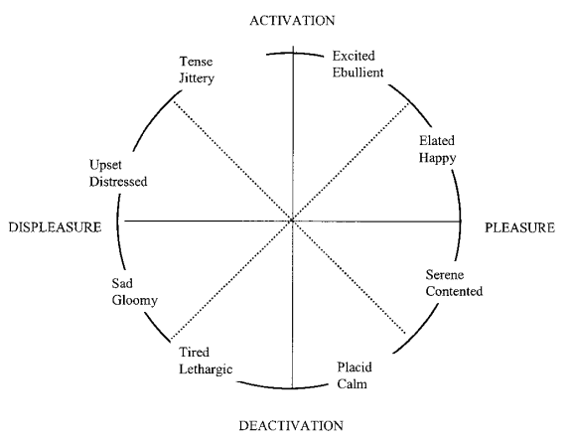

Slide 32
Note that
Pretty much any emotion can be mapped onto this framework
But is it sufficient to distinguish between different emotions?
How can disgust and upset be distinguished?
Isn’t there something interesting in the difference between disgust and upset?

Slide 33
Questions? Comments?

Slide 34
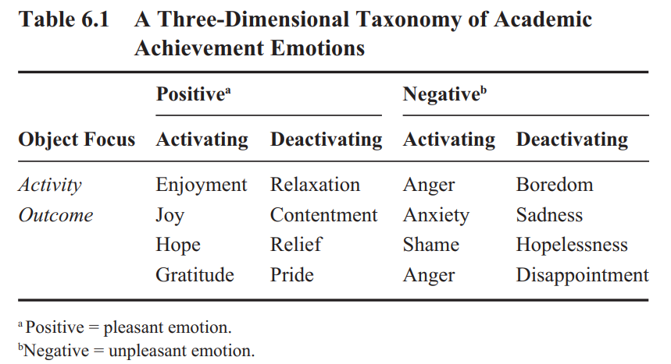
Boekarts & Pekrun (2015)

Slide 35
Questions? Comments?

Slide 36
Social-emotional skills (Oberle & Schonert-Reichl, 2017)
Self-awareness
Self-management
Social awareness
Relationship skills
Responsible decision-making skills

Slide 37
Social and emotional learning (review in Oberle & Schonert-Reichl, 2017)
SEL programs associated with better outcomes
Increased prosocial behaviors
Decreased antisocial behaviors
Better mental health
Better academic achievement test scores
Better academic achievement

Slide 38
Social and emotional learning (review in Durlak et al., 2011)
Attributes of successful SEL programs
Sequenced activities that teach social-emotional skills in coordinated and connected ways
Active learning and participation
Focus on one or more specific social-emotional skills
Explicit discussion of skills being focused on

Slide 39
Social and emotional learning (review in Durlak et al., 2011)
Attributes of successful SEL programs
Sequenced activities that teach social-emotional skills in coordinated and connected ways
Active learning and participation
Focus on one or more specific social-emotional skills
Explicit discussion of skills being focused on
Attention to implementation fidelity

Slide 40
Comments? Questions?

Slide 41
Explore in more detail
In breakout groups
https://www.rulerapproach.org/how-it-works/classroom-instruction/
What do you like about this approach?
What concerns do you have?
When we return, post your group’s (or your own) top thoughts in the chat window

Slide 42
Comments? Thoughts? Questions?

Slide 43
Upcoming Classes
12/17: Social Factors that Mediate Learning
12/20: Final Paper due

