Slide 1
Foundations of Teaching and Learning
October 22, 2021

Slide 2
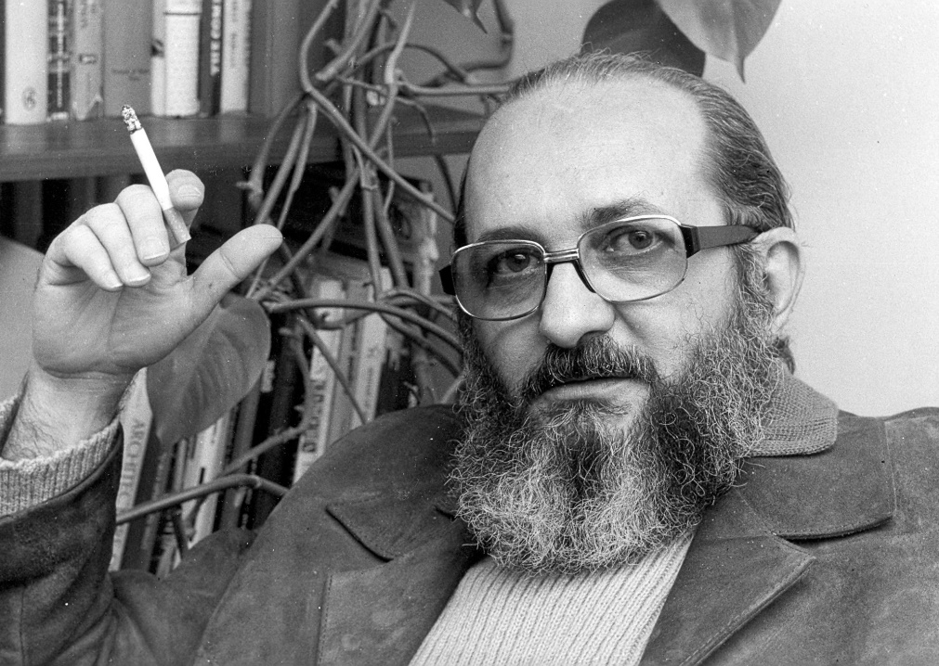
Paulo Freire
A thinker with a bit more of an interesting personal history than the other folks we have studied

Slide 3
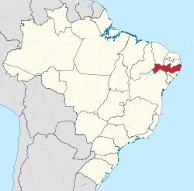
Freire in 1943
Teaching in public school in Pernambuco

Slide 4
Pernambuco in 1943
The capital, Recife, combines
Violence equal to Rio de Janeiro
Great poverty
The countryside
Highly illiterate
Most of the population live in fazendas (plantations) where coroneis (land barons) exercise heavy control over plantation workers’ lives

Slide 5
The Nordeste today
Human development index comparable to Angola
In strong contrast to other parts of Brazil such as Rio Grande do Sul, Santa Catarina, or São Paulo, which are more comparable to Southern Europe

Slide 6
The Nordeste today
The successors of the Coroneis still have considerable power in Northeastern rural areas
Though they haven’t used the term to describe themselves since the 1990s
Attempts at rural development and business education often meet with strong (and sometimes violent) opposition
However, with greater civil rights since the 1988 Constituição Cidadã, and the attention of the national news media, the power of the successors of the Coroneis is much reduced

Slide 7
Freire in 1946
Running Pernambuco Department of Education

Slide 8
Freire in 1962
Began large-scale programs in literacy education

Slide 9
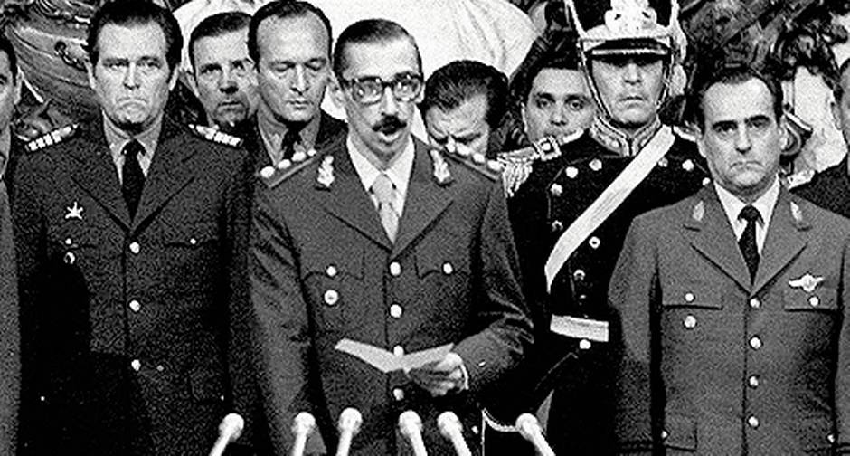
Brazil in 1964
The Junta Militar takes control of the government
Freire is imprisoned and then exiled to Bolivia

Slide 10
Freire in the 1960s-1980s
Freire begins publishing
He designs/advises large-scale literacy programs in Chile, Nicaragua, Guinea-Bissau…
These programs critiqued for deviating from his published ideas and becoming increasingly focused on the political stances of ruling parties (Kirekendall et al., 2010)
He eventually moves to Harvard and then Geneva

Slide 11
Freire
Just as Vygotsky is hard to understand outside of the context of the Soviet Union and Marxist dialectic
Freire is hard to understand outside the context of Brazil’s social situation in that era, his exile by the Junta Militar, and his subsequent activities in designing literacy programs

Slide 12
Freire and Ramos
Ramos was Freire’s preferred translator
Despite being a native speaker of neither Portuguese nor English

Slide 13
Freire and Ramos
Ramos was Freire’s preferred translator
Despite being a native speaker of neither Portuguese nor English
Unfortunately for us, Freire thought Ramos was awesome and refused to authorize any other translations.
He viewed it as disloyal to even consider the possibility

Slide 14
Freire and Ramos
Freire’s Portuguese is lyrical and beautiful
Ramos’s English translation of Freire is appalling
Weird or confusing word choices
Ramos restructures entire sections in ways that make very little to sense to me.

Slide 15
Freire and Ramos
One of the biggest issues is literal translations of terms – “banking education” being the best example
A colorful metaphor, even if the translation of “educação bancária” is awkward

Slide 16
Freire and Ramos
Freire’s seemingly dismissive use of the word “illiterates” is completely Ramos
Freire’s writing in Portuguese is respectful towards the students he works with

Slide 17
What is Freire’s model for a teacher?

Slide 18
What is Freire’s model for a teacher?
Teacher-student with students-teachers (alt trans: "Teacher who is learning with learners who are teaching")
Teacher is in dialogue with students, who teach even while being taught. Growing together.
Arguments based on authority aren't considered worthwhile (in Ramos "are no longer valid")
Teachers are on the side of freedom, not against it
Teacher is re-forming reflections based on the reflections of the students

Slide 19
“Culture Circles”
(Perhaps better translated as "cultural center activities")

Slide 20
“Culture Circles”
How do they differ from traditional education for adults?

Slide 21
“Culture Circles”
How do they differ from traditional education for adults?
Coordinator instead of teacher
Dialogue instead of lecture
Programs broken into learning units instead of large-scale formal courses (translated as "syllabi")
Integrating understanding political situations and determining plans for action with formal topics of study

Slide 22
Freire’s Dialogue and Anti-Dialogue
Dialogue: Working together to develop understanding in an attitude of "simpatia"
“Simpatia" translated as "empathy" but a better translation would be "harmonious mutual understanding"
Developing critique in the context of searching together for something, with faith in each other and humility
Anti-Dialogue: The relationship of harmonious mutual understanding is broken

Slide 23
Design of education
For Freire, education is designed in partnership with the population being served
How does that differ from childrens' education in America today?
How does that differ from adult/professional education in America today?

Slide 24
Freire and Dewey
How does Freire's differentiation between dialogue and anti-dialogue compare to Dewey's traditionalism/progressivism?

Slide 25
Sets of statements
“High school teaching should integrate modern political issues”
“High school teaching should focus on skills and concepts and avoid modern political issues”
“Paulo Freire’s ideas are important, pretty much everywhere.”
“Paulo Freire’s ideas might be valuable in some contexts, but aren’t useful in the country I grew up in.”
“The role of a teacher is to help their students learn”
“The role of a teacher is to learn along with their students”
Which ones do you agree more with?

Slide 26
Go to breakout rooms
Pick one of these sets of statements that you disagree about and discuss them
Don’t try to convince your conversational partners but try to find “harmonious mutual understanding”

Slide 27
Thoughts? Questions?

Slide 28
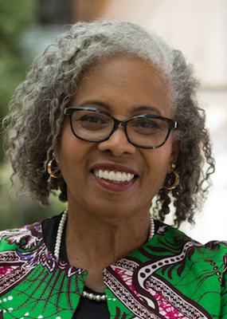
Ladson-Billings
Key theorist in culturally relevant pedagogy and critical race theory

Slide 29
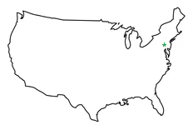
Ladson-Billings in 1953
Attending public school in Philadelphia

Slide 30
Culturally-relevant pedagogy
Committed to collective, not merely individual, empowerment

Slide 31
Three criteria of culturally-relevant pedagogy
(a) Students must experience academic success
(b) students must develop and/or maintain cultural competence
(c) students must develop a critical consciousness through which they challenge the status quo of the current social order

Slide 32
Academic success
“Despite the current social inequities and hostile classroom environments, students must develop their academic skills. The way those skills are developed may vary, but all students need literacy, numeracy, technological, social, and political skills in order to be active participants in a democracy.”
“…ensuring that the students learned that which was most meaningful to them.”

Slide 33
Cultural Competence
“…maintain some cultural integrity as well as academic excellence.”
“Culturally relevant teachers utilize students' culture as a vehicle for learning.”

Slide 34
Examples of Cultural Competence
Teacher used students’ familiarity with rap music to discuss curricular topics around literal and figurative meanings and technical aspects of poetry
Bringing in artists or craftspersons in residence from parents and using what they teach as bridge to more formally academic skills
Explicit instruction in code-switching

Slide 35
“But isn’t that just good teaching?”
Are these principles (academic success and cultural competence) generally applicable in education?

Slide 36
“But isn’t that just good teaching?”
Are these principles (academic success and cultural competence) generally applicable in education?
Should cultural competence (in Ladson-Billing’s sense; in terms of the local population) be a part of instruction in all schools?

Slide 37
“But isn’t that just good teaching?”
Are these principles (academic success and cultural competence) generally applicable in education?
Should cultural competence (in Ladson-Billing’s sense; in terms of the local population) be a part of instruction in all schools?
What do you do in a highly multi-cultural classroom?
What do you do about students who are not part of the (local) majority group?

Slide 38
What about critical consciousness?
Is that “just good teaching”?

Slide 39
What about critical consciousness?
Is that “just good teaching”?
How do we scale critical consciousness and avoid oversimplification, party lines, and backlash?

Slide 40
Thoughts? Questions?

Slide 41
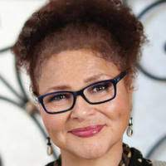
Lisa Delpit
Key writer and researcher discussing issues of power and diversity in classrooms
MacArthur “genius grant” winner

Slide 42
Cultures of Power (Delpit, 1988)
Issues of power are enacted in classrooms.
There are codes or rules for participating in power; that is, there is a "culture of power."
The rules of the culture of power are a reflection of the rules of the culture of those who have power.
If you are not already a participant in the culture of power, being told explicitly the rules of that culture makes acquiring power easier.
Those with power are frequently least aware of — or least willing to acknowledge — its existence. Those with less power are often most aware of its existence.

Slide 43
How do you communicate with someone who has more power but is clueless?
Delpit notes that the most common response when dealing with someone who is both powerful and clueless is silence
“Anyway, I'm not bothering with it anymore, now I'm just in it for a grade”
“So, I shut them out. I go back to my own little cubby, my classroom, and I try to teach the way I know will work, no matter what those folk say”
"Please tell those people, just don't help us anymore! I give up. I won't talk to them again!“
“It just doesn't make any sense to keep talking to them.”

Slide 44
How do you communicate with someone who has more power but is clueless?

Slide 45
How do you avoid being the kind of person who people just can’t talk to?

Slide 46
Equity and Power
"I want the same thing for everyone else's children as I want for mine.”
But, as Delpit points out, different students need different things
How do we avoid providing “the same thing for everyone else's children as I want for mine.”?

Slide 47
The importance of product
“Teachers do students no service to suggest, even implicitly, that "product" is not important. In this country, students will be judged on their product regardless of the process they utilized to achieve it. And that product, based as it is on the specific codes of a particular culture, is more readily produced when the directives of how to produce it are made explicit.”
What do you think?

Slide 48
The importance of product
“Teachers do students no service to suggest, even implicitly, that "product" is not important. In this country, students will be judged on their product regardless of the process they utilized to achieve it. And that product, based as it is on the specific codes of a particular culture, is more readily produced when the directives of how to produce it are made explicit.”
What do you think?
How does this compare/contrast to Freire?

Slide 49
The importance of product
“Teachers do students no service to suggest, even implicitly, that "product" is not important. In this country, students will be judged on their product regardless of the process they utilized to achieve it. And that product, based as it is on the specific codes of a particular culture, is more readily produced when the directives of how to produce it are made explicit.”
What do you think?
How does this compare/contrast to Dewey?

Slide 50
Thoughts or questions?

Slide 51
The importance of learning the culture of power
“To summarize, I suggest that students must be taught the codes needed to participate fully in the mainstream of American life, not by being forced to attend to hollow, inane, decontextualized subskills, but rather within the context of meaningful communicative endeavors; that they must be allowed the resource of the teacher's expert knowledge, while being helped to acknowledge their own "expertness" as well; and that even while students are assisted in learning the culture of power, they must also be helped to learn about the arbitrariness of those codes and about the power relationships they represent. “

Slide 52
Application
How could Penn GSE do a better job of “granting students access to the culture of power”? (Students = you!)
Please discuss in breakout groups
You are welcome to post anonymous responses if you want me and the rest of the class to read them – not required https://docs.google.com/forms/d/e/1FAIpQLSdVxDrZEA1ESwecT9YwH6sdx2C7Dd3J5KSI2Ai2X3jPryVRlQ/viewform?usp=sf_link
I will post to the discussion forum
Caveat: I can’t promise I can do anything about any of it

Slide 53
Final thoughts or questions?

Slide 54
Upcoming Classes
10/29: Adaptive Learning Systems
11/5: Learning in a Digitally Connected World
11/12: Identity and Culture

