Slide 1
Foundations of Teaching and Learning
November 12, 2021

Slide 2
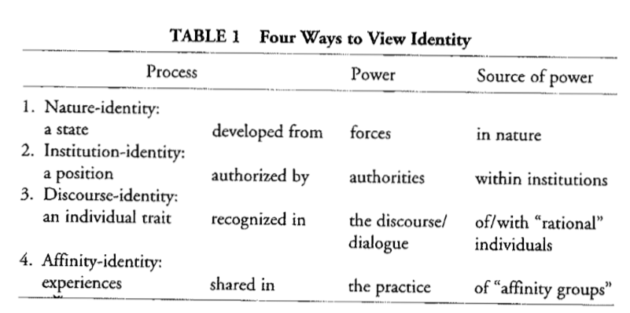
Gee’s Four Categories of Identity

Slide 3
Gee’s Examples for Himself
Nature-Identity
Identical Twin
Institution-Identity
College Professor
Discourse-Identity
A Charismatic Person
Affinity-Identity
Trekkie

Slide 4
An identity can be each of these
See Gee’s example of race
I-identity: laws, rules, or policies that classify individuals as being of a certain race, with specific implications
N-identity: racist eugenics, but also – for instance – factual genetic characteristics such as pre-disposition to Tay-Sachs disease
D-identity: cultural features around racial identity, both positive and negative
A-identity: voluntary selection of practices or preferences seen as being shared with other members of same race

Slide 5
Let’s list in the chat
Identities that you yourself identify with
Starting with N-identities

Slide 6
Let’s list in the chat
Identities that you yourself identify with
I-identities

Slide 7
Let’s list in the chat
Identities that you yourself identify with
D-identities

Slide 8
Let’s list in the chat
Identities that you yourself identify with
A-identities

Slide 9
Thoughts? Questions?

Slide 10
Zhang
Discusses some specific dimensions of cultural difference and how it relates to collaborative learning, building off of Hofstede’s model of cultural dimensions

Slide 11
Hofstede’s (1984, 2003) dimensions
Based on extensive surveys of IBM employees around the world

Slide 12
Hofstede’s (1984, 2003) dimensions
Based on extensive surveys of IBM employees around the world
Determined dimensions on which nations differed

Slide 13
Hofstede’s (1984, 2003) dimensions
Power distance
Individualism .vs. collectivism
Uncertainty avoidance
Masculinity .vs. femininity
Long-term orientation .vs. short-term orientation
Indulgence .vs. restraint

Slide 14
Zhang’s discussion of dimensions
Power distance
High power distance = more respect for teachers, higher likelihood of treating instructors and texts as authoritative
Low power distance = greater preference for questioning early in learning process
Analytical versus holistic/dialectical thinking
Avoidance of contradiction, clarification versus acceptance of contradiction and complexity
Low-context versus high-context cultures
Low-context: meaning mostly captured in words
High-context: meaning captured partially in social/vocal/relationship cues
Preference for face-to-face over textual communication in high-context cultures

Slide 15
Thoughts? Questions?

Slide 16
Incompleteness
There are many findings in group differences in education that are not explained by these models (Baker et al., 2019)

Slide 17
Ogan et al. (2012)’s work
Collaborative behaviors during blended learning do not map particularly well to collectivism or power distance
Brazil, Costa Rica, Mexico – close, “yoked” collaboration
USA – occasional collaboration
Philippines – avoidance of collaboration

Slide 18
Off-Task Behavior: West side of Pacific Ocean versus the rest of the world
Very low off-task behavior rates in Japan, China, Thailand, and the Philippines – much lower than the rest of the world (Chase & Mueller, 1989; Lan et al., 2009; Weisz et al., 1995; Rodrigo et al., 2013)
No obvious explanation for this pattern in existing cultural theories -- these countries are quite different from each other, and countries that share specific cultural features with these countries, according to dimensional models, do not seem to also have low off-task behavior.

Slide 19
Are between-country differences driven by
National/personal culture?
Culture of schooling?

Slide 20
Are countries even the right unit?
Guatemala versus Honduras
Mississippi versus Massachusetts
Shenzhen versus rural Xinjiang

Slide 21
Even if there are differences between large groups
Are they seen in most/all individuals as individual traits?
Or are they emergent in the culture of specific situations, and not seen in all participants?
Are all Americans individualistic? Are all Brazilians collectivistic?

Slide 22
Do you match the Hofstede Dimensions
For the country you most grew up in
https://www.hofstede-insights.com/product/compare-countries/
Choose your country
Then click read more

Slide 23
Thoughts? Questions?

Slide 24
Teachers’ Narrative Arcs (Machalow et al., 2020)
Identity viewed as teacher’s narratives about their own experience with mathematics over time

Slide 25
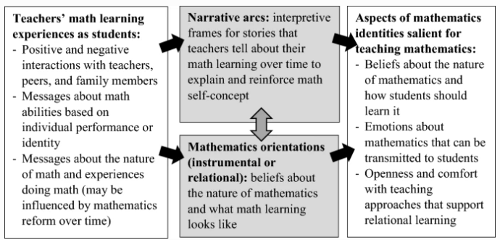
Teachers’ Narrative Arcs (Machalow et al., 2020)

Slide 26
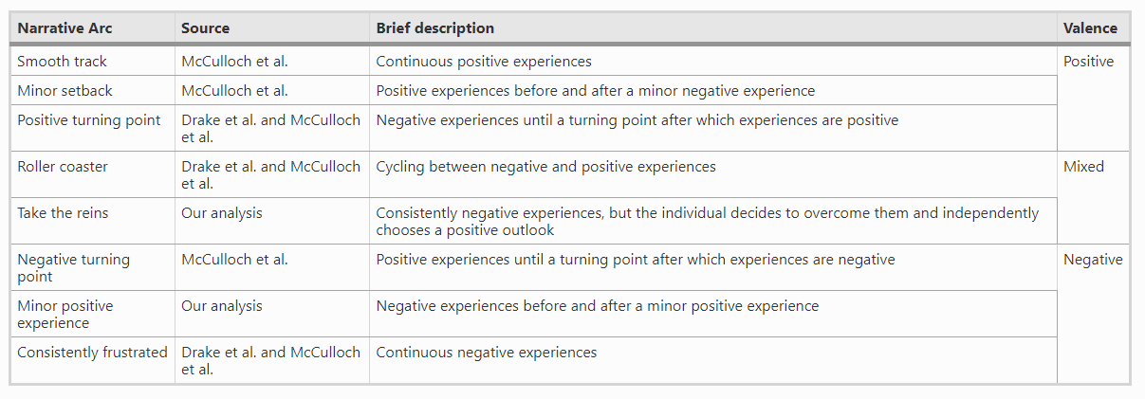
Teachers’ Narrative Arcs (Machalow et al., 2020)

Slide 27
Teachers’ Narrative Arcs and Orientation to Mathematics
Negative-valence narrative arcs
Mostly instrumental orientation (focused on replicating strategies, correct answers, and external rewards)
Positive-valence narrative arcs
Mostly relational orientation (focused on problem solving, creativity, and internal motivation)

Slide 28
Thoughts? Questions?

Slide 29
Upcoming
11/12 THIS AFTERNOON in-person meetup (320p-4p)
11/15 Essay due
11/19: Motivation and Engagement
11/24: Constructionism (special day/time)
12/3: Effective Learning Strategies

