Slide 1
Foundations of Teaching and Learning
December 17, 2021

Slide 2
Final assignment
Any questions?

Slide 3
Stereotype Threat
A person belongs to a group for which society at large has a negative stereotype
“Standardized and simplified conception of groups based on some prior assumptions” – Wikipedia
Stereotype Threat: “The existence of such a stereotype means that anything one does or any of one's features that conform to it make the stereotype more plausible as a self-characterization in the eyes of others, and perhaps even in one's own eyes.” (Steele & Aronson, 1995)

Slide 4
Stereotype Threat
Every group is vulnerable to stereotype threat, to at least some degree
Although stereotype threat can be rather comical for privileged/powerful groups

Slide 5
For instance…

Slide 6
For instance…
My dream of being an NBA star may have been crushed by stereotype threat

Slide 7
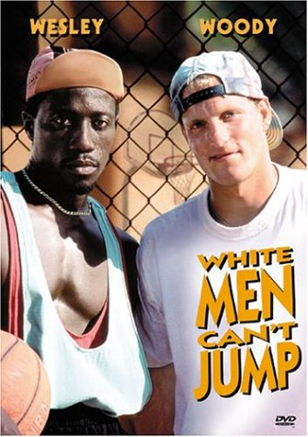
For instance…
My dream of being an NBA star may have been crushed by stereotype threat

Slide 8
For instance…
My dream of being an NBA star may have been crushed by stereotype threat
Or alternatively by the fact that I’m 5’8”

Slide 9
Groups Affected
Documented for
African-Americans in the USA (Steele & Aronson, 1995)
Latinos in the USA (Aronson & Salinas, 1999)
Females in STEM classes worldwide (Flore & Wicherts, 2015)
Elderly on cognitive tests (Barber et al., 2015)
Roma in Slovakia (Slobodnikova, 2017)
Immigrants in Europe (Appel et al., 2015)

Slide 10
Groups Affected
These groups face negative stereotypes about their group’s intelligence or ability in a subject
In the light of these stereotypes, many students experience anxiety
About whether they will be judged and treated stereotypically
And even about their own intelligence in the light of these stereotypes (Steele, 1990)
Person affected does not need to believe the stereotype, just that other people believe it

Slide 11
Conceptualization of Situation Matters
Effect on IQ sub-tests reduced if the test is presented as a test of eye-hand coordination (Katz et al., 1965)
Effect reduced on IQ tests if student told they will only be compared to other members of their own group (Katz et al., 1964)
Students perform worse on GRE items if told these items measure intelligence, than if told these items are given purely to study psychological factors (Steele & Aronson, 1995)

Slide 12
Questions? Comments?

Slide 13
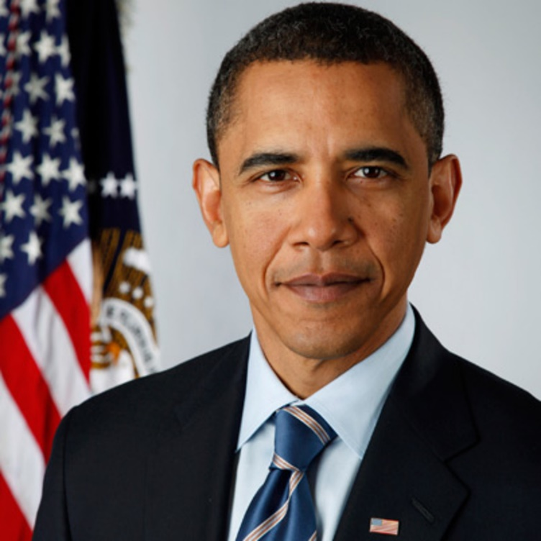
Obama Effect
Will highly publicized success of member of same group reduce stereotype threat?
By concretely challenging stereotypes

Slide 14
(Marx, Ko, & Friedman, 2009)
At four points in time
Early in presidential campaign
Right after Obama accepted presidential nomination with speech at Democratic National Convention
Middle of campaign
Right after Obama won presidency

Slide 15
Procedure
Adults nationwide recruited over internet
European-American and African-American
Given “test of verbal problem-solving ability”
Then asked about concerns about performance and stereotypes
Example: ‘‘I worry that if I perform poorly on this test, others will attribute my poor performance to my race”

Slide 16
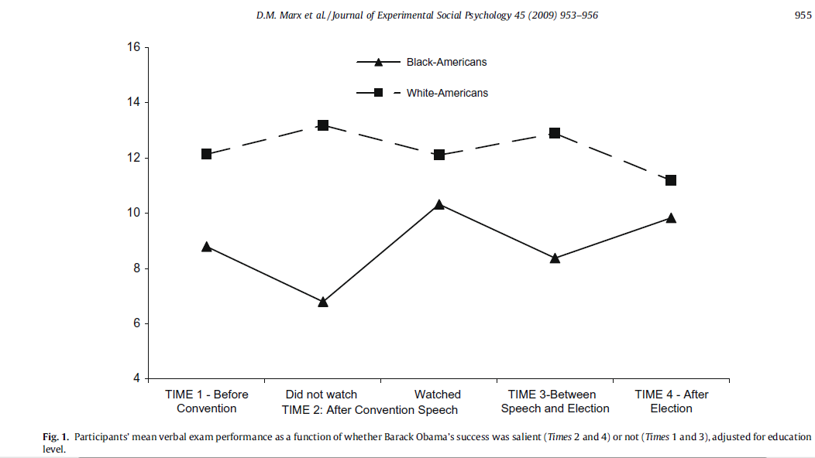

Slide 17
Questions? Comments?

Slide 18
Impacting Stereotype Threat

Slide 19
Interventions: Initial Mixed Results
Self-theory interventions reduced stereotype threat effects for female students but not for Latino or Black students (Good, Aronson, & Inzlicht, 2003)
Obama effect reminder intervention did not reduce stereotype threat effects for Black students (Aronson et al., 2009)
Teaching students about stereotype threat reduced its effects on female students (Johns et al., 2005)

Slide 20
Different Types of Stereotype Threat?
Shapiro & Neuberg (2007) argue that there are two types of stereotype threat
Group-as-target stereotype threats: concerns that a stereotype-relevant performance will reflect poorly on the abilities of one's group
Self-as-target stereotype threats: concerns that a stereotype-relevant performance will reflect poorly on one's own abilities.

Slide 21
Differentiated Interventions
Role model interventions effective at reducing group-as-target stereotype threat
Reading an article about successful member of same group before experiment
Self-affirmation interventions effective at reducing self-as-target stereotype threat
Writing an essay about personal most important value and an example of how they embodied it
Effective for both female and Black students

Slide 22
More general findings
Meta-analysis (Liu, Liu, & Wang, 2021)
Found that interventions around beliefs and identity generally more effective than interventions around overall resilience or grit
Across groups/categories

Slide 23
Questions? Comments?

Slide 24
Anxiety

Slide 25
Anxiety
State anxiety
“Trait anxiety”
Math anxiety, science anxiety, language anxiety

Slide 26
Anxiety
Generally associated with worse performance across a lot of studies
Hembree (1988) reviewed 562 studies on test anxiety
Effects peak in middle school, then diminish as students get older (von der Embse et al., 2018)

Slide 27
Anxiety
Can lead students to not trust their correct answers
See, for instance, Andres et al. (2021), which found that anxious students were more likely to delete correct answers (in online learning)

Slide 28
How does anxiety work?
Anxiety and stereotype threat both occupy working memory (Maloney et al., 2013)
Effectively creating extraneous cognitive load and reducing performance

Slide 29
Questions? Comments?

Slide 30
Executive Function/Control
The management, regulation, and control of cognitive processes

Slide 31
Executive Function/Control
The management, regulation, and control of cognitive processes
Can be impaired by pre-occupying thoughts or stressors (as discussed in Mullainathan & Shafir reading)

Slide 32
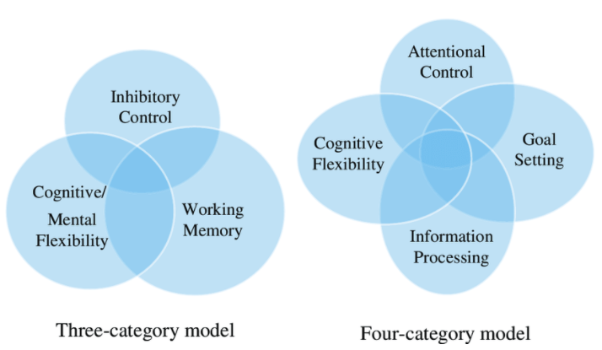
Categories of Executive Function (Ackerman & Friedman-Krauss, 2017)

Slide 33
Who here can would be willing to share an example
Failure in your own attentional control
What was the situation
What did you do
What was the outcome

Slide 34
Who here can would be willing to share an example
Failure in your own inhibitory control (beyond attention)
What was the situation
What did you do
What was the outcome

Slide 35
Who here can would be willing to share an example
Failure in your own ability to show cognitive/mental flexibility
What was the situation
What did you do
What was the outcome

Slide 36
Questions? Comments?

Slide 37
We talked two weeks ago…
About the difficulty of training executive function through brain games

Slide 38
But executive function is malleable early in life
Poverty strong predictor of poorer executive function (Raver et al., 2013; Allee-Hernon & Roberts, 2019), even into adulthood (Evans et al., 2021), in part due to household chaos and parental stress
Teacher stress also predicts poorer executive function in children (Neuenschwander & Friedman-Krauss, 2017)
Less-structured time supports development of executive function (Doebel et al., 2021)
Childhood use of electric babysitter (aka television) associated with poorer long-term executive function (Lillard & Peterson, 2011)

Slide 39
Comments? Questions?

Slide 40
Final Activity
We have covered a lot this semester
A lot of thinkers
A lot of empirical work
Please go into breakout groups, look back through the course syllabus, and discuss
What are some things you learned in this class this semester that will probably be useful to you going forward?
When we return, everyone should post one thing to the chat that they learned and think is useful

Slide 41
Thank you all for a great semester
I learned a lot from all of you – thank you

Slide 42
Upcoming Tasks
12/20: Final Paper due
12/21: Celebrate at home
12/22-: Please please flatten the curve

