Slide 1
Foundations of Teaching and Learning
December 3, 2021

Slide 2
Assignment 4
Any questions?

Slide 3
Today’s Class
Snake Oil
Good Stuff

Slide 4
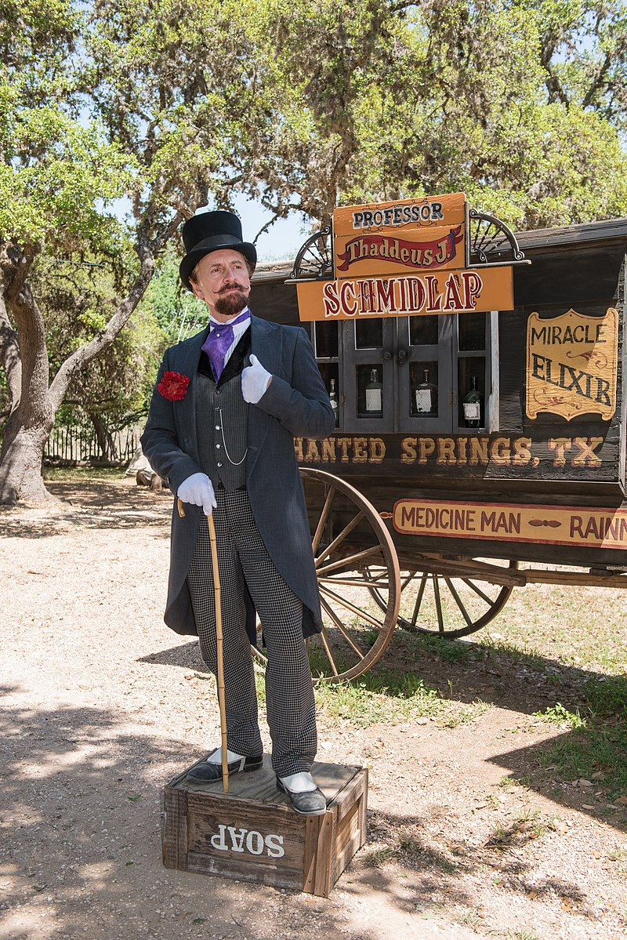
Snake Oil

Slide 5
Learning Styles

Slide 6
Learning Styles
“But why aren’t any of you talking about what every teacher knows is the most important thing in education – what a student’s learning style is?” – Senior program officer at very important scientific foundation

Slide 7
Who here…
Thinks of themselves as a verbal learner?
Thinks of themselves as a visual learner?

Slide 8
What did Pashler et al.’s survey reveal?

Slide 9
What did Pashler et al.’s survey reveal?
Why do people want to believe in learning styles still?

Slide 10
Worth noting
Muñoz-Merino and his colleagues (2014) have found evidence that there is stable preference for competition versus cooperation
And that better outcomes are achieved if you align to this preference
Very different than traditional learning styles

Slide 11
Comments? Questions?

Slide 12
Who here…
Knows their Myers-Briggs Personality Type?

Slide 13
Who here…
Knows their Myers-Briggs Personality Type?
Incidentally, no personality psychologist really believes in the MBTI anymore ☹
Currently the HEXACO model is trying to topple the Big Five model

Slide 14
The Big Five
Extraversion
Agreeableness
Openness
Conscientiousness
Neuroticism
Individuals who are high in this trait tend to experience mood swings, anxiety, irritability, and sadness. Those low in this trait tend to be more stable and emotionally resilient.

Slide 15
HEXACO
Honesty-Humility: Persons with very high scores on the Honesty-Humility scale avoid manipulating others for personal gain, feel little temptation to break rules, are uninterested in lavish wealth and luxuries, and feel no special entitlement to elevated social status. Conversely, persons with very low scores on this scale will flatter others to get what they want, are inclined to break rules for personal profit, are motivated by material gain, and feel a strong sense of self-importance.
(I’m a skeptic on the unity of the Humility-Honesty dimension, personally)

Slide 16
Comments? Questions?

Slide 17
Neuromyths
What are some myths that are commonly held by educators (and the general population) about neuroscience?

Slide 18
Neuromyths (Howard-Jones, 2014)
We only use 10% of our brains
Learning styles
Right-brained/left-brained learners/people
“Learning problems associated with developmental differences in brain function cannot be remediated by education”

Slide 19
Another neuromyth
First in Math claims their software makes a child’s neurons grow faster than the competitors
"Scientific research shows that this type of learning causes myelin, a neural insulation, to grow and thicken around axons, which connect the brain's neurons to each other. Increased myelin makes the information signal that passes through the neural network faster, stronger, and longer lasting. The result is quicker thinking, and better retention."

Slide 20
Another neuromyth (Grospietsch & Mayer, 2020)
Children must be exposed to as many stimuli as possible early in life or their learning will be impaired for their whole lives

Slide 21
Another neuromyth (Grospietsch & Mayer, 2020)
You can listen to tapes while you sleep and learn unconsciously

Slide 22
Another neuromyth (Grospietsch & Mayer, 2020)
Cross-body exercises better connect your left and right hemispheres and make you smarter overall

Slide 23
Is it a Neuromyth?
Brain training software does not improve cognitive skill (Owen et al., 2010; Stojanoski et al., 2021)
Brain training software improves cognitive skill but at best only for closely-related tasks (Simons et al., 2016; Rossignoli-Palomeque et al., 2018)
Brain training can produce general benefits (McDougall & House, 2012; Gordon et al., 2013)
Review noting continuing disagreement and suggesting that clearer definitions and methods needed (Katz et al., 2018)

Slide 24
Comments? Questions?

Slide 25
Other possible neuromyths you’d like to talk about?

Slide 26
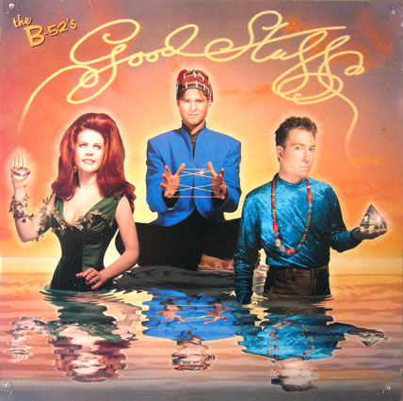
The Good Stuff

Slide 27
Spaced practice

Slide 28
Spaced practice
It works
Returning to a topic periodically
Spaced practice
Is more effective for memory than
Covering it all at once
Massed practice

Slide 29
Spiraling Review
Modern models of memory tend to find that increasing spacing works better than even spacing (i.e. Pavlik & Anderson, 2005, 2008; Khajah et al., 2014)
Which is called spiraling review

Slide 30
Spiraling review
Who here learned in a classroom that used spiraling review (or spaced practice in general)?

Slide 31
Spiraling review
Who here taught in a classroom that used spiraling review (or spaced practice in general)?

Slide 32
Spiraling review
Who here has used a learning app that used spiraling review (or spaced practice in general)?
Duolingo
Anki
Pimsleur

Slide 33
Spiraling Review
Common in USA in 1960s and 1970s
It works, why don’t we use it more?

Slide 34
Comments? Questions?

Slide 35
Interleaving
Switching between topics or between cover stories

Slide 36
What are the benefits of interleaving for learning?
Why might these be seen?

Slide 37
What are the challenges to intensive use of interleaving in education?

Slide 38
What are the challenges to intensive use of interleaving in education?
How could these be addressed?

Slide 39
Testing
Students seem to study more effectively when they know a test is coming up (even a low-stakes quiz)
Why might this be?

Slide 40
If you could take 616 again
Would you prefer it if I used reading quizzes?
Why or why not?

Slide 41
I used to use reading quizzes in 616…

Slide 42
Comments? Questions?

Slide 43
Cognitive Load

Slide 44
Cognitive Load
Intrinsic
Extraneous
Germane
Let’s collaboratively define each of these

Slide 45
Extraneous Cognitive Load
What are some examples?

Slide 46
Extraneous Cognitive Load
What are some examples?
How could we reduce the amount of extraneous cognitive load in each of these examples?

Slide 47
Germane Cognitive Load
What are some examples?

Slide 48
Comments? Questions?

Slide 49
Upcoming Classes
12/10: Emotions and Learning
12/17: Social Factors that Mediate Learning
12/20: Final Paper due

