Slide 1
Adaptive Learning Systems
EDUC5100
Fall 2022

Slide 2
Welcome!

Slide 3
Any questions about
Scaffolding Meta-cognition and SRL
(aka last class)

Slide 4
Any questions about
Assignment 3

Slide 5
We continue today…
With a key direction over the last decade
Tutoring complex behavior

Slide 6
Two steps
Detecting complex behavior
Responding to complex behavior

Slide 7
A Reprise
Let’s connect back to previous lectures
Remember Cognitive Tutor/MATHia
  Model Tracing determines whether student got problem step right
  Knowledge Tracing aggregates across problem steps to assess overall knowledge of skill

Slide 8
We can map this to any assessment of complex behavior
Overall paradigm
  Assessment of complex behavior determines whether student got problem step right
  Knowledge Tracing aggregates across problem steps to assess overall knowledge of skill

Slide 9
Approaches for Recognizing
Complex Behavior
Model tracing
ECD
ML

Slide 10
Approaches for Recognizing
Complex Behavior
Model tracing
ECD
ML
Why isn’t Constraint-Based Modeling listed here?

Slide 11
Model Tracing: Reprise

Slide 12
Production-System Models
Represent performance (and therefore skill) as a set of if-then rules (“productions”)
  Can be written in plain English

Slide 13
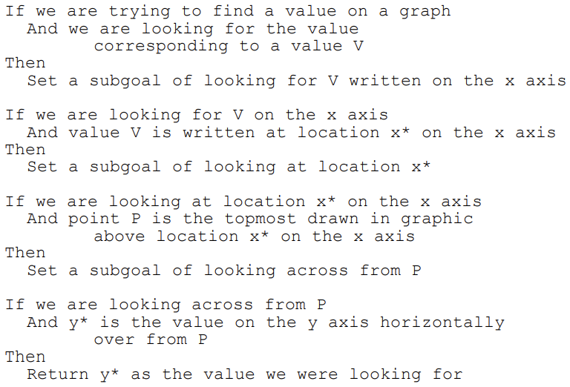
Example (Baker et al., 2001)

Slide 14
Model Tracing: Reprise
Can recognize complex behavior as long as it can be represented by a set of if-then rules
Which is often possible!

Slide 15
Comments? Questions?

Slide 16
Evidence Centered Design
(Mislevy et al., 1997)

Slide 17
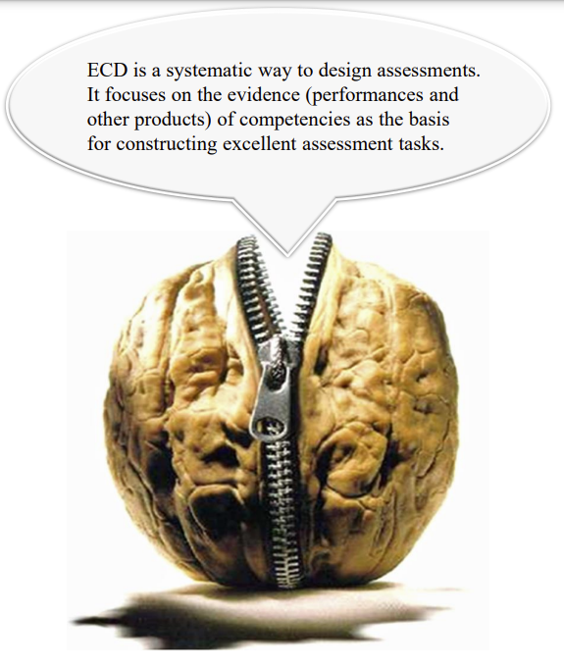
Image from Shute, Kim, Razzouk (n.d.) ECD for Dummies.

Slide 18
ECD
Creates an assessment argument composed of
  Competency Model
    What collection of knowledge, skills, and other attributes should be assessed?
  Evidence Model
    What behaviors should reveal different levels of the targeted competencies?
  Task Model/Action Model
    What tasks/situations can elicit the behaviors that make up the evidence?
  Assembly Model
    How much evidence is required?

Slide 19
Task Model/Action Model
Task Model is situation that learner interacts with, that provides evidence about competencies
Alternate term Action Model is used when situation is dynamic (as in a simulation or game) and a sequence of actions is required to demonstrated competencies
Situations described in terms of
  Presentation format (what student sees)
  Work product (what student does)

Slide 20
Evidence Model: two parts
Evidence Rules: Distill observable variables (features) from the work product
Statistical Model: Express a relationship between the evidence and the competencies we want to assess
Statistical model can be as simple as whether one indicator is present/absent, or adding observable variables together, or as complex as a Bayes Net

Slide 21
How ECD is developed
Rationally/prescriptively
Designer designs situation where skill can be demonstrated
Designer determines what evidence rules and statistical model are

Slide 22
ECD: Notes
Used in situations where situation can be developed so that evidence rules and statistical model can be developed by a designer
Not used where situation is too complex for designer to confidently design evidence rules and statistical model

Slide 23
Examples in a sec
But first, any questions?

Slide 24
ECD Examples

Slide 25
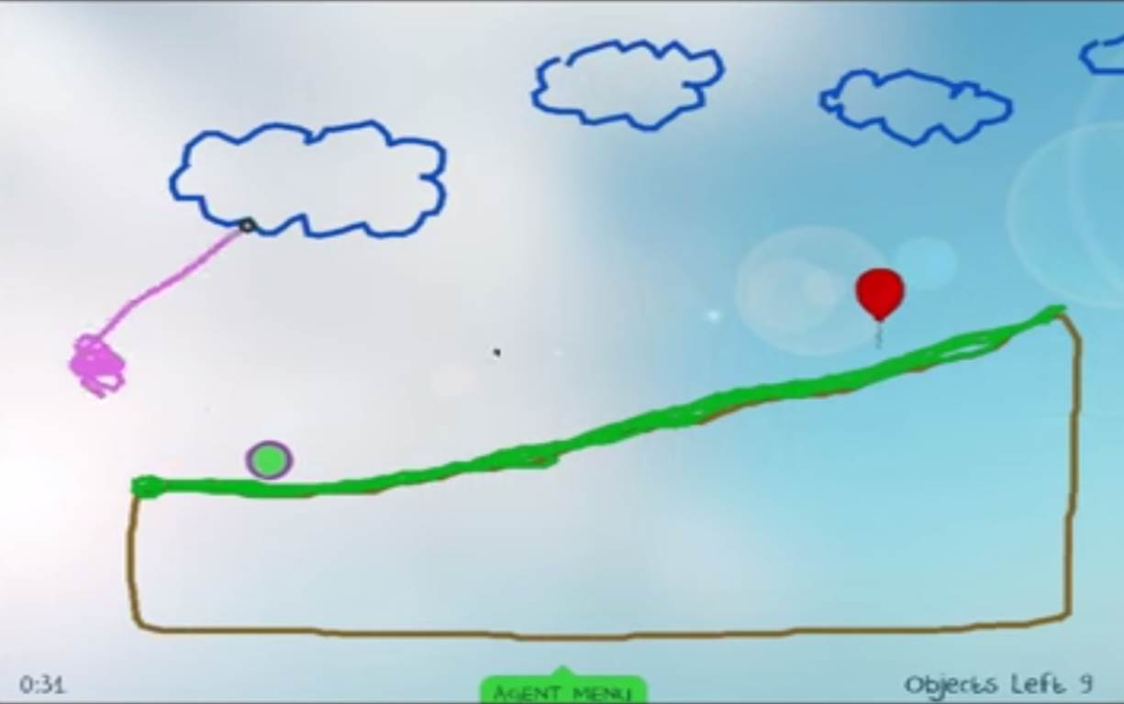
Physics Playground
(Kim et al., 2016)
Probably best-known example of ECD in an adaptive learning system

Slide 26
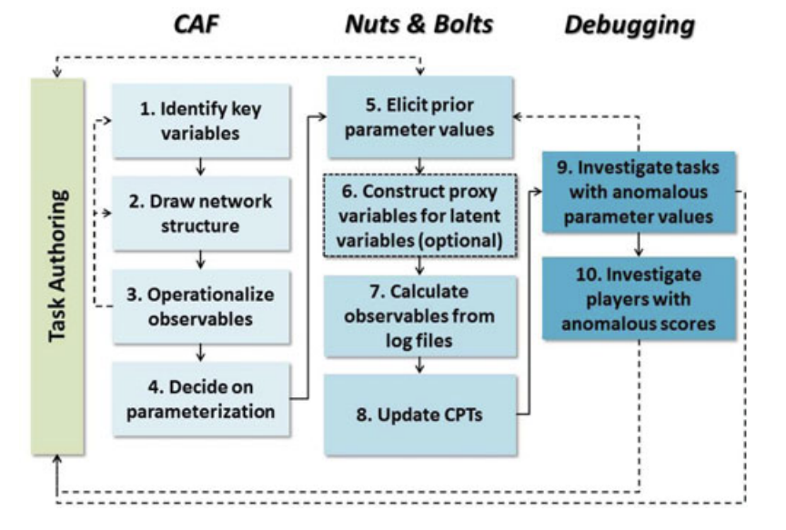
Ten steps to developing model
(Kim et al., 2016)

Slide 27
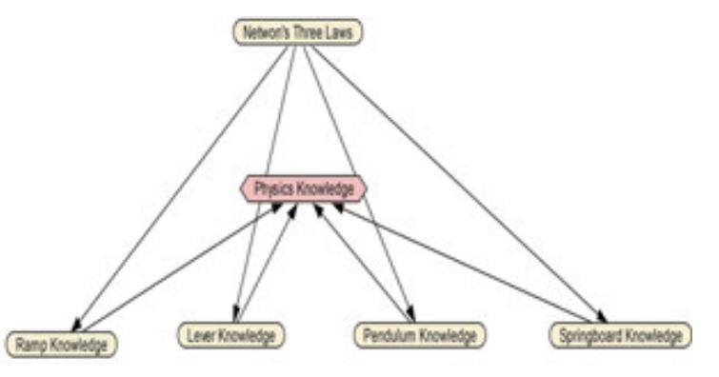
Final competency model
(Kim et al., 2016)
Simplification of earlier model that had attempted to further differentiate types of physics knowledge; would have needed too many game levels

Slide 28
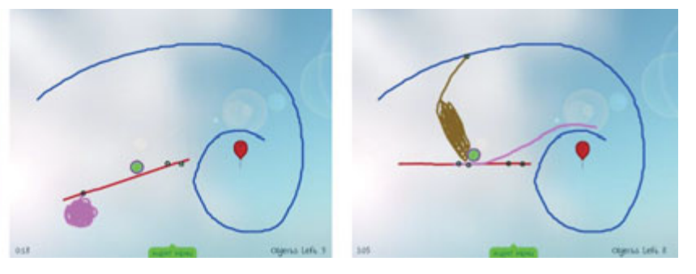
Multiple solutions involving different knowledge
Silver trophy = solved level
Gold trophy = solved level elegantly with minimal objects (requires use of target strategy)

Slide 29
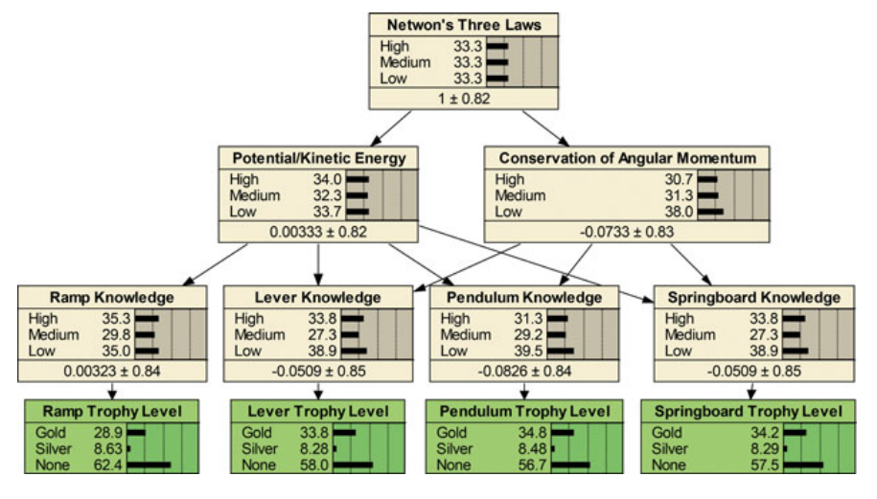
Mapping from evidence to competencies (Kim et al., 2016)

Slide 30
Evidence Identification
(Shute & Moore, 2017a)
Built rational “evidence identification” models to identify which strategy used
Used these to distinguish which reason silver trophy obtained for
“For example, pendulums rotate around a single pin, so any drawn object that does this is most likely a pendulum. Ramps tend to be in contact with the ball for a longer period of time. Levers tend to rotate when the ball comes into contact with them. Springboards tend to be connected to other objects with two pins and include a weight—either attached to the springboard or dropped on it and then deleted.”

Slide 31
Questions? Comments?

Slide 32
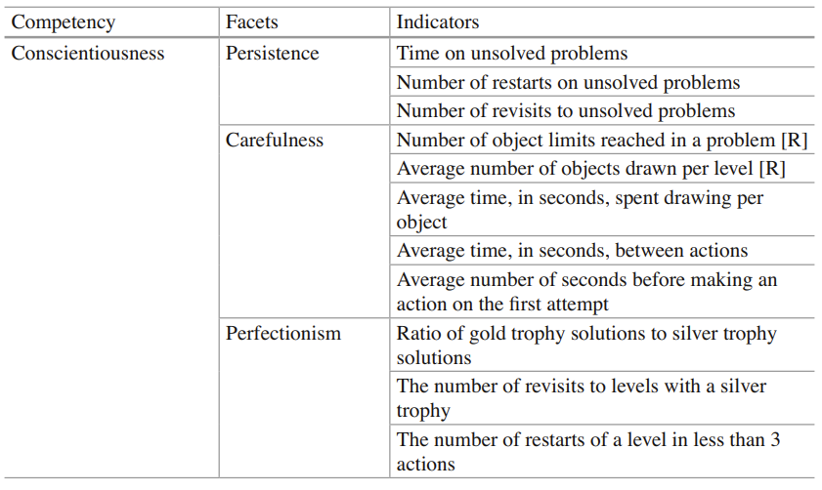
Other uses of ECD in
Physics Playground
Conscientiousness (Shute & Moore, 2017b)

Slide 33
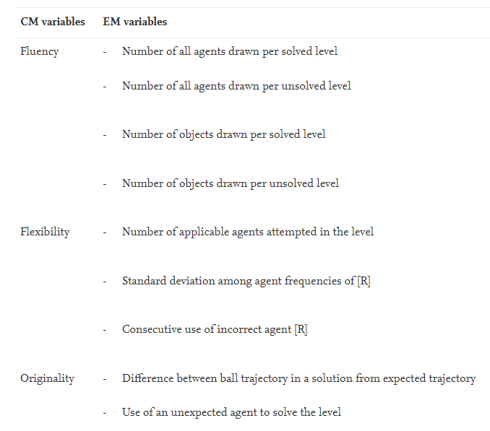
Other uses of ECD in
Physics Playground
Creativity
(Shute &
Rahimi,
2021)

Slide 34
Other uses of ECD in Learning Systems
World of Goo (Shute & Kim, 2012)
Quest to Learn (Shute & Torres, 2012)
Plants versus Zombies (Shute et al., 2015)
Shadowspect (Kim et al., 2019)
CISCO Networking Academy (Behrens et al., 2004)
SimCityEDU (Risconscente et al., 2015)

Slide 35

SimCityEDU

Slide 36
SimCityEDU
Very high-profile collaboration involving ETS, Pearson, GlassLab and a ton of funding
Can ECD be applied to SimCity for assessment?

Slide 37
SimCityEDU: Findings
Yes, but to make assessment easier, scenarios were designed with very few actions available
These scenarios generally weren’t much fun
Project started with great enthusiasm, ended quietly

Slide 38
ECD Strengths and Weaknesses
Your thoughts?

Slide 39
ECD Benefits
(Shute, Kim, & Razzouk, n.d.)
Transparency: ECD models can be inspected and debated for accountability
Convergency: Can handle lots of types of data
Reusability: Parts of model can be used in different situations (for instance, you can adapt evidence model between tasks)
Flexibility: Can be used for many purposes

Slide 40
ECD Barriers
(Shute, Kim, & Razzouk, n.d.)
Over-structuring: Easier to assess if task is very structured, leading designers to structure things too much
  SimCityEDU
Cost: A lot of work to get everything in place
Scope: Need to get competency model at right level, or too hard to build
Rubrics: Can be hard to develop rubrics for complex behavior that are not subjective

Slide 41
Comments? Questions?

Slide 42
ML
The use of machine learning to determine whether a student’s behavior at a specific time demonstrates a competency

Slide 43
ML
The use of machine learning to determine whether a student’s behavior at a specific time demonstrates a competency
We’ve already discussed the use of this for written text (essays) in a past class
  Doing this for short written text is largely the same as for essays (algorithmic methods are a little different)

Slide 44
How is ML trained?
Ground truth labels obtained
Algorithm taught to recognize the ground truth labels

Slide 45
How is ground truth obtained for complex behavior?
Text replays
Screen replays
Then human coding
(Quantitative field observations and video of student faces used to detect affect and disengagement, but not for the type of model we’re discussing today)

Slide 46
Text Replays
Pretty-prints of student interaction behavior from the logs

Slide 47
Examples

Slide 48
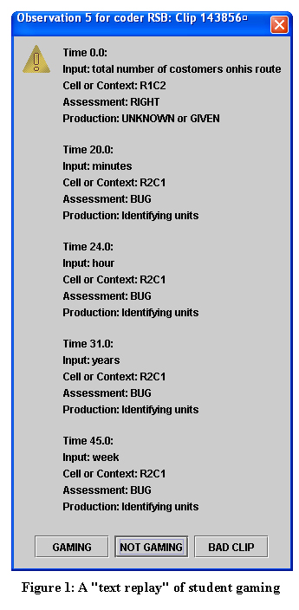

Slide 49
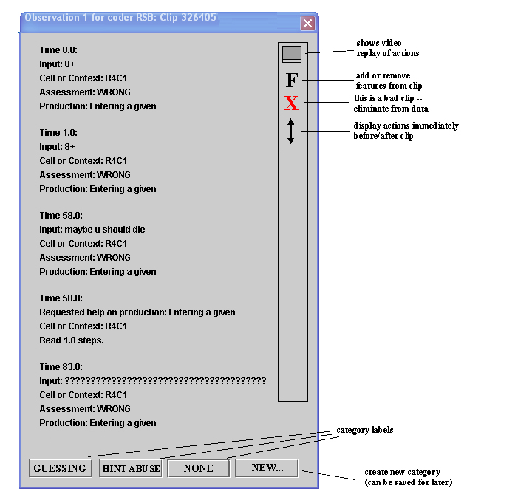

Slide 50
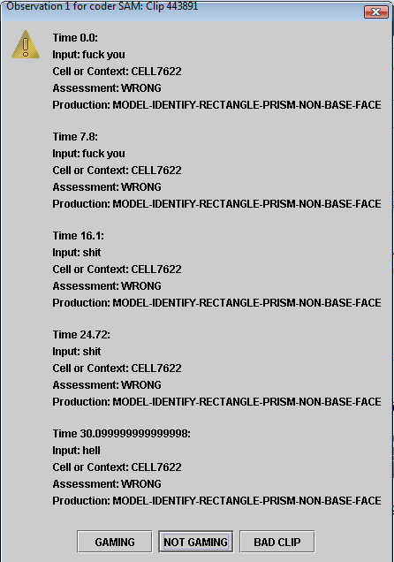

Slide 51
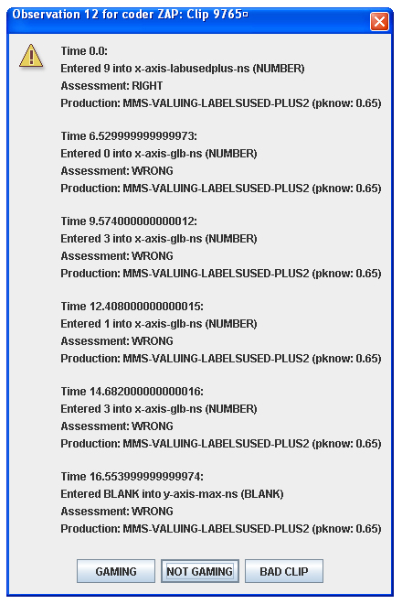

Slide 52
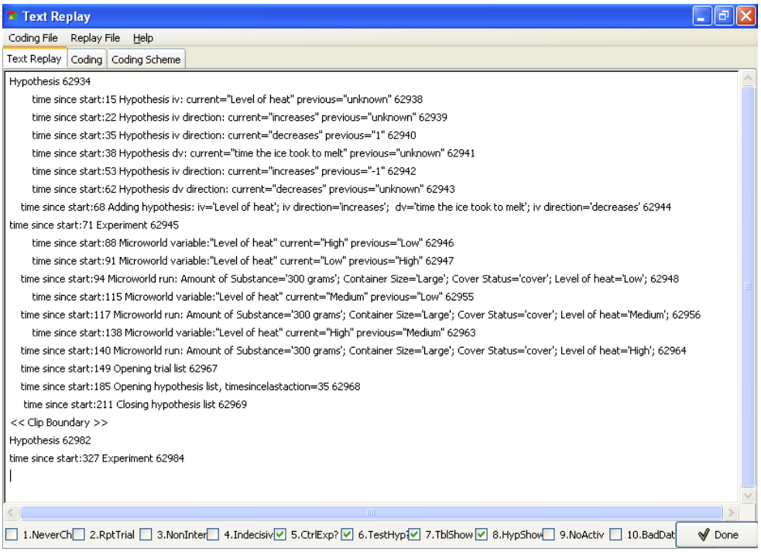

Slide 53
Screen Replays

Slide 54
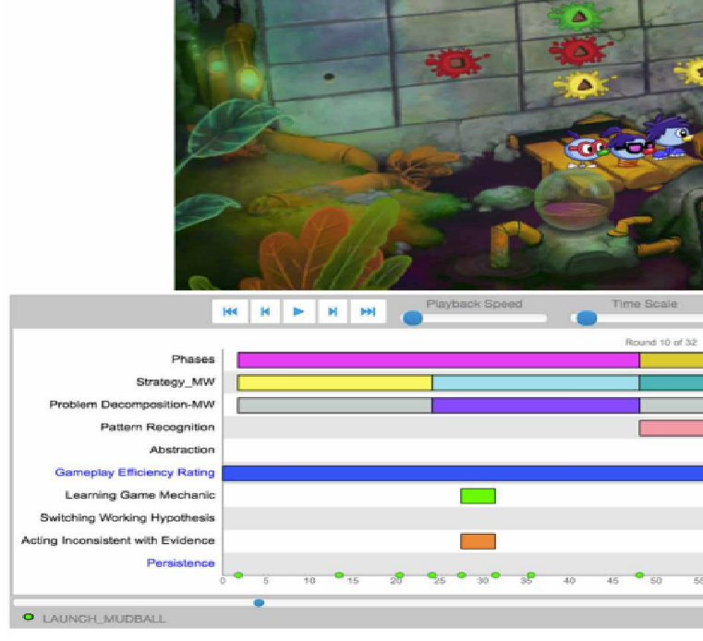

Slide 55
What are the tradeoffs?
Text replays
Screen replays

Slide 56
Questions? Comments?

Slide 57
Inq-ITS
(Sao Pedro et al., 2013)
Slides adapted from Sao Pedro’s dissertation defense

Slide 58
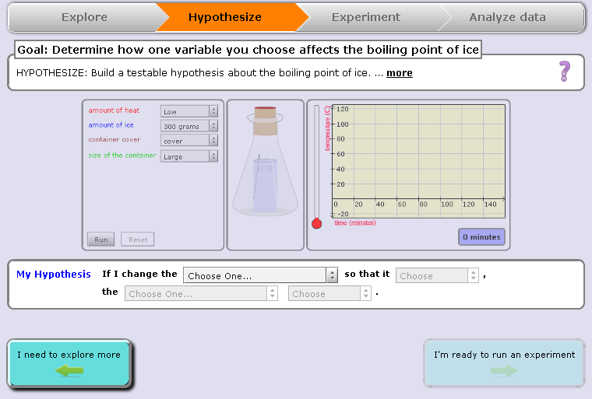
“If I change the amount of ice so that it decreases… the boiling point decreases”
Notes:
(1) Introduce structure first – that we break inquiry down into STAGES. The stages are listed at the top.

Slide 59
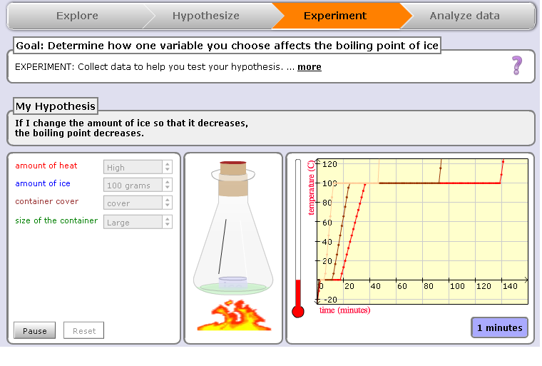

Slide 60
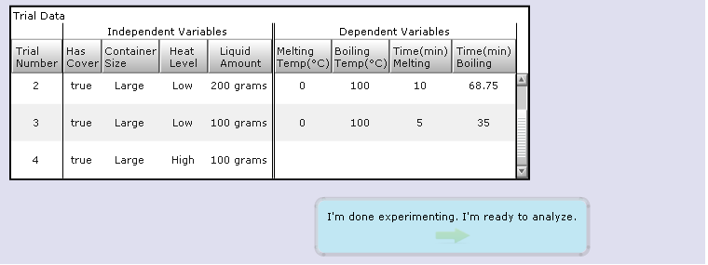

Slide 61
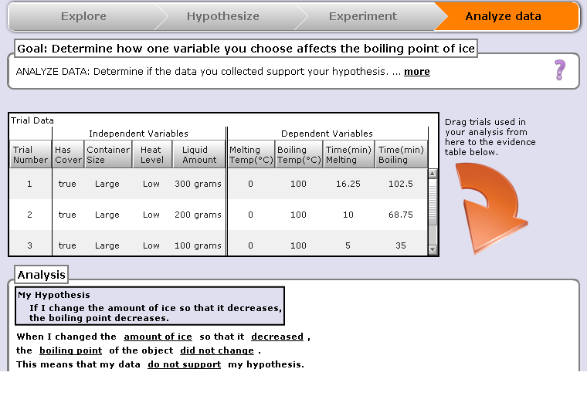

Slide 62
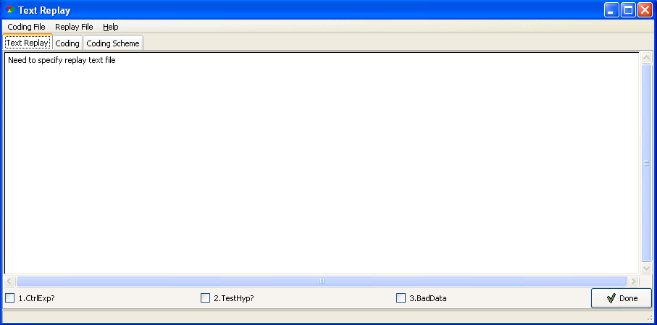
Hypothesis
time since start: 0 Hypothesis iv: current=“Level of heat” previous=“unknown”
time since start: 2 Hypothesis iv direction: current=“increases” previous=“unknown”
time since start: 6 Hypothesis dv: current=“time the ice took to melt” previous=“unknown”
time since start: 8 Hypothesis dv direction: current=“decreases” previous=“unknown”
time since start: 12 Adding hypothesis: iv=“Level of heat” iv direction=“increases”
dv=“time the ice took to melt” dv direction=“decreases”
time since start: 16 Experiment
time since start: 22 Variable change: “Level of heat” current=“High” previous=“Low”
time since start: 23 Run: Level of heat=“High”, Cover=“Off”, Container Size=“Small”, …
time since start: 27 Reset Experiment
time since start: 30 Variable change: “Level of heat” current=“Med” previous=“High”
time since start: 32 Run Experiment: Level of heat=“Med”
time since start: 51 Reset Experiment
time since start: 52 Run: Level of heat=“Med”, Cover=“Off”, Container Size=“Small”, …
<<Clip Boundary>>
Text Replay Tagging:
Inter-Rater Reliability (between human coders)
Designing Controlled Experiments: κ = .69
Testing Stated Hypotheses: κ = 1.00
Notes:
Other detectors = gaming the system
Just don’t forget to say that this is just one example of student work. In some cases students ran several trials and engaged in a wide variety (variation) of data collections.

Slide 63

Build and Validate Detectors
Remove Features
Build Model
X
X
Training
?
Inter-correlated
r >= .6
J48 Decision Trees
Test
Six-fold cross-validation by student
Training
Tagged Clips
Test
Notes:
This algorithm was chosen based on previous successes in generating behavior detectors using text replays (Baker & de Carvalho, 2008; Baker, Mitrovic & Mathews, 2010).

Slide 64
Features Used
(Sao Pedro et al., 2012)
Selected by domain experts for relevance
All actions count
Total run count
Complete run count
Num variable changes made when designing experiments
Num changes to variables associated with stated hypotheses when designing experiments
Adjacent and pairwise controlled experiments counts (both with and without considering repeats)
Pairwise and adjacent repeat trials counts
The number of simulation pauses

Slide 65
Algorithm Used: J48 Decision Trees
Classical Machine Learning algorithm
Predicted human labels from combination of features

Slide 66
Integrating Evidence
Each time a student completes a simulation, performance is evaluated as to whether it reflects the two skills
Evidence aggregated across simulations into a mastery estimate using BKT

Slide 67
Generalizability of Detection
Predicts inquiry performance in real-world tasks (San Pedro et al., 2013) and across learning domains (San Pedro et al., 2014)
  Between physics topics
  Between physics and biology

Slide 68
Questions? Comments?

Slide 69
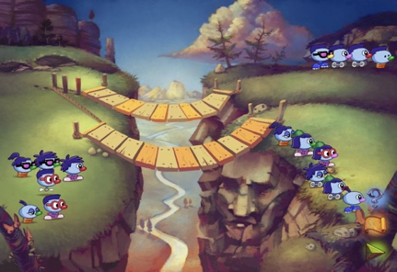
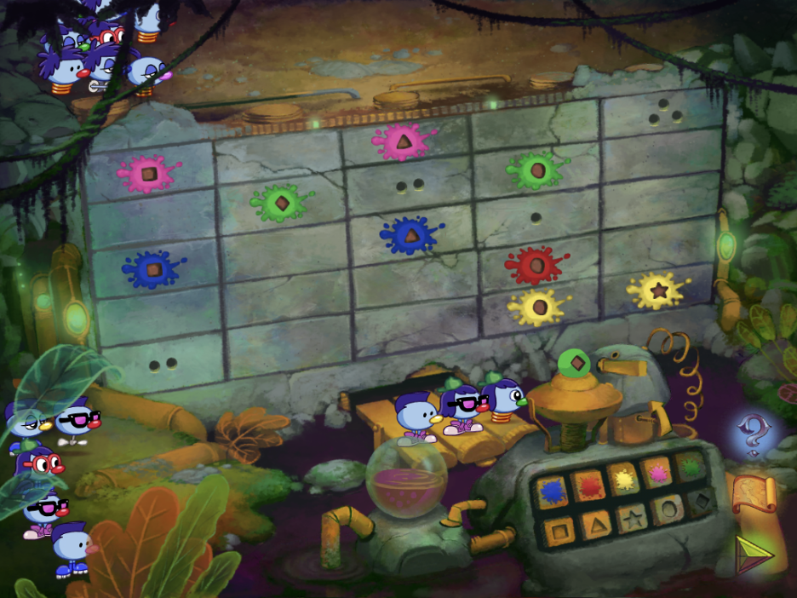
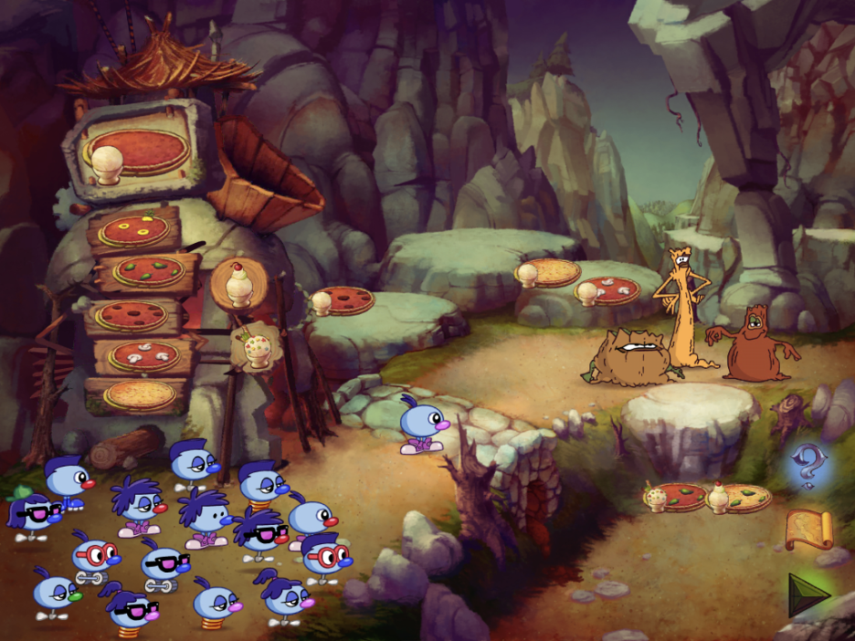
Zoombinis
(Rowe et al., 2019, 2021)
Pizza Pass
Allergic Cliffs
Mudball Wall

Slide 70
Computational Thinking
“The conceptual foundation required to solve problems effectively and efficiently (i.e., algorithmically, with or without the assistance of computers) with solutions that are reusable in different contexts” (Shute, Sun, & Asbell-Clarke, 2017).
“CT is often described as a set of thinking practices that may include: problem decomposition, abstraction, algorithmic thinking, conditional logic, recursive thinking, and debugging.” (Asbell-Clarke et al., 2020)

Slide 71
Computational Thinking:
Constructs Studied
Problem Decomposition: reducing the complexity of a problem by breaking it into smaller, more manageable parts.
Pattern Recognition: seeing trends and groupings in a collection of objects, tasks, or information.
Abstraction: generalizing from observed patterns and making general rules or classifications about objects, tasks, or information by discerning relevant from irrelevant information.
Algorithm Design: establishing reusable procedures that solve sets of problems.

Slide 72
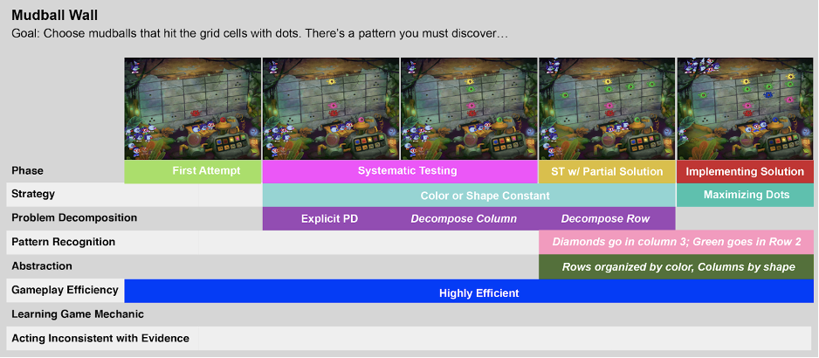
Hand Labeling: Video Coding
Interrater reliability over 0.7 for all constructs
Notes:
This is an overview of labeling of the Mudball puzzle using the Data Arcade tool.
For each puzzle, two researchers labeled all rounds of gameplay except the first round.

Slide 73
Detector Development
Feature engineering → classic machine learning algorithm approach

Slide 74
Detector Development
74-113 features created for each puzzle
  Based on past feature engineering experience on team, ideas from domain experts
  41 features common across all puzzles
Feature values were aggregated at the round level when detecting gameplay efficiency and strategies

Slide 75
Category | Example Feature | Feature Rationale
Pizza Pass, Mudball Wall, and Allergic Cliffs
Overall Gameplay: These features describe general aspects of a student’s play such as the outcome of each round (all Zoombinis through, Some Zoombinis through, no Zoombinis through, Quit) | Number of Zoombinis ejected from the puzzle | Zoombinis being ejected from the puzzle is a significant sign play is not going well.
Topping Futzes (Pizza Pass only): Switches toppings before the pizza is delivered to the troll. | Number of futzes since last pizza | More futzing may indicate that the player is unsure about their next move.
Mudball Duplicates (Mudball Wall only): These features capture the extent to which learners throw similar mudballs at the wall | Current consecutive number of duplicate mudballs | Duplicate mudballs are wasted resources because no new information is gained. This suggests players may not understand the game mechanic.
Zoombini Timing (Allergic Cliffs only): These features describe the speed with which learners select Zoombinis to cross the bridges. | Time since the last unsuccessful Zoombini. | More time since the last unsuccessful Zoombini may indicate if players have figured out the underlying rule

Slide 76
Detector Development
Separate detectors built for each CT category in Pizza Pass, Mudball Wall, and Allergic Cliffs
Tried multiple classic ML algorithms; took best performing for each model
  W-J48
  W-JRip
  Linear regression with a step function
  Naive Bayes

Slide 77
Comments? Questions?

Slide 78
Other Uses of this Paradigm
Impulse (Rowe et al., 2014)
RumbleBlocks (Harpstead et al., 2015)
Progenitor X (Owen et al., 2016)
CueThink (Zhang et al., 2021)

Slide 79
ML Strengths and Weaknesses
Your thoughts?

Slide 80
When might one prefer ECD?

Slide 81
When might one prefer ML?

Slide 82
When might one prefer
Model Tracing?

Slide 83
Integrating into KT
Quite easy
ECD typically provides [0,1] outputs – can be integrated into KT just like traditional items
ML typically provides {0,1} probabilities – easy to integrate into KT with simple extensions (Sao Pedro et al., 2013)

Slide 84
Scaffolding Complex Behavior

Slide 85
Inq-ITS

Slide 86
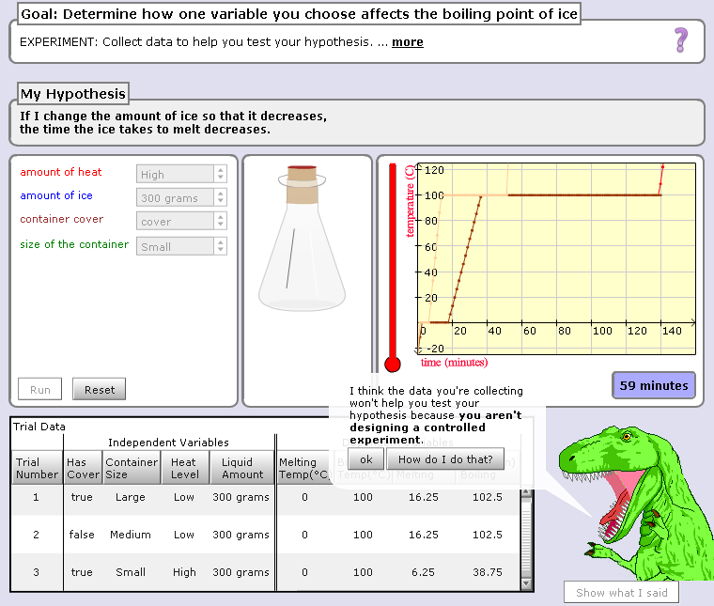

Slide 87
Hey, are you just playing with the buttons? Take your learning seriously or I will eat you!!!

Slide 88
Result
Significantly better performance (Sao Pedro et al., 2013; Gobert et al., 2018)
Transferred to other topics (Li et al., 2019)

Slide 89
Questions? Comments?

Slide 90
Deep Thought
(Stamper et al., 2013)
Logic proof tutor
Modeling approach a bit different, but scaffolding relevant

Slide 91
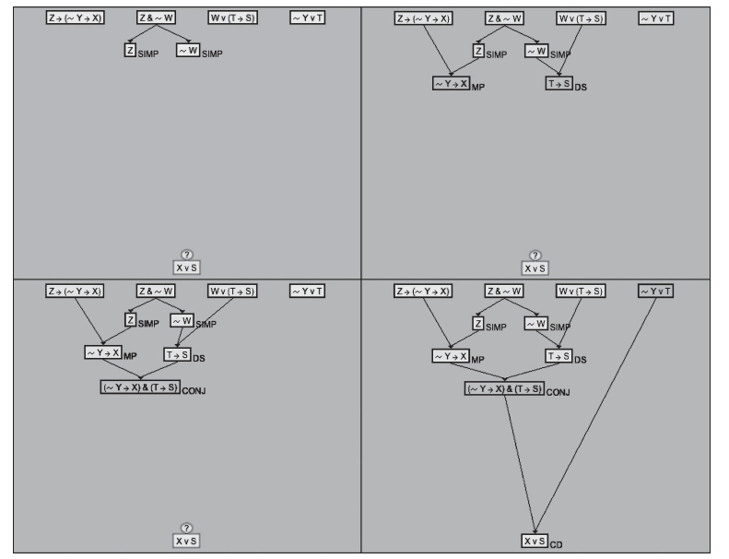

Slide 92
Deep Thought
(Stamper et al., 2013)
Logic proof tutor
Recommended next action to students based on previous actions
  By students who had eventually solved proof
  That were same as current student’s process so far

Slide 93
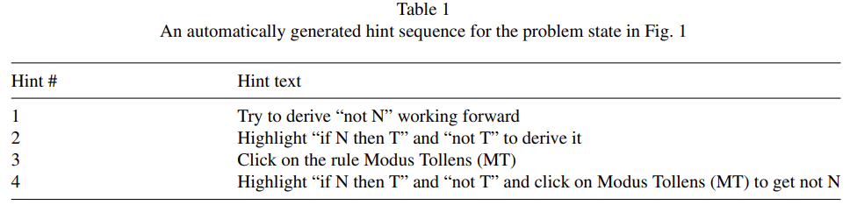
Example of Hint

Slide 94
Deep Thought
(Stamper et al., 2013)
Led to better post-test score and better course grade
Also reduced quitting behavior

Slide 95
Questions? Comments?

Slide 96
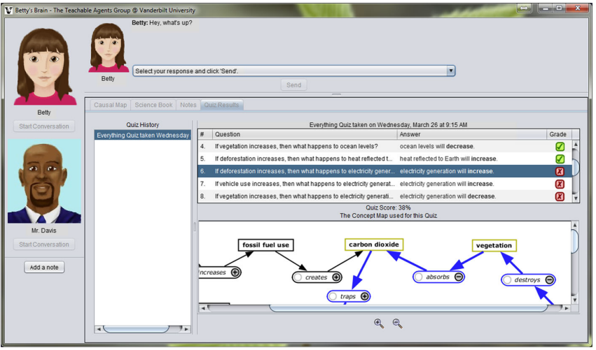
Betty’s Brain

Slide 97
Mr. Davis
(Leelawong et al., 2008)
Provides feedback when student provides incorrect answers or when student demonstrates poor SRL strategy

Slide 98
Mr. Davis
(Leelawong et al., 2008)
“Betty, to do well on this quiz you must understand the causal relationships that make up the chain of events that happen in the river. A chain of direct relationships produces a chain of events. Paying attention in class leads to better understanding and better understanding produces better grades is an example of a chain of events.
Betty, below is a part of the chain of events you need to know to answer the quiz 2 questions correctly. Your tutor will have to figure out how to use these hints to teach you with the concept map, but you can help your tutor by giving explanations for your answers to the quiz questions. Remember it is a good idea for your tutor to get an explanation from you for the first question on this quiz. Check back here after you take the quiz again for more parts of the chain.
Fish live in the river, and while they help algae by exhaling carbon dioxide, algae also depend on fish and macroinvertebrates in another way. Fish make their waste in the river, and this waste plays an important role in the interdependence between fish and algae.
Also, don't forget to look at the resources if you need more information.”

Slide 99
Questions? Comments?

Slide 100
Physics Playground
(Bainbridge et al., 2021)
When student demonstrates they do not know a competency, system provides video
  Showing related puzzle
  Providing narration
https://www.youtube.com/watch?v=aHP8Ex0HaBY

Slide 101
Physics Playground
(Bainbridge et al., 2021)
Led to better performance on far transfer test
But, oddly, not on near transfer test

Slide 102
These examples are very different from each other

Slide 103
Huge Space of Potential Interventions

Slide 104
Huge Space of Potential Interventions
Stealth interventions that change learner experience in subtle ways
Reports to student or instructor
Hints and messages
Videos
Embodied behaviors by agents
Many more

Slide 105
Questions? Comments?

Slide 106
Activity
Let’s say that we can detect that a student is unable to change a car’s oil in a VR simulation
Sketch what you would have the learning system do
We’ll share out answers in a few minutes

Slide 107
Activity
Let’s discuss some of the solutions

Slide 108
Last comments and questions?

Slide 109
Upcoming classes
Nov 17
  Dialogue Tutors
Nov 22
  Embodied Agents
  VIRTUAL CLASS
Dec 1
  Games and Gamification
  VIRTUAL CLASS

Slide 110
The End

