Slide 1
Adaptive Learning Systems
EDUC5100 Fall 2022

Slide 2
Welcome!

Slide 3
Any questions about
Assignment 3

Slide 4
Continuing From Last Time

Slide 5
Activity
Let’s say that we can detect that a student is unable to change a car’s oil in a VR simulation
Sketch what you would have the learning system do
We’ll share out answers in a few minutes

Slide 6
Activity
Let’s discuss some of the solutions

Slide 7
Last comments and questions on Tutoring Complex Behavior?

Slide 8
We continue today…
With “The educational technology of the future”

Slide 9
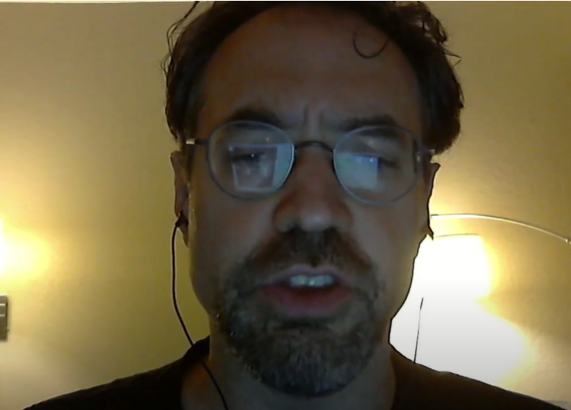
We continue today…
With “The educational technology of the future”
“And it always will be. Hah.”

Slide 10
We continue today…
With “The educational technology of the future”
Tutorial Dialogue aka Knowledge Construction Dialogues

Slide 11
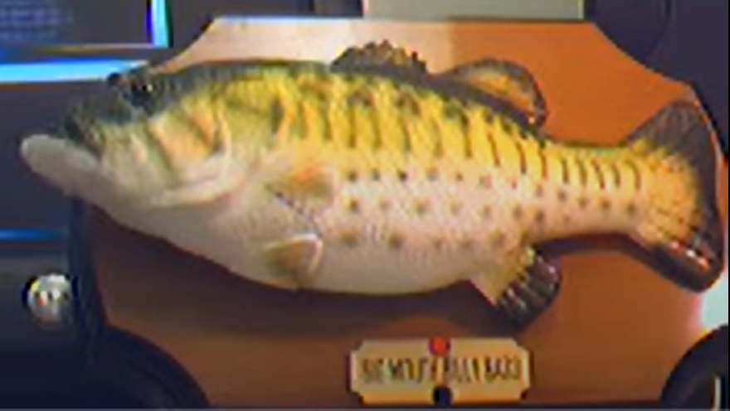
You’ve seen the fish

Slide 12
But does it work? And how does it work?

Slide 13
To learn, we go to the Maestros
Art Graesser
Kurt VanLehn

Slide 14
Alas, no dialogue tutor is available
Art Graesser
Kurt VanLehn

Slide 15
But they have been kind enough to put slides on the web
Art Graesser
Kurt VanLehn

Slide 16
A framework for thinking about dialogue tutors (VanLehn, 2009)

Slide 17
Human tutorial dialogue is a sequence of episodes, one per step
Slide from VanLehn (2009)
Q: Why does a computer need disk as well as RAM?
Step
S: RAM is too small. Only the disk is big enough.
T: That’s usually true. But suppose you bought a lot of RAM? Why wouldn’t that work?
S: The battery would run out too fast.
T: Excellent. What else?
S: That’s it.
T: What if the battery dies?
S: Oh. The RAM dies.
T: Anything wrong with that?
S: You lose your files.
T: Besides the user’s files, what else would be lost?
S: Beats me.
T: The operating system!
Step
Step

Slide 18
Schematic of tutorial dialogue
Slide from VanLehn (2009)
Problem statement
Step
Step
Step
Step
Answer
Reflection (optional)

Slide 19
Schematic of dialogue about a single step
Slide from VanLehn (2009)
Step end
T: Tell
Step start
T: Elicit
S: Correct
Remediation:
T: Hint, or prompt, or explain, or analogy, or …
S: Incorrect

Slide 20
Comparisons of expert to novice human tutors
Slide from VanLehn (2009)
Step end
Novices
T: Tell
Step start
Experts
T: Elicit
S: Correct
T: Hint, or prompt, or explain, or analogy, or …
S: Incorrect
Experts may have a wider variety

Slide 21
Comments? Questions?

Slide 22
Fairly simple process
How does it work in the most complex/complete system, AutoTutor?

Slide 23
Slide from Graesser (2017)

Slide 24
Slide from Graesser (2017)
Which of these seem most valuable?

Slide 25
Slide from Graesser (2017)
Which of these would you question?

Slide 26
Slide from Graesser (2017)

Slide 27
Slide from Graesser (2017)

Slide 28
Slide from Graesser (2017)

Slide 29
Slide from Graesser (2017)
Which of these might you want to add?

Slide 30
Thoughts so far? Comments?

Slide 31
Slide from Graesser (2017)

Slide 32
Slide from Graesser (2017)
Does this seem OK/safe?

Slide 33
Slide from Graesser (2017)

Slide 34
Slide from Graesser (2017)

Slide 35
Comments? Questions?

Slide 36
Slide from Graesser (2017)

Slide 37
Slide from Graesser (2017)

Slide 38
Slide from Graesser (2017)

Slide 39
Slide from Graesser (2017)

Slide 40
Any questions?

Slide 41
Slide from Graesser (2017)

Slide 42
Slide from Graesser (2017)

Slide 43
Slide from Graesser (2017)

Slide 44
Comments? Questions?

Slide 45
Slide from Graesser (2017)

Slide 46
Slide from Graesser (2017)

Slide 47
Comments? Questions?

Slide 48
Slide from Graesser (2017)

Slide 49
Slide from Graesser (2017)

Slide 50
Slide from Graesser (2017)

Slide 51
Last comments or questions regarding AutoTutor?

Slide 52
AutoTutor Lite (Hu et al., 2009)
Building AutoTutor content is expensive and time-consuming
Essentially, one-PhD-student-PhD-duration to build a tutor on a specific topic
About the same as a model tracing tutor

Slide 53
AutoTutor Lite (Hu et al., 2009)
Designed for easier authoring
Does not offer full range of semantic analysis methods
Limited to LSA and keyword-based analysis
Simplified student model
Relevance of the contribution (calculated as the degree of semantic similarity to expected answers)
Novelty (semantic similarity to the learner’s previous contributions)
Does not detect misconceptions
Much less dialog flexibility
Focuses on question and answer
Gives prompts to incomplete answers
Can also offer vicarious tutoring

Slide 54
Comments? Questions?

Slide 55
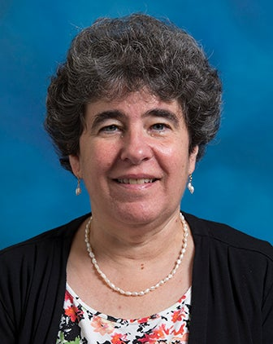
ITSPOKE (Litman & Silliman, 2014)
A dialogue tutor, but speaking out loud
Built on Why2-Atlas tutor (VanLehn et al., 2002)
Can detect uncertainty/confusion from speech patterns, tone of voice (Litman & Forbes-Riley, 2011, 2013)
Responds to uncertain correct answers by giving additional info on why answer is correct and continuing discussion
Did not improve learning outcomes

Slide 56
Comments? Questions?

Slide 57
Contemporary Scaled Dialogue Tutors

Slide 58
Watson Tutor (Ventura et al., 2018; Afzal et al., 2019)
Large-scale use of AutoTutor-style approach for several courses
Also adds multimedia hints
Papers are vague on what courses it is integrated into, but Afzal et al. (2019) shows examples from what appears to be middle school physical science

Slide 59
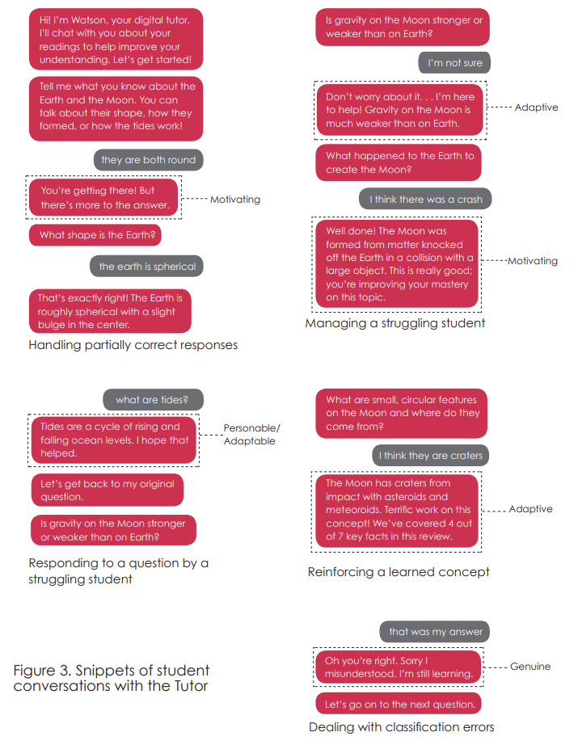

Slide 60
Questions? Comments?

Slide 61
KorbitITS (Kulshreshtha et al., 2022)
Dialogue Tutor for data science that generates responses using foundation model AI
Breaks student answer into cause-effect components
Matches components to reference answers using foundation model

Slide 62
KorbitITS (Kulshreshtha et al., 2022)
Generates feedback based on
Example responses for other topics
Correct reference answers
Foundation model to combine these into feedback for current question
Algorithm that ranks possible responses based on foundation models detectors of sentence
Well-formedness
Perplexity (bad)
Likelihood of leading to complex (non-yes/no) response
Semantic relationship to desired target sentence

Slide 63
KorbitITS (Kulshreshtha et al., 2022)
Four feedback cases
Incorrect cause and incorrect effect
Incorrect cause alone
Incorrect effect alone
Missing cause

Slide 64
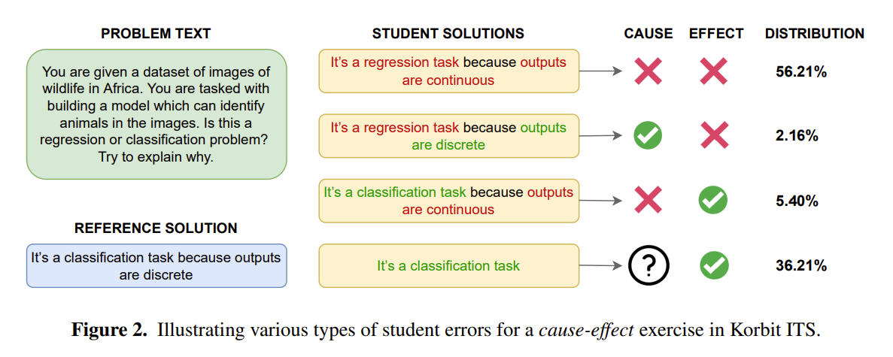
KorbitITS (Kulshreshtha et al., 2022)

Slide 65
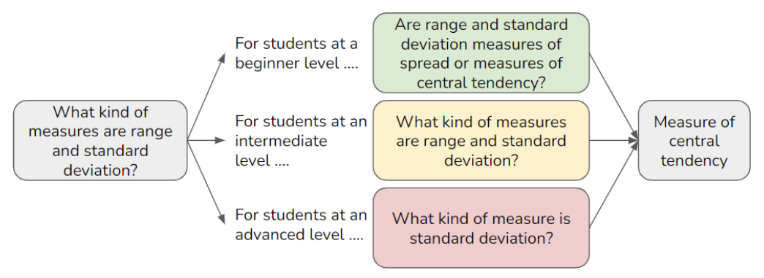
KorbitITS (Elkins et al., 2022)
System adapts question for students of different overall ability
While retaining same answer

Slide 66
Questions? Comments?

Slide 67
Contemporary Scaled Dialogue Tutors
Maybe the future is here?

Slide 68
Contemporary Scaled Dialogue Tutors
Maybe the future is here?
Nooooooooooooooooooo

Slide 69
Broader Comments or Questions?

Slide 70
Upcoming classes
Nov 22 SPECIAL DAY
Embodied Agents
VIRTUAL CLASS
NO OFFICE HOURS
Dec 1
Games and Gamification
VIRTUAL CLASS
NO OFFICE HOURS
Dec 8
A/B Testing and Iterative Refinement

Slide 71
The End

