Slide 1
Adaptive Learning Systems
EDUC5100 Fall 2022

Slide 2
Continuing from last class…

Slide 3
Gamification Features (Lomas et al., 2017)
Novelty
Operationalized as frequency of changing gaming parameters

Slide 4
Gamification Features (Lomas et al., 2017)
Novelty
What might be some ways to mess this up?

Slide 5
Gamification Features (Lomas et al., 2017)
Suspense
How close the player is to losing

Slide 6
Gamification Features (Lomas et al., 2017)
Suspense
What might be some ways to mess this up?

Slide 7
Gamification Features (Johnson et al., 2005)
Fish Tanks and Sandboxes
Initially give player version of game with fewer features (Fish Tank) or where student can’t lose (Sandboxes)

Slide 8
Gamification Features (Johnson et al., 2005)
Fish Tanks and Sandboxes
What might be some ways to mess this up?

Slide 9
Gamification Features (Wouters & van Oostendrop, 2017)
Narrative

Slide 10
Gamification Features (Wouters & van Oostendrop, 2017)
Narrative
What might be some ways to mess this up?

Slide 11
Gamification Features (Wouters & van Oostendrop, 2017)
Narrative
What might be some ways to mess this up?
Several studies find improved engagement but uncertain learning effect (Wouters & van Oostendrop, 2017)

Slide 12
Anti-Gamification Feature (Mayer et al., 2019)
Prompting player to write self-explanations during gameplay
Leads to better learning
But does the game still feel like a game?

Slide 13
Other Features?
Has anyone here seen another gamification feature they would like to discuss?

Slide 14
Beyond the game
Several papers find that providing non-game activities relevant to game concepts before or after gameplay improves learning (Mayer et al., 2019)
What are your thoughts on this?

Slide 15
Breakout Task
In a minute, I will put you into breakout rooms
Your task: take Aplusix: Algebra Assistant and make it fun (without totally rewriting it)
Try to come up with ideas you think will genuinely work

Slide 16
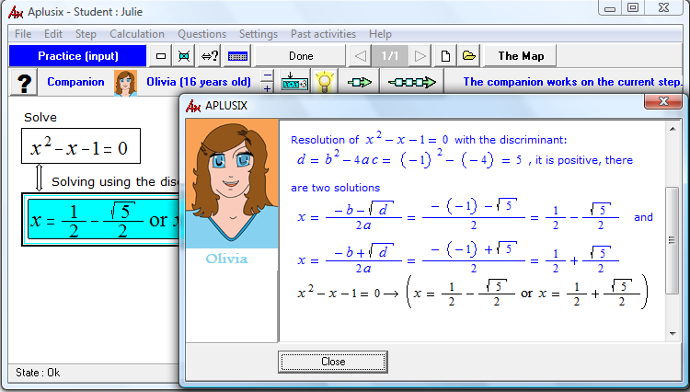
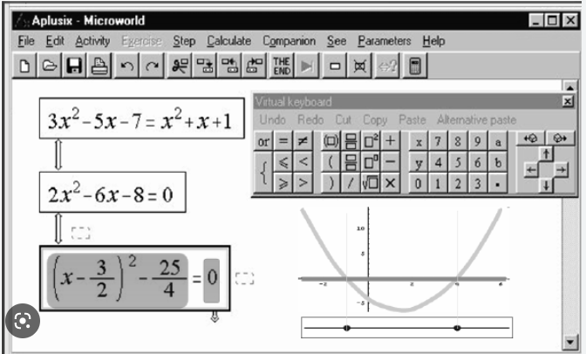

Slide 17
Let’s share out some of the ideas

Slide 18
Broader Comments or Questions?
On Gamification

Slide 19
On to today’s topic
Original lecture title
A/B Testing and Iterative Refinement

Slide 20
On to today’s topic
Original lecture title
A/B Testing and Iterative Refinement

Slide 21
On to today’s topic
New lecture title
Learning Engineering

Slide 22
Learning Engineering
“Learning engineering is the systematic application of principles and methods from the learning sciences to support and improve our understanding of learners and learning processes . . . Learning engineers design learning experiences and environments informed by the learning sciences. They combine knowledge, tools, and techniques from a variety of technical, pedagogical, empirical, and design-based disciplines while collaborating with subject-matter experts, software engineers, and others.” (Kolodner, 2021)

Slide 23
Learning Engineering
“Learning engineering applies a rigorous combination of theory, data, and analysis to develop and improve educational systems and methodologies to produce enduring and high-quality learning” (Baker, Boser, & Snow, 2022)

Slide 24
Learning Engineering
Goal is design rather than scientific discovery (Means, 2018)
Leverages learning sciences and cognitive science (Rosé et al., 2019)
Leverages computer science, rapid growth in data, improvement in learning analytics methods (Shimmei & Matsuda, 2020)
Applies the ideas of engineering to learning; is about both effectiveness and efficiency (Dede, Richards, & Saxberg, 2018).

Slide 25
Questions? Comments?

Slide 26
The Key Idea
Iterate, iterate, iterate!

Slide 27
The Key Idea
Iterate, iterate, iterate!
But do so based on data…

Slide 28
A/B Testing
What is A/B Testing?

Slide 29
A/B Testing
What is A/B Testing?
What is the difference (in practical usage of the terms) between
A/B testing
Randomized Controlled Trial (RCT)

Slide 30
A/B/n testing
Create variants of your system
2 is A/B
3+ is A/B/n
Randomly decide which variant a student receives
Compare results between variants

Slide 31
Sequential quasi-experimentation
Create variants of your system
Try one then, then try the next one, and so on
Compare results between variants

Slide 32
A/B or Sequential Quasi
What are the strengths and weaknesses of each?

Slide 33
A/B/n or quasi?
A/B/n
Results and implications are clearer
Faster to conduct
Sequential quasi
Easier to use in classrooms or other settings where students talk
You can adapt design based on results at each step

Slide 34
Questions? Comments?

Slide 35
Learning Analytics/EDM
A great source of variables for A/B/n & quasi-experiments
Not enough just to compare conditions
What are you comparing them in terms of?

Slide 36
Let’s say we are comparing 2 versions of an adaptive learning system
What are some dependent variables we could compare the 2 versions in terms of?

Slide 37
Some possible variables
Completion
Stopout/dropout/quitting
Within-system learning
Use of learning outside the system
Gaming the system, careless behavior
Frustration, boredom, engaged concentration
Self-regulated learning strategies

Slide 38
Measuring learning within-system
Knowledge (using knowledge models)
Mastery rate (speed of learning)

Slide 39
Further Comments?

Slide 40
How big a sample should you use?

Slide 41
Some options
Use everybody
Pick a number in advance
Pick a convenience cohort
Conduct statistical power analysis

Slide 42
Some options
Use everybody
Pick a number in advance
Pick a convenience cohort
Conduct statistical power analysis
Does everybody know what this is?

Slide 43
What are the pluses and minuses?
Use everybody
Pick a number in advance
Pick a convenience cohort
Conduct statistical power analysis

Slide 44
Why not just run the A/B test on everyone?

Slide 45
Why not just run the A/B test on everyone?
Do you want to deploy an untested change to a million learners when you could deploy it to 300?

Slide 46
Comments? Questions?

Slide 47
Some examples
ASSISTments determined which learning supports were more effective (Razzaq et al., 2006)
Hints better than scaffolds
Led to using scaffolds much less often, way beyond original study context

Slide 48
Some examples
ASSISTments determined which learning supports were more effective (Razzaq et al., 2006)
Hints better than scaffolds
Led to using scaffolds much less often, way beyond original study context
But… Zhou et al. (2021) found opposite effect in replication study, also within ASSISTments
Different age group
Different content

Slide 49
Some examples
Cognitive Tutor refined their knowledge model and increased student learning (Koedinger et al., 2013)
Split some skills in knowledge model so that mastery was calculated separately
Led to time focused on specific skills and better learning

Slide 50
Some examples
HarvardX iteratively developed a strategy for getting students to come back after they stop out (Whitehill et al., 2015)
Designed and delivered email messages
Led to higher completion rates
Never scaled to other MOOCs and I’m not sure why

Slide 51
Some examples
Mindspark developed a fast way to determine which skills had lower-quality knowledge models (Agarwal et al., 2018)
Applied Bayesian Knowledge Tracing model to all skills
Looked for skills with unexpectedly high guess or slip rates
Investigated those skills in detail and fixed them, leading to better optimization of student time

Slide 52
Some examples
Alef NextGen determined which content was least effective (and fixed it) (Baker et al., 2018)
Applied variant of Bayesian Knowledge Tracing model to all skills, which also fit learning parameter for video content
Looked for videos with very low learning and improved them
Also looked for videos with very high learning and studied them

Slide 53
Some examples
MathGarden introduced delay before students were allowed to skip a problem (and fixed it) (Savi et al., 2018)
The longer the delay, the less likely students were to solve the problem
Longer delays led to longer average problem-solving time (i.e. students were attempting problems that took them longer to solve)
Longer delays led to lower percent correct

Slide 54
Comments? Questions?

Slide 55
From self-improvement to big science
ASSISTments platform now offers external researchers ability to conduct A/B studies on their platform
Used by dozens of external researchers
Not used to improve platform, but helps to answer research questions

Slide 56
From self-improvement to big science
Similar functionality and availability emerging in other platforms, such as MATHia and Realizeit

Slide 57
Thoughts? Comments?

Slide 58
Bringing today and last week together..
Deep-dive on learning engineering to optimize a rewards system
(Wang et al., 2022)

Slide 59
Context: Kupei AI Learning System
AI-driven learning system tutoring 3rd-12th grade students in English and Math in China
Study run from April 22, 2021 to June 17, 2021
5726 students
27785 concepts and 1,393,529 actions (working on a concept)

Slide 60
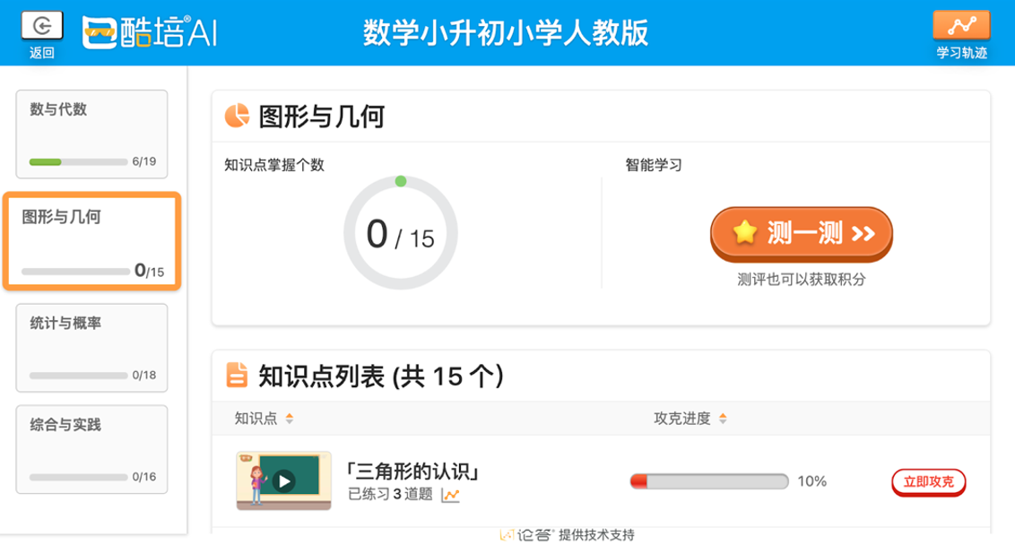
Kupei AI Learning System
Courses → Grade → Units → Concepts
Practice activities and video learning content
Diagnostic test before each unit
Computer-adaptive test to determine what concepts unknown, to focus student practice time
Optional but recommended
Students can be assessed as mastering concepts in either test or practice
Student Unit Learning Screen
The large orange button says “test” and the red button at the bottom right says “practice.” In this unit, there are 15 concepts to master. The progress bar next to the practice button shows mastery progress for each concept.
Translation courtesy of my co-authors, since I can’t read Chinese

Slide 61
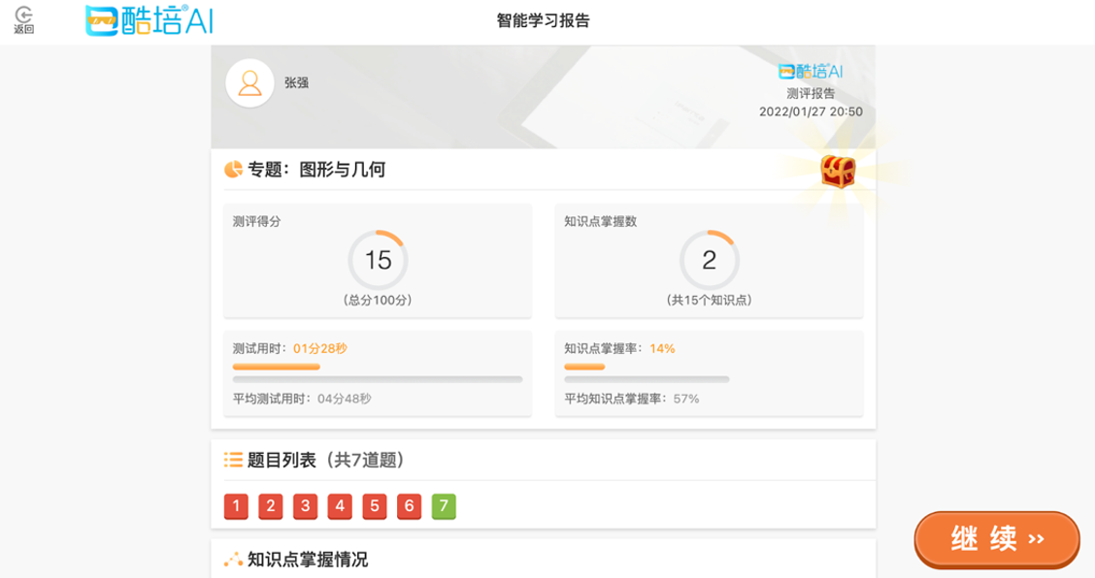
Mastery
Concept proficiency three levels: unmastered, basic mastery, and advanced mastery
Bayesian Knowledge Tracing (Corbett & Anderson, 1995)
Unmastered = <80% probability of knowing a skill
Basic Mastery = 80% to 95%
Advanced Mastery = >95%
Advanced mastery earned from practice
Basic mastery earned from tests or practice
Concepts connected on a knowledge graph
Results Screen After Diagnostic Test
The left circle shows the student received a score of 15/100. The right circle shows the number of concepts mastered in the unit, which is 2/15. The bottom row of numbers from 1 to 7 are the questions the student answered in the diagnostic test: red means they answered the question incorrectly and green means they answered correctly.

Slide 62
Versions
Learning engineering iterations to guide student time allocation and effort

Slide 63
Three Iterations of Re-Design
Version 0 (initial) through V3
Developing and modifying a point-based rewards system
Adjusting the amount of points given in different situations
Leaderboard to show students their relative success
Leaderboard
Students are ranked based off the number of points, or stars, they earned in comparison with their classmates.

Slide 64
Quasi-Experimental Approach
Switch condition on certain date
Compare between time-slices
Disadvantages:
Risk of some contamination between conditions
Less clear causal inference
Advantages:
Convenience
No unequal treatment of students using system at same time
No resentful demoralization
See how much and how quickly students adapt to design change

Slide 65
Version 0 (V0) - April 22 to April 28 (and before)
Control version with no point system implemented
Basis to compare the results of adding a point system on student learning

Slide 66
Version 1 (V1) - April 29 to May 8
Purpose: Impact of point system on student behavior
One point given for both English and Math basic mastery
Points can only be earned through practice

Slide 67
Version 1 (V1) - Learning Behavior
Students completed more English than Math concepts
47.4% for English in V0 → 59.5% in V1
English faster to complete, so easier to earn points
Students completed more practice than tests
49.1% for practice in V0 → 60% in V1
No points given in tests
Subject Concept Distribution
Student proportion of completed concepts in Math practice, Math test, English test, and English practice by day

Slide 68
Version 1 (V1) - Learning Improvement
Increase in Math basic mastery rate
59.4% in V1 → 60.8% in V2
Increase in Math and English advanced mastery rate
39.6% in V1 for Math→
41.6% in V2
49.7% in V1 for English → 52.6% in V2
Time spent to achieve basic mastery decreased in English
Median of 35.7 seconds
Time increased in Math
Median of 7.3 seconds

Slide 69
Version 1 (V1) - Key Takeaways
Students behavior driven by points
Increase practice since students can only earn points through practice
Increase English since took less time to achieve basic mastery
Overall improvement, especially English

Slide 70
Version 2 (V2) - May 9 to May 31
Purpose: balance proportion of time spent in English and Math
Made earning basic mastery for English worth one point and Math practice worth three points

Slide 71
Version 2 (V2) - Learning Behavior
More Math concepts completed, balancing overall proportion of Math and English completed
44.7% for Math in V1 →
49.3% in V2
Increase practice over tests
56.6% for practice in V1 → 66.5% in V2
Subject Concept Distribution
Student proportion of completed concepts in Math practice, Math test, English test, and English practice by day

Slide 72
Version 2 (V2) - Learning Improvement
Increase English basic mastery rate
71% in V1 → 73% in V2
Slight decrease in English advanced mastery rate
49.5% in V1 → 47.7% in V2
Increase in median time spent to earn basic mastery for Math and English
734.67 median seconds for Math in V1 → 813.97 seconds in V2
347.45 median seconds for English in V1 → 377.6437 seconds in V2

Slide 73
Version 2 (V2) - Key Takeaways
Adding more points to Math successfully balanced out time spent on Math and English courses
Students spent even more time practicing since they can’t earn points through tests
But time per concept learned is going up…

Slide 74
Version 3 (V3) - May 9 to May 31
Purpose: Increase diagnostic test usage
Students can earn points through achieving basic mastery on tests

Slide 75
Version 3 (V3) - Learning Behavior
Students completed more tests compared to practice
35.4% tests completed in V2 → 53.6% in V3
Subject Concept Distribution
Student proportion of completed concepts in Math practice, Math test, English test, and English practice by day

Slide 76
Version 3 (V3) - Learning Improvement
Median time to achieve basic mastery decreased in English and Math
372.4 median seconds for English in V2 → 326.2 seconds in V3,
773.2 median seconds for Math in V2 → 560.3 in V3
Basic mastery decreased for English
67.8% in V2 → 64.7% in V3
Advanced mastery rate decreased for Math and English
2.6% decrease in Math
7.1% decrease in English

Slide 77
Version 3 (V3) - Key Takeaways
Allowing students to earn points on tests encouraged them to take tests and not skip
Tests allow students to master concepts faster
Decrease in median time to achieve basic mastery for Math and English
Decrease in advanced mastery rate for both subjects since tests only give basic mastery, not advanced, and students do not have a point-based incentive to earn advanced mastery

Slide 78
Study Conclusions

Slide 79
Conclusions
Point system improves learning efficiency (less time to master and higher mastery rate)
Students are incentivized to do tasks that earn them points quickly
English takes less time than Math
Practice only gives points
This incentive addressed through engineering point distribution for different activities
Point distribution guides student learning behavior

Slide 80
Limitations
Rapid iterations → impact changes blend together
Longer periods of each version needed for clearer differences
Clear and unquestionable evidence requires randomized comparison on entirely new students
Students who used multiple versions might react to new versions differently than those who did not

Slide 81
Future Studies
Each iteration’s impact on other aspects of learning besides mastery
Students can do problems across grade level and could choose content from younger grades for easier points
Differences in older versus younger students in each version
Compare gaming the system (frequency and form) by condition (cf. Zou et al., 2022 -- gaming in Kupei)

Slide 82
Future Studies
Analyze impact of V4 implemented after this study
Allowed students to earn an additional point for advanced mastery
Conduct efficacy study comparing final version to a control condition

Slide 83
Last Thoughts, Comments?

Slide 84
Upcoming milestones
Dec 12
Final paper due
Dec 15
Intelligent Tutoring Systems in the Classroom
Dec 19
Response posts for final paper due

Slide 85
The End

