Slide 1
Adaptive Learning Systems
EDUC5100 Fall 2022

Slide 2
Continuing from last class…

Slide 3
Bringing last two weeks together..
Deep-dive on learning engineering to optimize a rewards system
(Wang et al., 2022)

Slide 4
Context: Kupei AI Learning System
AI-driven learning system tutoring 3rd-12th grade students in English and Math in China
Study run from April 22, 2021 to June 17, 2021
5726 students
27785 concepts and 1,393,529 actions (working on a concept)

Slide 5
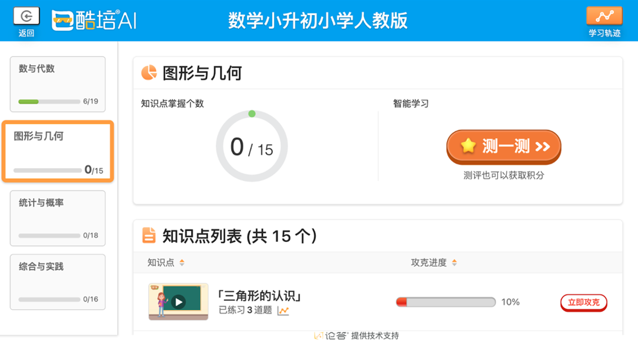
Kupei AI Learning System
Courses → Grade → Units → Concepts
Practice activities and video learning content
Diagnostic test before each unit
Computer-adaptive test to determine what concepts unknown, to focus student practice time
Optional but recommended
Students can be assessed as mastering concepts in either test or practice
Student Unit Learning Screen
The large orange button says “test” and the red button at the bottom right says “practice.” In this unit, there are 15 concepts to master. The progress bar next to the practice button shows mastery progress for each concept.
Translation courtesy of my co-authors, since I can’t read Chinese

Slide 6
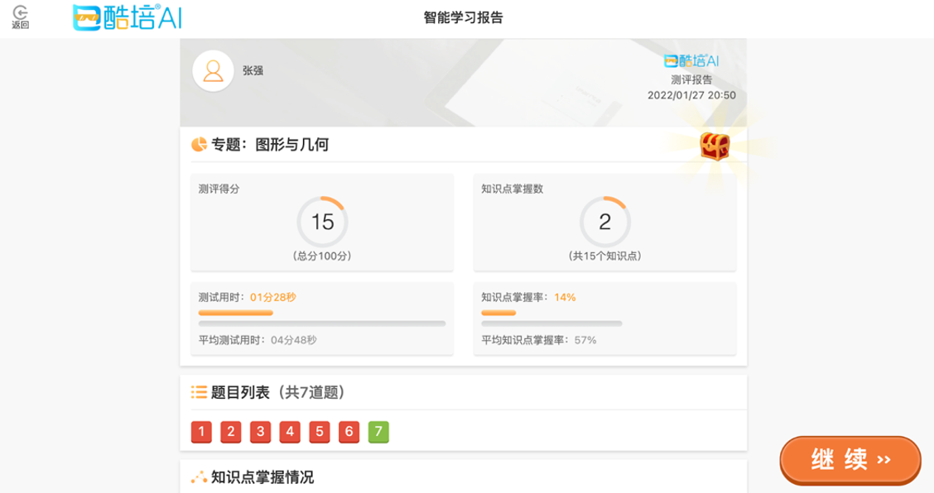
Mastery
Concept proficiency three levels: unmastered, basic mastery, and advanced mastery
Bayesian Knowledge Tracing (Corbett & Anderson, 1995)
Unmastered = <80% probability of knowing a skill
Basic Mastery = 80% to 95%
Advanced Mastery = >95%
Advanced mastery earned from practice
Basic mastery earned from tests or practice
Concepts connected on a knowledge graph
Results Screen After Diagnostic Test
The left circle shows the student received a score of 15/100. The right circle shows the number of concepts mastered in the unit, which is 2/15. The bottom row of numbers from 1 to 7 are the questions the student answered in the diagnostic test: red means they answered the question incorrectly and green means they answered correctly.

Slide 7
Versions
Learning engineering iterations to guide student time allocation and effort

Slide 8
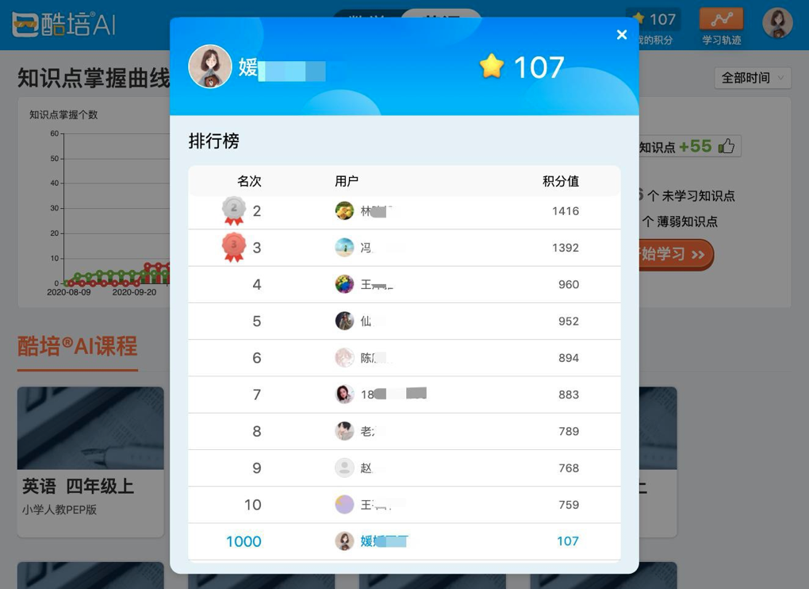
Three Iterations of Re-Design
Version 0 (initial) through V3
Developing and modifying a point-based rewards system
Adjusting the amount of points given in different situations
Leaderboard to show students their relative success
Leaderboard
Students are ranked based off the number of points, or stars, they earned in comparison with their classmates.

Slide 9
Quasi-Experimental Approach
Switch condition on certain date
Compare between time-slices
Disadvantages:
Risk of some contamination between conditions
Less clear causal inference
Advantages:
Convenience
No unequal treatment of students using system at same time
No resentful demoralization
See how much and how quickly students adapt to design change

Slide 10
Version 0 (V0) - April 22 to April 28 (and before)
Control version with no point system implemented
Basis to compare the results of adding a point system on student learning

Slide 11
Version 1 (V1) - April 29 to May 8
Purpose: Impact of point system on student behavior
One point given for both English and Math basic mastery
Points can only be earned through practice

Slide 12
Version 1 (V1) - Learning Behavior
Students completed more English than Math concepts
47.4% for English in V0 → 59.5% in V1
English faster to complete, so easier to earn points
Students completed more practice than tests
49.1% for practice in V0 → 60% in V1
No points given in tests
Subject Concept Distribution
Student proportion of completed concepts in Math practice, Math test, English test, and English practice by day

Slide 13
Version 1 (V1) - Learning Improvement
Increase in Math basic mastery rate
59.4% in V1 → 60.8% in V2
Increase in Math and English advanced mastery rate
39.6% in V1 for Math→
41.6% in V2
49.7% in V1 for English → 52.6% in V2
Time spent to achieve basic mastery decreased in English
Median of 35.7 seconds
Time increased in Math
Median of 7.3 seconds

Slide 14
Version 1 (V1) - Key Takeaways
Students behavior driven by points
Increase practice since students can only earn points through practice
Increase English since took less time to achieve basic mastery
Overall improvement, especially English

Slide 15
Version 2 (V2) - May 9 to May 31
Purpose: balance proportion of time spent in English and Math
Made earning basic mastery for English worth one point and Math practice worth three points

Slide 16
Version 2 (V2) - Learning Behavior
More Math concepts completed, balancing overall proportion of Math and English completed
44.7% for Math in V1 →
49.3% in V2
Increase practice over tests
56.6% for practice in V1 → 66.5% in V2
Subject Concept Distribution
Student proportion of completed concepts in Math practice, Math test, English test, and English practice by day

Slide 17
Version 2 (V2) - Learning Improvement
Increase English basic mastery rate
71% in V1 → 73% in V2
Slight decrease in English advanced mastery rate
49.5% in V1 → 47.7% in V2
Increase in median time spent to earn basic mastery for Math and English
734.67 median seconds for Math in V1 → 813.97 seconds in V2
347.45 median seconds for English in V1 → 377.6437 seconds in V2

Slide 18
Version 2 (V2) - Key Takeaways
Adding more points to Math successfully balanced out time spent on Math and English courses
Students spent even more time practicing since they can’t earn points through tests
But time per concept learned is going up…

Slide 19
Version 3 (V3) - May 9 to May 31
Purpose: Increase diagnostic test usage
Students can earn points through achieving basic mastery on tests

Slide 20
Version 3 (V3) - Learning Behavior
Students completed more tests compared to practice
35.4% tests completed in V2 → 53.6% in V3
Subject Concept Distribution
Student proportion of completed concepts in Math practice, Math test, English test, and English practice by day

Slide 21
Version 3 (V3) - Learning Improvement
Median time to achieve basic mastery decreased in English and Math
372.4 median seconds for English in V2 → 326.2 seconds in V3,
773.2 median seconds for Math in V2 → 560.3 in V3
Basic mastery decreased for English
67.8% in V2 → 64.7% in V3
Advanced mastery rate decreased for Math and English
2.6% decrease in Math
7.1% decrease in English

Slide 22
Version 3 (V3) - Key Takeaways
Allowing students to earn points on tests encouraged them to take tests and not skip
Tests allow students to master concepts faster
Decrease in median time to achieve basic mastery for Math and English
Decrease in advanced mastery rate for both subjects since tests only give basic mastery, not advanced, and students do not have a point-based incentive to earn advanced mastery

Slide 23
Study Conclusions

Slide 24
Conclusions
Point system improves learning efficiency (less time to master and higher mastery rate)
Students are incentivized to do tasks that earn them points quickly
English takes less time than Math
Practice only gives points
This incentive addressed through engineering point distribution for different activities
Point distribution guides student learning behavior

Slide 25
Limitations
Rapid iterations → impact changes blend together
Longer periods of each version needed for clearer differences
Clear and unquestionable evidence requires randomized comparison on entirely new students
Students who used multiple versions might react to new versions differently than those who did not

Slide 26
Future Studies
Each iteration’s impact on other aspects of learning besides mastery
Students can do problems across grade level and could choose content from younger grades for easier points
Differences in older versus younger students in each version
Compare gaming the system (frequency and form) by condition (cf. Zou et al., 2022 -- gaming in Kupei)

Slide 27
Future Studies
Analyze impact of V4 implemented after this study
Allowed students to earn an additional point for advanced mastery
Conduct efficacy study comparing final version to a control condition

Slide 28
Thoughts, Comments?

Slide 29
On to ITS in the classroom…

Slide 30
Intelligent Tutors/Adaptive Learning Systems are used at scale
In classrooms around the world
And they often work – successful efficacy trials for many systems showing better learning than traditional curricula

Slide 31
Intelligent Tutors/Adaptive Learning Systems are used at scale
In classrooms around the world
How do teachers use them?

Slide 32
Modalities
Homework
Blended Learning
Students use learning system in classroom

Slide 33
Blended Learning
Students use learning system totally individually
Students mostly use learning system individually but discuss occasionally
Yoked collaboration (Ogan et al., 2012)

Slide 34
Who here has seen one of these strategies being used in a classroom?
Students use learning system totally individually
Students mostly use learning system individually but discuss occasionally
Yoked collaboration (Ogan et al., 2012)

Slide 35
Who here has seen one of these strategies being used in a classroom?
Students use learning system totally individually (Philippines – Rodrigo and colleagues)
Students mostly use learning system individually but discuss occasionally (USA, UAE)
Yoked collaboration (Costa Rica, Mexico, Brazil – Ogan and colleagues)

Slide 36
How should ITS/AL design be different for these use cases?
Students use learning system totally individually
Students mostly use learning system individually but discuss occasionally
Yoked collaboration

Slide 37
Off-Task Behavior
How should off-task behavior be handled in these use cases?

Slide 38
Off-Task Behavior
How should off-task behavior be handled in these use cases?
Off-task behavior in moderation can re-engage bored students (Baker et al., 2011) and improve group work dynamics (Kreijns, 2004)

Slide 39
Thoughts? Comments?

Slide 40
What is the teacher doing?
Disengagement
Availability for discussion
Proactive Remediation (Miller et al., 2015; first discussed in Schofield, 1995)

Slide 41
Proactive Remediation (Miller et al., 2015)
“In this paper, we focus on proactive remediation, dynamically planned intervention by the teacher with one or more students. In a proactive remediation, the teacher decides to provide help to one or more students on a topic that they are not currently struggling with, based on evidence that the student(s) need to learn that topic. The teacher plans such interventions using formative assessment data provided by the tutoring system. Proactive remediation is different from the traditional view of on-task conversations in blended learning [10], where the student discusses the current material being presented in the tutor, with another student or the teacher.” (Miller et al., 2015)

Slide 42
When Should a Teacher Engage in Proactive Remediation? (instead of giving student space)
“In this paper, we focus on proactive remediation, dynamically planned intervention by the teacher with one or more students. In a proactive remediation, the teacher decides to provide help to one or more students on a topic that they are not currently struggling with, based on evidence that the student(s) need to learn that topic. The teacher plans such interventions using formative assessment data provided by the tutoring system. Proactive remediation is different from the traditional view of on-task conversations in blended learning [10], where the student discusses the current material being presented in the tutor, with another student or the teacher.” (Miller et al., 2015)

Slide 43
Thoughts? Comments?

Slide 44
Blended learning teaching practices Wise & Jung (2019)
Whole-class scaffolding, devoting more attention to explaining specific concepts that were difficult for students: “I [could] even adjust sometimes on the fly during the semester if it seems like students are not learning what they are hoping to learn in the class, or not learning what I think I want them to be learning in the course”
Targeted scaffolding, focusing attention on particular students… who seemed to be disengaged or struggling: “I intervened with them a bit earlier than I might have otherwise as they hadn’t missed so many classes”

Slide 45
When is whole-class scaffolding warranted?
Whole-class scaffolding, devoting more attention to explaining specific concepts that were difficult for students: “I [could] even adjust sometimes on the fly during the semester if it seems like students are not learning what they are hoping to learn in the class, or not learning what I think I want them to be learning in the course”
Targeted scaffolding, focusing attention on particular students… who seemed to be disengaged or struggling: “I intervened with them a bit earlier than I might have otherwise as they hadn’t missed so many classes”

Slide 46
Thoughts? Comments?

Slide 47
Changing instruction
Using data on student performance to change instruction in subsequent class (Xhakaj et al., 2017)

Slide 48
Example
https://www.youtube.com/watch?v=kGxQsN0DBUU

Slide 49
Changing instruction
Increasing coverage of difficult topics
Selecting students with misconceptions to call on (a common practice in traditional Russian classrooms, done based on hand-grading; Khachatryan, 2020)
Selecting students with great answers to call on

Slide 50
Thoughts? Comments?

Slide 51
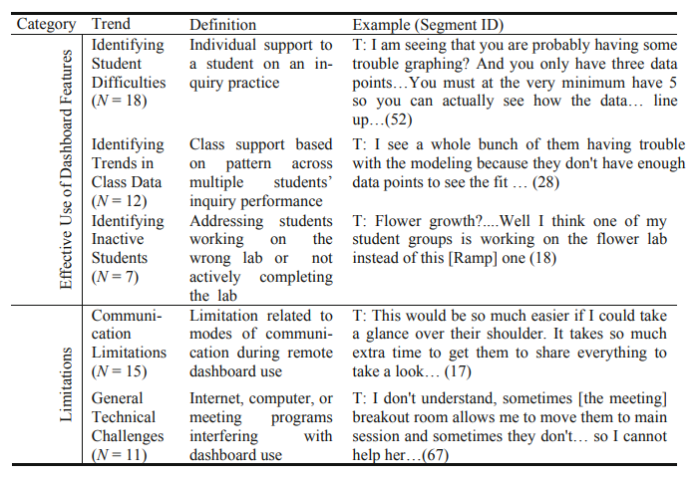
Remote learning teaching practices (Dickler et al., 2021)

Slide 52
Thoughts? Comments?

Slide 53
How does classroom orchestration need to be different
When all students are working on the same content on the same day (ASSSISTments, Alef NextGen)
When different students are working on totally different topics at the same time (MATHia, ALEKS)

Slide 54
Information Resources Teachers Use
Examples
Mostly, but not all, dashboards

Slide 55
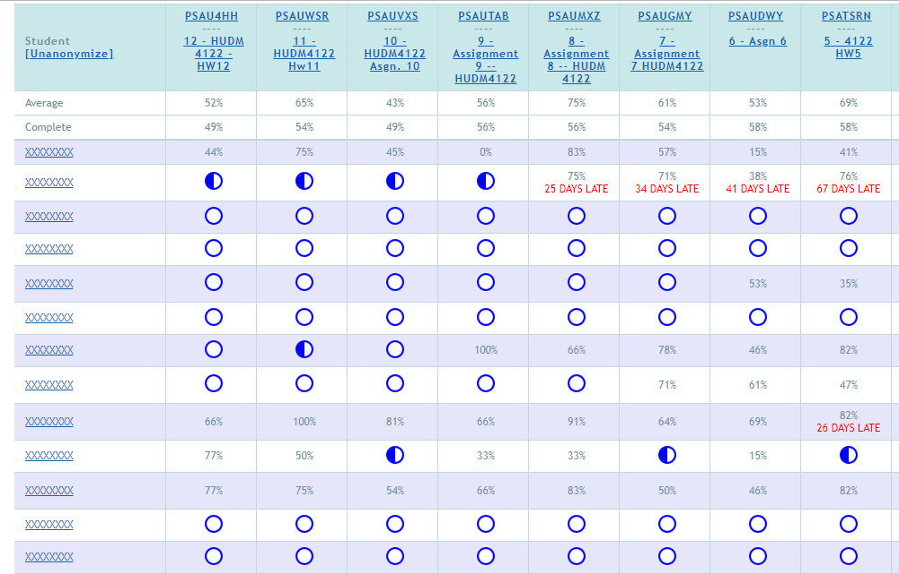
ASSISTments

Slide 56
ASSISTments

Slide 57
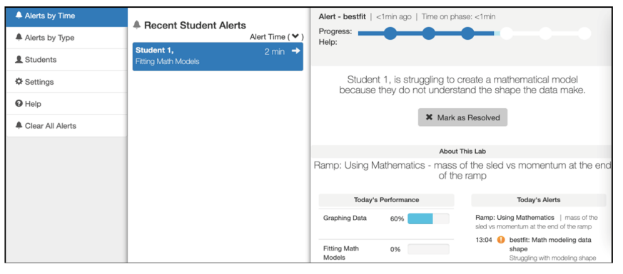
Inq-Blotter

Slide 58
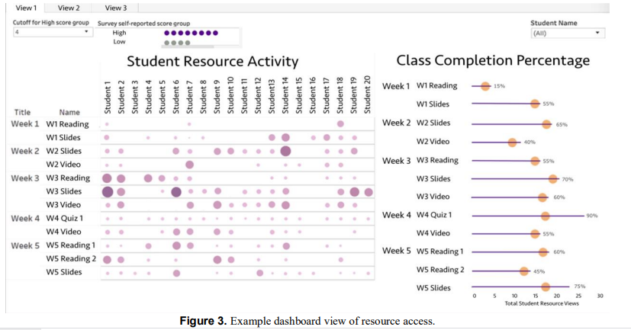
Wise & Jung

Slide 59
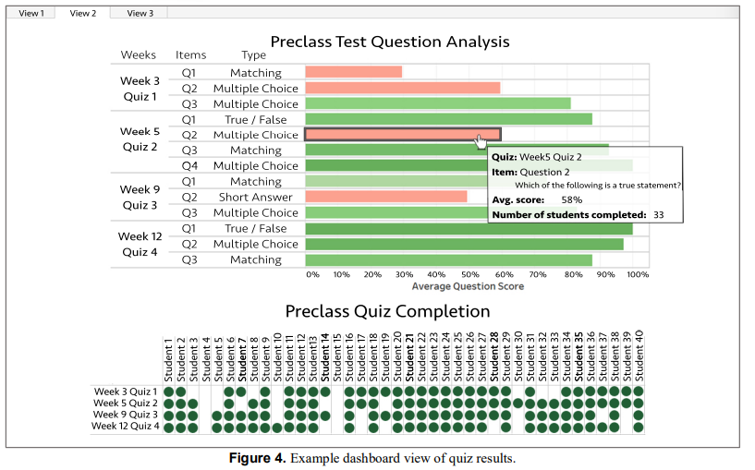
Wise & Jung

Slide 60
Some tensions in report design (Duncan et al)
Detail versus big picture
Mastery versus progress
Benchmarking between students or with reference to a goal

Slide 61
Thoughts? Comments?

Slide 62
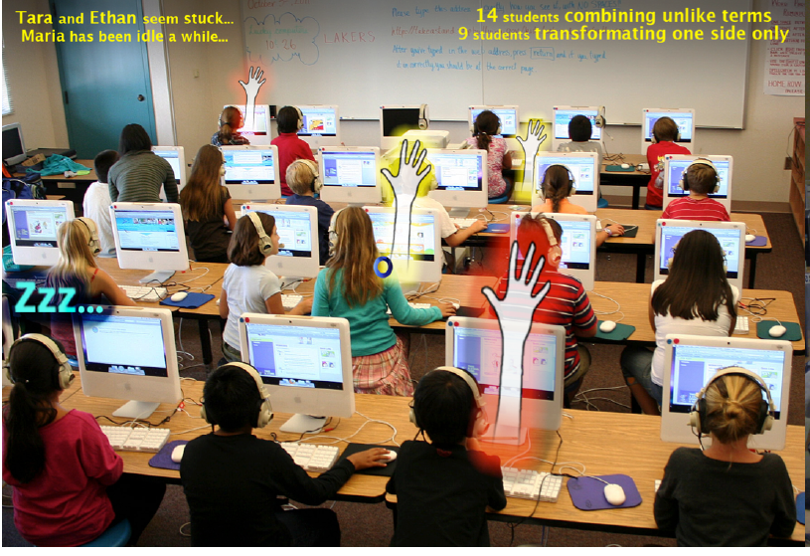
Holstein et al

Slide 63
Thoughts? Comments?

Slide 64
Teacher Control
Teachers often want to have control of system and student experience
For example, ability to re-order topics and advance a student who is not making progress

Slide 65
Teacher Control
These choices often lead to lower learning effectiveness (Sales et al., 2016; Ritter et al., 2016)

Slide 66
Teacher Control
These choices often lead to lower learning effectiveness (Sales et al., 2016; Ritter et al., 2016)
Should we give teachers the ability to lower learning effectiveness, out of the fear of de-adoption?
How can we encourage teachers to make better choices?

Slide 67
Teacher Preparation
Adaptive learning systems usually obtain better results in their second year of classroom use (Pane et al., 2014; Roschelle et al., 2016)
Teachers know how to use them more effectively
How can we better support teachers in learning how to use systems effectively, to get better first-year performance?

Slide 68
Last comments or questions on ITS in the classroom?

Slide 69
Wrapping up

Slide 70
Wrapping up
Please take five minutes to write down some things you learned from this class this semester

Slide 71
Wrapping up
Please take five minutes to write down some things you learned from this class this semester
Please each share one for the class (ideally one that no one else has already said)

Slide 72
Last milestone
Dec 19
Response posts for final paper due
Enjoy your winter break
Thanks for your great participation all semester
It was great learning together with you

Slide 73
The End

