Slide 1
Adaptive Learning Systems
EDUC5100 Fall 2022

Slide 2
Welcome!

Slide 3
We continue today…
With another relatively advanced and relatively technologically mature aspect of contemporary learning systems
Technology: knowledge graphs
Adaptivity it supports: prerequisite and postrequisite selection

Slide 4
Knowledge Graph
What is a knowledge graph?

Slide 5
Note
A knowledge space is a type of knowledge graph
The only real difference between knowledge spaces and other types of knowledge graphs (like Bayesian Networks) is the math under the hood
That math isn’t really important for this class, but we will discuss its implications later in the session if there’s time

Slide 6
Knowledge Graph
What is a prerequisite?

Slide 7
Knowledge Graph
What is a prerequisite knowledge graph?

Slide 8
Partial Order Knowledge Spaces
Does anyone remember (from the Essa paper)
The difference between Partial Order Knowledge Spaces and regular Knowledge Spaces and Knowledge Graphs?

Slide 9
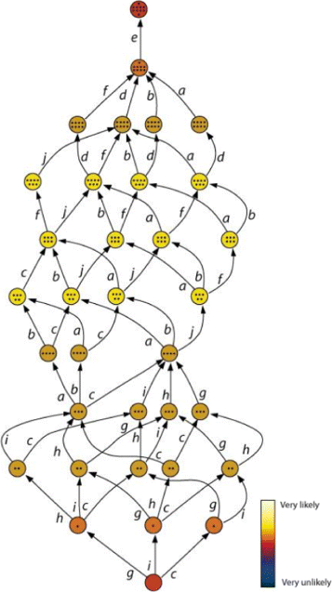
Subset of ALEKS Knowledge Space

Slide 10
What is the outer fringe
Of a knowledge space or knowledge graph
And why is it important?

Slide 11
Exercise
Get in groups of 3
Draw a prerequisite knowledge graph of arithmetic
It does not have to be perfect

Slide 12
Could one group please share?

Slide 13
Other groups: how did your knowledge graph differ?

Slide 14
Any observations on your graph or process?

Slide 15
Of course…
… this is not how knowledge graphs are drawn in the real world

Slide 16
Of course…
… this is not how knowledge graphs are drawn in the real world
Actually, sadly, it is

Slide 17
How could humans design a knowledge graph in a more principled way?

Slide 18
How could humans design a knowledge graph in a more principled way?
Knewton has/had a process for design, but I don’t think it’s fully publicly available

Slide 19
How could you collect test data to help you do it?

Slide 20
How could you use online learning system data to do it?

Slide 21
Essa notes
Knowledge spaces and knowledge graphs can be built by humans and refined using data
But they can also be discovered totally from data (Brunskill, 2011; Desmarais & Liu, 1995; Chen et al., 2016; Chen et al., 2018)
What might be the advantages and disadvantages of each approach?

Slide 22
Comments? Questions?

Slide 23
How are prerequisite knowledge graphs used
By adaptive learning systems?

Slide 24
How are prerequisite knowledge graphs used
By adaptive learning systems?
Place student in curriculum
Pick or recommend next topic(s)
Go back to prereqs for struggling student

Slide 25
What if?
For each of these applications
Place student in curriculum
Pick next topic
Go back to prereqs for struggling student
What would be the harm if
The knowledge graph said skill A was prerequisite to skill B but it isn’t!
Skill A is prerequisite to skill B but the knowledge graph doesn’t know that!

Slide 26
Comments? Questions?

Slide 27
Knowledge Graphs are trade secrets
Khan Academy shared theirs at one point, but they don’t seem to do so anymore
ASSISTments shares an old one, but it’s not very extensive
Companies spend hundreds of thousands of dollars to build good ones
Lots of repeated effort

Slide 28
Thoughts? Comments?

Slide 29
Brief Digression about the Implications of the Math
Knowledge spaces sometimes tend to be over-confident about student knowledge compared to Bayesian Networks
They (typically) make decisions based on much less evidence

Slide 30
Brief Digression about the Implications of the Math
Bayesian Networks sometimes tend to over-propagate information
If configured in standard ways, and not calibrated properly, they sometimes adjust estimates of skills very far away from the one the student is learning now
They take substantial data to properly calibrate

Slide 31
Brief Digression about the Implications of the Math
Desmarais has written several papers showing that BN fit data better than KS
Desmarais research trajectory story
KS still popular, because data fit isn’t everything

Slide 32
Comments? Questions?

Slide 33
Zou et al. article
They find that students learn more if teachers follow recommendations about which skills the student is ready to learn
Note that both a knowledge graph and mastery learning (BKT) are used
Comments or questions on this paper?

Slide 34
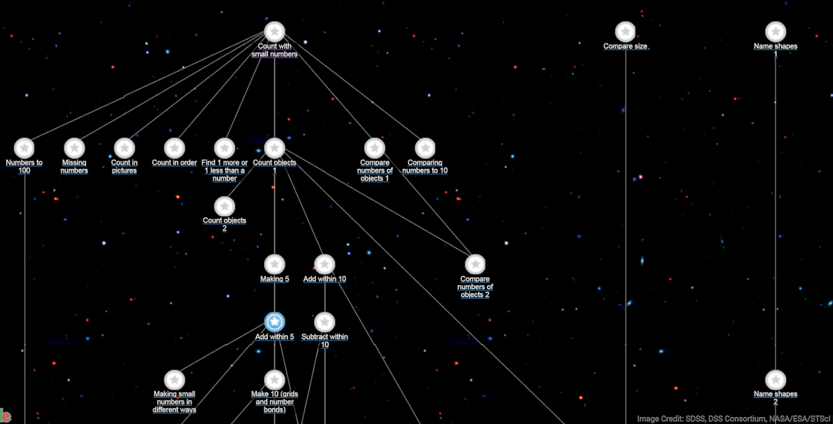
Khan Academy: Another prominent system using KG

Slide 35
Other systems using KG that you have heard of?

Slide 36
If there’s a couple minutes
Herb Simon story on decomposition and chunking

Slide 37
Upcoming classes
September 29 VIRTUAL
Memory Optimization and Spiraling Review
October 6
Hints and Feedback
October 13
Model-Tracing and Constraint-Based Modeling

Slide 38
The End

