Slide 1
Adaptive Learning Systems
EDUC5100 Fall 2022

Slide 2
Welcome!

Slide 3
We continue today…
With a technology that one sees in a lot of contemporary learning systems
Technology: hints and feedback
Is it adaptive?
It can be…

Slide 4
We continue today…
Rich base of research literature going back decades
Still a lot of gaps in that literature and promising directions never followed up on…

Slide 5
Let’s start with feedback

Slide 6
Feedback
“In this review, feedback is conceptualized as information provided by an agent (e.g., teacher, peer, book, parent, self, experience) regarding aspects of one’s performance or understanding. A teacher or parent can provide corrective information, a peer can provide an alternative strategy, a book can provide information to clarify ideas, a parent can provide encouragement, and a learner can look up the answer to evaluate the correctness of a response. Feedback thus is a “consequence” of performance.” – Hattie & Timperley (2007)

Slide 7
A student is doing math problems
What’s 3+6?
2x + 9 = 13. What’s x?
The student gives a wrong answer
What’s the simplest feedback we can give them?

Slide 8
Correctness feedback

Slide 9
Correctness feedback
What are the benefits of correctness feedback? (Compared to no feedback at all)
What are the drawbacks of correctness feedback? (Compared to no feedback at all)

Slide 10
The Next Step Up: Giving the correct answer
The student gets the wrong answer
We give them the right answer

Slide 11
The Next Step Up: Giving the correct answer
The student gets the wrong answer
We give them the right answer
What are the benefits of correct answer feedback? (Compared to correctness feedback)
What are the drawbacks of correct answer feedback? (Compared to correctness feedback)

Slide 12
Bug Messages
What’s a bug message?

Slide 13
Bug Message
2/3 + 1/4 = 3/7
Write down (on paper or your computer) a sentence you would give to a student who makes this error

Slide 14
Bug Message
2/3 + 1/4 = 3/7
Write down (on paper or your computer) a sentence you would give to a student who makes this error
Let’s read them out to the class

Slide 15
BUGGY/DEBUGGY (VanLehn, 1982, 1987)
Early work in intelligent tutoring attempted to classify every possible bug and the reason it occurred
Why don’t we do this anymore, do you think?

Slide 16
BUGGY/DEBUGGY (VanLehn, 1982, 1987)
104 bugs in learning subtraction
Are all these bugs important to specifically correct?

Slide 17
Preconceptions/Misconceptions
There are some stable misconceptions/preconceptions (Thissen-Roe et al., 2004)
But they are fairly rare and usually need a bigger intervention than a one-line message (Clement, 1983)

Slide 18
Contemporary Use of Bug Messages
Typically for an easy-to-repair issue
Working in the wrong part of the interface
Wrong units or type of answer

Slide 19
Comments? Questions?

Slide 20
Is Feedback Effective Overall?
Yes
Hattie & Timperley (2007) review 12 meta-analyses reviewing several hundred studies
And the answer is yes

Slide 21
Is All Feedback Effective?
No
Wisniewski, Zierer, & Hattie (2020) re-review the literature and find that feedback can vary so much in effectiveness that it shouldn’t be considered by itself

Slide 22
Delayed or Immediate Feedback?
Should we tell the student their answer is wrong right away?
Or should we give them time to figure it out on their own?
What are the benefits and drawbacks of each?

Slide 23
Delayed or Immediate Feedback?
A debate since Pressey (1950)/Brackbill et al. (1962) and still ongoing
Delayed feedback better (Metcalfe et al., 2009; Mullet et al., 2014)
Immediate feedback better (Kulik & Kulik, 1988; Lu et al., 2019)
No difference (Butler & Roediger, 2008; Nakata, 2015; Fyfe et al., 2019)

Slide 24
Delayed or Immediate Feedback? What’s Going on Here
In 1988, Kulik & Kulik said that it really depends on the design of the study
That still seems to be the case today, with most studies on one side of the debate or the other poking at methodological flaws in the other side
For example, Lu et al (2019) discovered longer time between hint and test for immediate feedback condition than delayed feedback conditions in Metcalfe’s studies, and replicated those studies with equal time to test, getting the opposite result

Slide 25
Comments? Questions?

Slide 26
Levels of Feedback (Hattie & Timperley, 2007)
Does anyone remember these from the reading?

Slide 27
Levels of Feedback (Hattie & Timperley, 2007)
Task performance
Process of understanding how to do a task
Regulatory or metacognitive processes
Self/personal level (unrelated to the specifics of the task)

Slide 28
Feedback on Task Performance: Key Review Findings
Generally effective
Better when high-level rather than extremely specific
Example in Hattie & Timperley: telling students how many degrees off their LOGO solution was leads students to focus on tweaking rather than deeper problems
Most useful: simple feedback on simple problems

Slide 29
Feedback on Task Process: Key Review Findings
Supporting students on detecting their errors is beneficial
Helping students learn to identify cues that help them determine how to solve the problem is beneficial

Slide 30
Some notes (McKendree, 1990)
Feedback more effective when it:
Helps students understand when a procedure applies and doesn’t apply
Helps students see how to break down a problem into steps
Thoughts? Comments?

Slide 31
Example: Adaptive Scaffolding of Error Detection/Correction (Mathan, 2003; Koedinger et al., 2009)
When student makes an error in creating formula, system leads student through realizing that formula is incorrect, and inferring why the result is different than what was expected/desired
Scaffolding skill in error correction

Slide 32
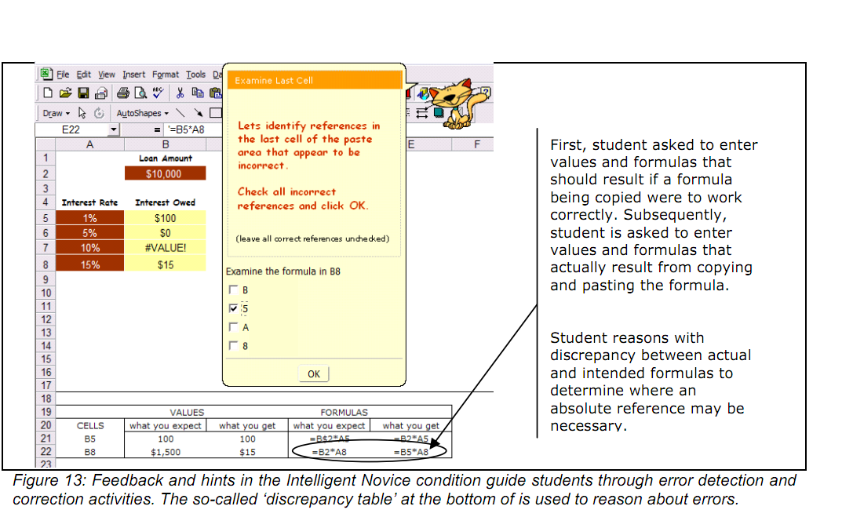

Slide 33
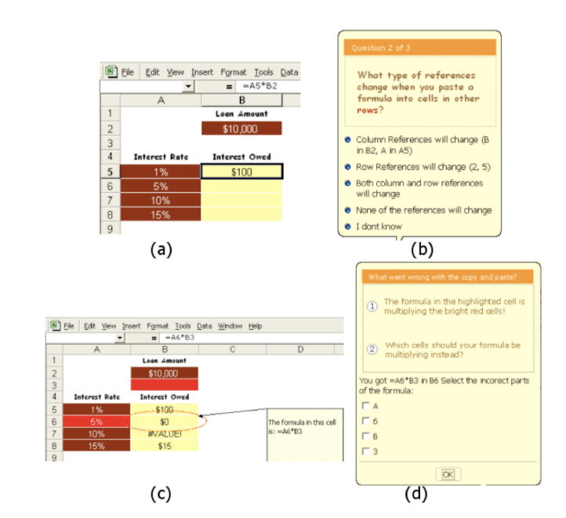

Slide 34
Results
Led to better learning, transfer, retention

Slide 35
Thoughts? Comments?

Slide 36
Feedback on Self-Regulation: Key Review Findings
Effective if it helps students devote more effort to task and target their effort better
Effective if it helps students know how and when to seek help
Effective if it increases self-efficacy, but…

Slide 37
Feedback on Self: Key Review Findings
Praising student for their ability usually has negative effects

Slide 38
Questions? Comments?

Slide 39
Hints
On-demand learning supports
“Hints” and “help” used inter-changeably in ITS literature

Slide 40
Hints: Simplest version
Simply telling the student the answer
Often called a “bottom-out hint”
What are the advantages and drawbacks of offering bottom-out hints versus offering no hints?

Slide 41
Hints: Another simplest version
Offering a single “tip” on demand
What are the advantages and drawbacks of offering single tip versus no hints?
What are the advantages and drawbacks of offering single tip versus bottom-out hints?

Slide 42
Hints: Another simplest version
A lot of ways one can give a “tip” (Heiner et al., 2004)
With different implications for learning outcomes
For example, in young children learning to read, telling them the meaning of the word they were trying to read helped more than breaking down word into syllables (Heiner et al., 2004)

Slide 43
Multi-step hints
System offers multiple hint levels, which student can click forward on
Early levels orient student towards task goal
Later levels explain process
Final bottom-out hint

Slide 44
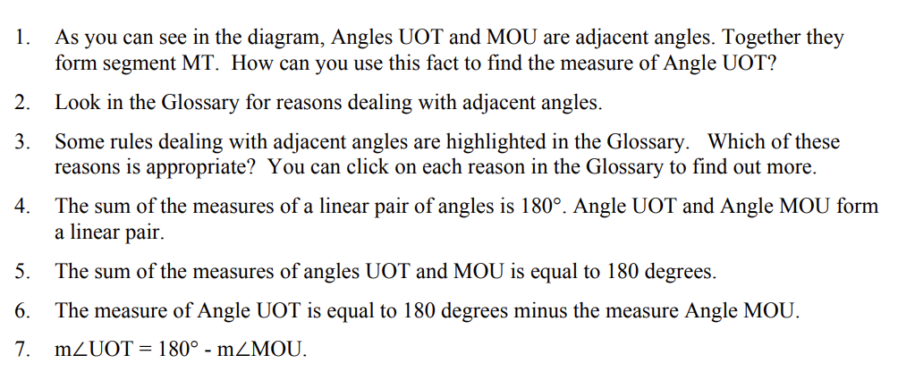
Multi-step hints
System offers multiple hint levels, which student can click forward on
Example from Aleven et al (2006)

Slide 45
Multi-step hints
What are the benefits and drawbacks of multi-step hints?
What would be some important considerations for getting them right?

Slide 46
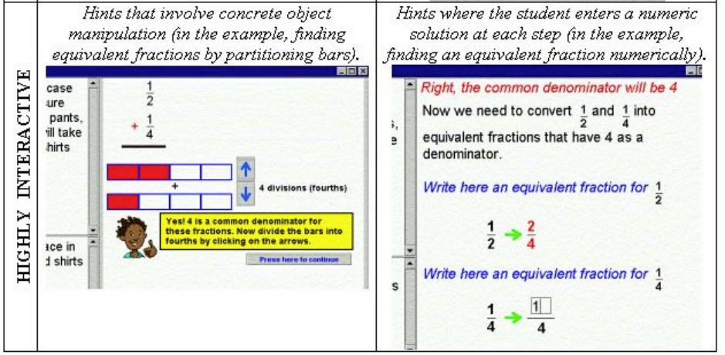
Interactive Hints (Arroyo et al., 2000)

Slide 47
Interactive Hints
Mixed results: interactive hints better for girls but worse for boys (Arroyo et al., 2000)
Attempted replication: interactive hints no better for boys or girls (Pardos et al., 2011)
Thoughts? Comments?

Slide 48
Video Hints (Ostrow & Heffernan, 2014)

Slide 49
Video Hints (Ostrow & Heffernan, 2014)
Video hints associated with better learning
Why might this be?
Why hasn’t this work been followed up – why aren’t more systems using this approach?

Slide 50
Hint use
Hint use can be effective or ineffective

Slide 51
Model of Help-Seeking (Aleven et al., 2003)
1. Become aware of need for help
2. Decide to seek help
3. Identify potential helper(s)
4. Use strategies to elicit help
5. Evaluate help-seeking episode

Slide 52
Thoughts or comments on this model?
1. Become aware of need for help
2. Decide to seek help
3. Identify potential helper(s)
4. Use strategies to elicit help
5. Evaluate help-seeking episode

Slide 53
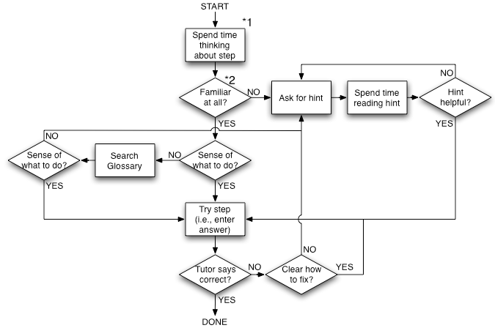
Model of Cognitive Tutor Help-Seeking (Aleven et al., 2006)

Slide 54
Where do you agree and disagree with this model?

Slide 55
What would it mean for a student to fail at each of these steps?

Slide 56
Could a student succeed at each of these steps, and still fail to learn?

Slide 57
Thoughts? Comments?

Slide 58
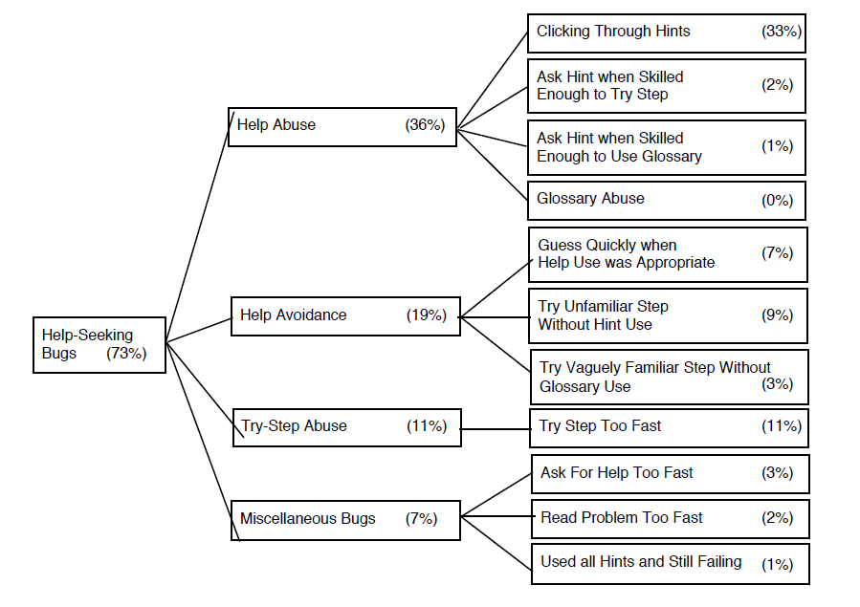
Aleven et al.’s (2006) help-seeking bugs
Gaming the System

Slide 59
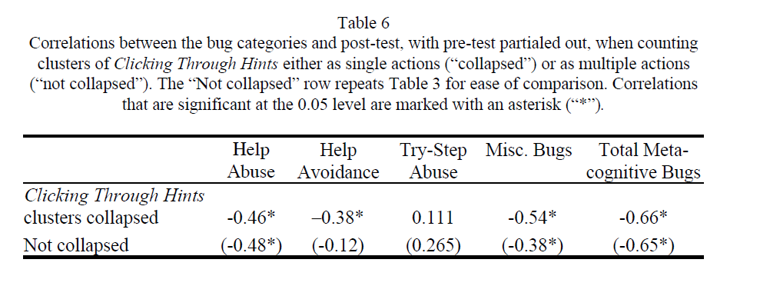
(Differential) Impacts of Help-Seeking (Aleven et al., 2006)

Slide 60
Thoughts? Comments?

Slide 61
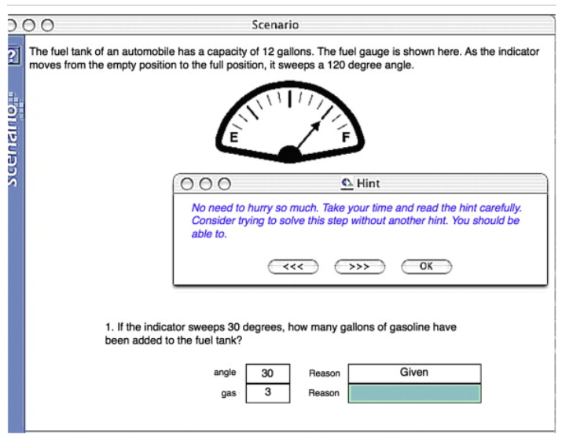
Attempt to tutor help-seeking (Roll et al., 2007, 2011)

Slide 62
Result
Led to better help-seeking behavior
Better help-seeking behavior seen even on entirely new content
No impact on learning of domain content

Slide 63
Thoughts? Comments?

Slide 64
Last comments and questions
On hints and feedback

Slide 65
Upcoming classes
October 10 System Review Due
October 13
Model-Tracing and Constraint-Based Modeling
October 20
Supporting Affect and Engagement
October 27
Essay Writing and Automated Scoring

Slide 66
The End

