Slide 1
Adaptive Learning Systems
EDUC5100 Fall 2022

Slide 2
Welcome!

Slide 3
We continue today…
With the question on everyone’s minds 15 year ago
The Future of Intelligent Tutoring Systems: Will it be Model Tracing or Constraint-Based Models?

Slide 4
We continue today…
With the question on everyone’s minds 15 year ago
The Future of Intelligent Tutoring Systems: Will it be Model Tracing or Constraint-Based Models?
The answer: mostly neither (but systems of each type used at scale)

Slide 5
How should we assess correctness?
Easiest option:
Design content that has a simple answer
Record what that simple answer is
Is this good enough?

Slide 6
What about…
… when we want to generate correct answers for a lot of content
… when we want to assess process as well as final answer
… when we want to recognize different kinds of errors (and why they occurred)
… when we want to handle answers that aren’t just a number or a word

Slide 7
What about…
… when we want to generate correct answers for a lot of content
… when we want to assess process as well as final answer
… when we want to recognize different kinds of errors (and why they occurred)
… when we want to handle answers that aren’t just a number or a word
We’ll revisit this one in future classes

Slide 8
Model Tracing
What is model tracing?

Slide 9
Model Tracing Requires…
… A cognitive model
Which requires…
… A cognitive architecture

Slide 10
The basic idea
A cognitive modeling architecture is a framework for developing models of human {behavior, learning}.
The architecture forces you to make your model plausible based on what we know about humans.

Slide 11
ACT-R
“Adaptive Character of Thought”
“Atomic Components of Thought”
“Anderson’s Cool Theory”

Slide 12
ACT-R
“Adaptive Character of Thought”
“Atomic Components of Thought”
“Anderson’s Cool Theory”
Cognitive modeling in education mostly similar to ACT-R 2
ACT-R now on version 7, but newer versions focus on finer-grained neuro and not useful for adaptive learning

Slide 13
ACT-R’s strengths
Accurate and predictive models of human performance at complex tasks.
Models the cognitive processes that lead to behavior:
Decision-Making
Problem-Solving
Analogy (more with earlier versions)
Memory Retrieval and Strengthening
Learning to be an Expert

Slide 14
The ACT-R Architecture
The human mind is modeled by a set of systems.
Each individual system is serial
Multiple systems can be running at once
Visual Perception
Auditory Perception
Motor Skills
Productions
Declarative Memory

Slide 15
Performance
Interaction between production rules and chunks of declarative memory
Each chunk can have sub-chunks
Each chunk has a certain strength of activation, which predicts speed and accuracy of recall (this may be familiar from past weeks)

Slide 16
Performance
Interaction between production rules and chunks of declarative memory
Each production also has a strength of activation
When productions reach a certain strength, they become “compiled” with neighboring productions into “automatized behavior”

Slide 17
Questions? Comments?

Slide 18
Production-System Models
Represent performance (and therefore skill) as a set of if-then rules (“productions”)
Can be written in plain English

Slide 19
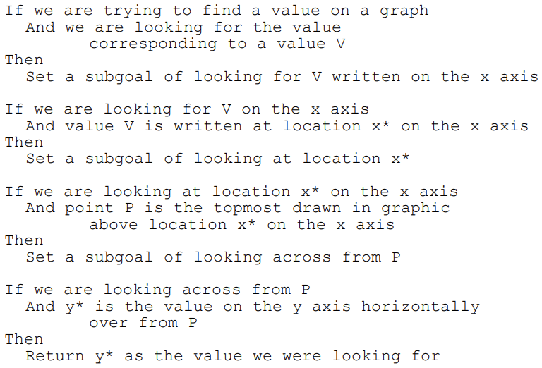
Example (Baker et al., 2001)

Slide 20
Model Tracing
A production-rule model of correct and incorrect behavior (“bug rules”) is created
As a student solves problems, the model is used to interpret whether the student’s behavior is correct or incorrect
This information is used to give feedback, and for knowledge tracing

Slide 21
Questions? Comments?

Slide 22
Benefits
Can be used to answer new problems
Provides natural way for diagnosing problems in process; determining where problem occurs
Provides natural link between “bugs” and cognition that produces them

Slide 23
Drawbacks
A huge to pain to develop
Hard to represent full range of wrong reasoning
Typically represents single chain of reasoning, but correct answer can often be obtained in multiple ways

Slide 24
Questions? Comments?

Slide 25
Example-Tracing Tutors (Aleven et al., 2016)
Method for making it easier to create a model-tracing tutor without needing to write production rules

Slide 27
Example-Tracing Tutors (Aleven et al., 2016)
Programming-by-demonstration
Expert demonstrates correct behavior on each problem
Can be used to demonstrate multiple paths to solution

Slide 28
Used by
Over 850 authors
Way more than model tracing tutors
Over 60,000 students
Way less than model tracing tutors

Slide 29
Comparison to Model Tracing
Much less flexible
Much much faster

Slide 30
Questions? Comments?

Slide 31
Constraint-based models

Slide 32
Constraint-based models
Model performance in a very different fashion
With a list of conditions that must be met
If all conditions are met, the answer is correct
Every constraint has a bug message attached to it

Slide 33
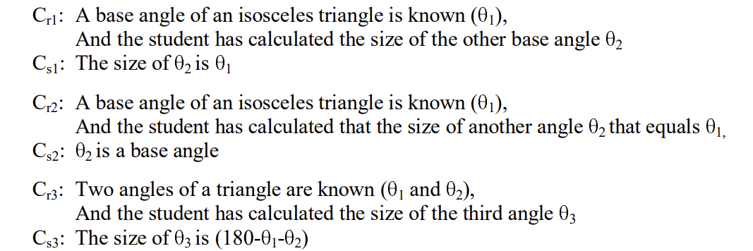
Constraint-based model: example

Slide 34
Constraint-Based Tutoring
Has been argued to be more effective for ill-defined domains, where student problem-solving may take a huge number of paths, but an incorrect solution can be recognized (Weerasinghe & Mitrovic, 2006)

Slide 35
More benefits? Drawbacks?

Slide 36
When…
What are the situations where we might expect model tracing to be better than constraint-based modeling?
What are the situations where we might expect constraint-based modeling to be better than model tracing?

Slide 37
EXERCISE
Let’s say that a student is learning to draw a scatterplot to represent data
Everyone split into groups of 3
Write out some constraints that you might want to have

Slide 38
EXERCISE
Let’s say that a student is learning to draw a scatterplot to represent data
Everyone split into groups of 3
Write out some constraints that you might want to have
Let’s hear a few

Slide 39
EXERCISE
Let’s say that a student is learning to draw a scatterplot to represent data
Everyone split into different groups of 3
Write out some productions (including both good rules and bug rules) that you might want to have

Slide 40
EXERCISE
Let’s say that a student is learning to draw a scatterplot to represent data
Everyone split into different groups of 3
Write out some productions (including both good rules and bug rules) that you might want to have
Let’s hear a few

Slide 41
Having done this…
Does anyone have new observations on the strengths and weaknesses of model tracing and constraint-based modeling?

Slide 42
Last comments and questions?

Slide 43
Upcoming classes
October 17 Posts Due on System Review
October 20
Supporting Affect and Engagement (Ocumpaugh)
October 27
Essay Writing and Automated Scoring
Nov 3
Tutoring Meta-cognition and Self-Regulated Learning (Cloude)

Slide 44
The End

