Slide 1
Adaptive Learning Systems
EDUC5100 Fall 2022

Slide 2
Welcome!

Slide 3
Any questions about
Supporting Affect and Engagement
(aka last class)

Slide 4
Any questions about
Assignment 2/3
Assignment 2 (Prospectus) is due tomorrow
Note extension

Slide 5
We continue today…
With a technology originally created for the purpose of assessment…

Slide 6
We continue today…
With a technology originally created for the purpose of assessment…
Then adapted to the purpose of learning

Slide 7
We continue today…
With a technology originally created for the purpose of assessment…
Then adapted to the purpose of learning
Automated Essay Scoring

Slide 8
Automated Essay Scoring (AES)
Technology that can take a student essay and score it
Either overall
Or in terms of several dimensions
Sometimes AES technologies can be leveraged to also provide detailed feedback

Slide 9
Automated Essay Scoring (AES)
The Rus et al chapter goes into a lot of detail about the technology behind this
I will only skim the surface of the technology, since this class focuses more on adaptive learning than student modeling
The technologies underlying AES gets a couple sessions in 6191 but it really could/should be a class all on its own

Slide 10
Automated Essay Scoring (AES): The Tech
Represent words
Early version: is it the same words, perhaps with spell-checking and stemming
Later versions: human semantic tagging, latent semantic analysis (represent meanings of words as a simplified matrix)
Still later versions: machine-learned words-to-vectors (literally Word2Vec, but other tech too)
Most recent versions: neural network representations of words

Slide 11
Automated Essay Scoring (AES): The Tech
Represent relationships between words
Early version: “bag of words”
Later versions: rule-based grammar parsing
Most recent versions: neural network representations of just vectors of words (such as sentences)

Slide 12
Automated Essay Scoring (AES): The Tech
Overall trend of going from interpretable representations to uninterpretable representations
Steadily better fit to data
More “weird” behavior (we’ll get to this in a minute)

Slide 13
Questions? Comments?

Slide 14
Transformer Models and Why They are Cool
Recently: extensive use of transformer models, neural network representations developed on massive amounts of Internet data
Hugely expensive to build
Make it possible to train new models with a lot less training examples

Slide 15
Transformer Models and Why They are Cool
In other words: whereas before you might have needed thousands of examples of high-grade and low-grade essays to create an automated essay scoring model for a specific prompt with high quality
Now it may be possible to do so with a much smaller number of examples

Slide 16
Questions? Comments?

Slide 17
“Weird” behavior
Automated essay scoring has always had the problem that, while it can usually replicate human judgment overall
It gets different cases wrong than people
People typically fail to be able to grade edge cases
Automated scoring sometimes gives good grades to visibly “way out of bounds” solutions
There is a cottage industry of critics who understand the algorithms and are good at getting the algorithms to fail in embarrassing ways

Slide 18
Example from Perelman (2015)
https://lesperelman.com/writing-assessment-robo-grading/presentation-on-automated-essay-scoring/

Slide 19
Example from Perelman (2015)
https://babel-generator.herokuapp.com/
Tool designed to generate essays that are gibberish but perform well on e-rater, a popular AES tool
https://lesperelman.com/writing-assessment-robo-grading/presentation-on-automated-essay-scoring/

Slide 20
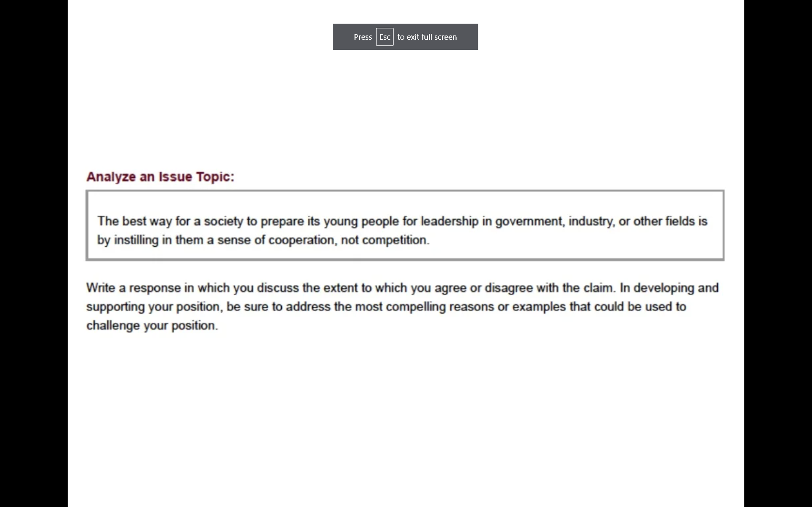
https://lesperelman.com/writing-assessment-robo-grading/presentation-on-automated-essay-scoring/

Slide 21
https://lesperelman.com/writing-assessment-robo-grading/presentation-on-automated-essay-scoring/

Slide 22
https://lesperelman.com/writing-assessment-robo-grading/presentation-on-automated-essay-scoring/

Slide 23
https://lesperelman.com/writing-assessment-robo-grading/presentation-on-automated-essay-scoring/

Slide 24
Example from Perelman (2015)
More examples can be found at the link
https://lesperelman.com/writing-assessment-robo-grading/presentation-on-automated-essay-scoring/

Slide 25
Note
In order to design this critique, Perelman used
Detailed published papers on how e-rater works
A web interface for being able to try out essays on e-rater and get results back
Anecdotal reports of Perelman submitting hundreds of essays in order to converge to a tool that made e-rater look awful

Slide 26
Another Note
At the time, Perelman was trying (and eventually succeeding) in commercializing a tool to teach students to write, PEG/MI Write
A tool competing with an e-rater based system also available commercially

Slide 27
Comments? Questions?

Slide 28
Are contemporary “deep learning” approaches equally vulnerable?
They probably won’t make the same mistakes as earlier generation system
Because they have more of a sense of what words/topics go together across sentences, they will probably be better at catching problems in the previous example
I have not seen a good attack on them yet

Slide 29
Are contemporary “deep learning” approaches equally vulnerable?
Almost unthinkable that they won’t make weird mistakes, but I don’t have a good sense on what those could be
Perhaps preference for mainstream opinions seen on the web a lot, over genuine student opinions?
Perhaps cohesion and assembly issues?

Slide 30
Are contemporary “deep learning” approaches equally vulnerable?
Foundation models generally have these kind of issues
Perhaps preference for mainstream opinions seen on the web a lot, over genuine student opinions?
Chatbots that learn to talk like the worst of social media
Autogenerated text that replicates undesirable associations
Perhaps cohesion and assembly issues?
Autogenerated images that have all the right pieces but put them in the wrong places or at the wrong scale

Slide 31
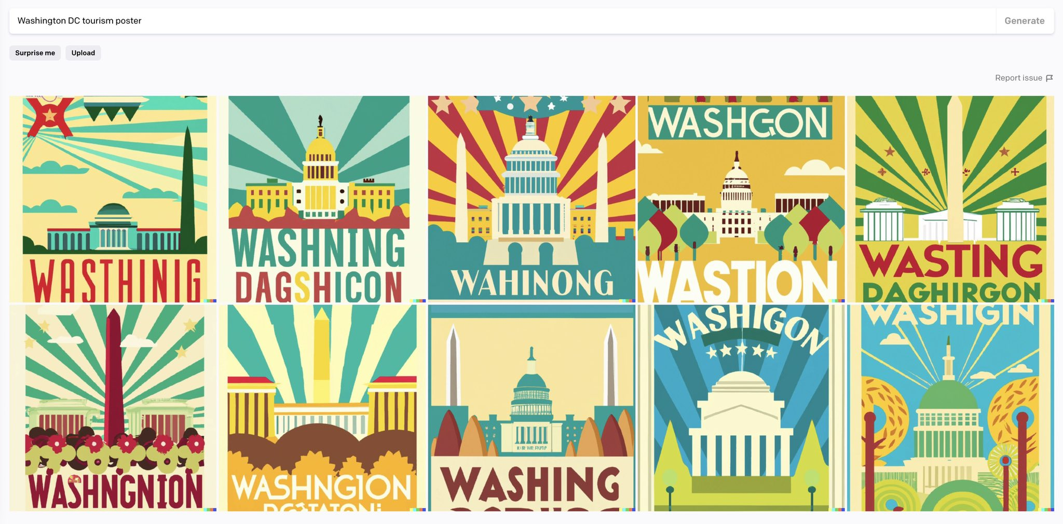

Slide 32
Comments? Questions?

Slide 33
From…
Automated Essay Scoring
To
Automated Writing Support

Slide 34
First…
Who here has graded essays before?

Slide 35
OK now…
Think of supporting students whose essays you have graded
Or if you have never graded
Think of support you might yourself want

Slide 36
What are some dimensions of feedback that would be useful?
Let’s list them out

Slide 37
Now let’s see what the field has actually done

Slide 38
Writing Pal (Roscoe & McNamara, 2013; Crossley et al., 2016)
Legitimacy
Non-words
Length
Relevance
Presence of key words
Structure
Number of paragraphs

Slide 39
PEG (Perelman, 2015)
Usage (Grammar Errors)
Articles
Commonly confused words
Preposition errors
Organization & Development
Finding and improving thesis statements
Sufficient number of supporting ideas

Slide 40
WriteToLearn (Foltz & Rosenstein, 2015)
Ideas
Organization
Conventions
Word choice
Sentence fluency

Slide 41
MI Write (Huang & Wilson, 2021) Later version of PEG
Spelling and Grammar
Idea development
Organization
Style
Sentence fluency
Word choice
Conventions
This list may seem rather familiar….

Slide 42
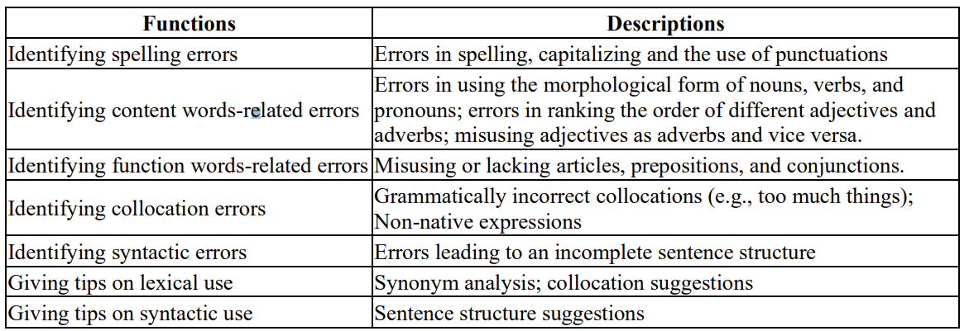
Pigai (Gao, 2021)

Slide 43
Comments? Questions?

Slide 44
Which of these types of feedback seems most valuable?

Slide 45
Are there any types of feedback that seem to be missing to you?

Slide 46
Are there any types of feedback that seem to be missing to you?
Let’s go back to your original list

Slide 47
A bit of an irony
Perelman used e-rater’s openness about how their system works and availability of system to run tests to make e-rater look terrible
Perelman and his colleagues do not publish details on how their tech works and do not have an open way to try their tool out
Preventing others from critiquing their tool the way Perelman critiqued ETS’s tool

Slide 48
As a side effect
Folks originally involved in e-rater did not publish nearly as much detail when describing WriteToLearn, and did not make tool openly available for critique
They learned their lesson, I guess

Slide 49
Comments?

Slide 50
By comparison
Could Grammarly be a good substitute for this kind of tool?
What do you think?

Slide 51
And speaking of Grammarly…
One of the big differences between adaptive learning systems for writing and Grammarly
Is a curriculum and more than just text feedback
i.e. videos and modules as feedback

Slide 52
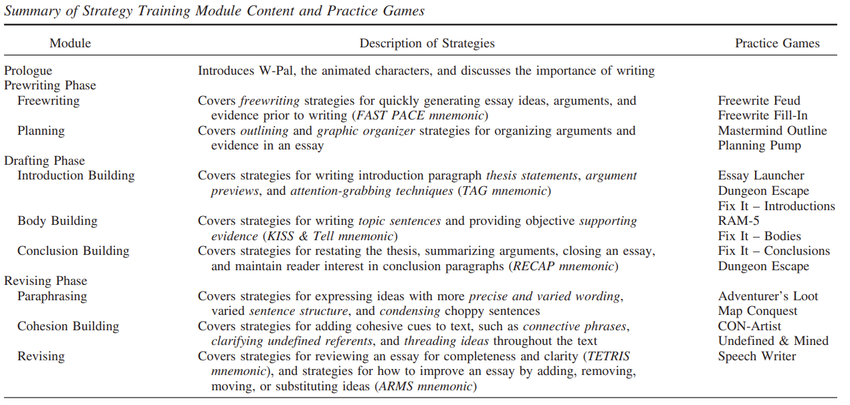
Writing Pal (Roscoe & McNamara, 2013)

Slide 53
Anything you would add or subtract?

Slide 54
Other comments or questions?

Slide 55
Scaffold or support
One criticism levied towards Grammarly is that it scaffolds performance more than it helps people learn to do it right
Is this a real problem?
Is it OK if a future generation of writers always uses Grammarly?

Slide 56
Scaffold or support
One criticism levied towards Grammarly (and related spelling/grammar checkers) is that it scaffolds more than it helps people learn

Slide 57
Qassemzadeh & Soleimani (2016)
Use of Grammarly did not lead to better performance on future essays without Grammarly

Slide 58
Scaffold or support
So it looks like Grammarly indeed scaffolds more than it helps people learn
Is this a real problem?
Is it OK if a future generation of writers always uses Grammarly?
What skills should we scaffold and what skills should we support learning of?

Slide 59
Last comments and questions?

Slide 60
Upcoming classes
Tomorrow 1159pm
Prospectus for Assignment 2
Nov 3
Tutoring Meta-cognition and Self-Regulated Learning (Cloude)
Nov 10
Assessing and Tutoring Complex Behavior
Nov 17
Dialogue Tutors

Slide 61
The End

