Slide 1
Learning Analytics: Process & Theory
January 27, 2014

Slide 2
Welcome…
To those who were here last Wednesday
And to those who are here for the first time

Slide 3
For those of you joining us for the first time…
Syllabus and all course materials are on my webpage
You need Sciences of the Artificial by Simon (1996) for Monday’s class

Slide 4
Anderson et al versus Greeno

Slide 5
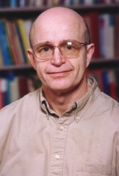
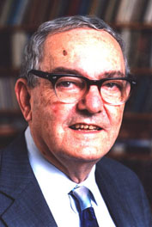
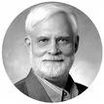
Anderson et al versus Greeno

Slide 6
John Anderson
Leader of development of ACT-R Theory
Pre-eminent attempt to develop a unified theory of cognition
Inventor of Cognitive Tutor
Blended math curricula used by hundreds of thousands of students a year
Inventor of Bayesian Knowledge Tracing
Still the best way to track student knowledge in online learning, 20 years later

Slide 7
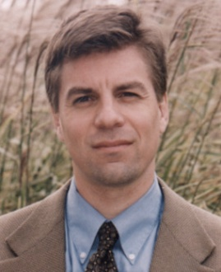
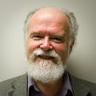
My grandadvisor

Slide 8
Lynne Reder
Extremely influential researcher in memory and cognition

Slide 9
Herbert Simon
Nobel Laureate in Economics
One of the “fathers” of both Cognitive Science and Artificial Intelligence
Important Philosopher of Design and Applied Science
Wrote the book we’re going to read next week

Slide 10
Jim Greeno
Key theoretician of situationalist perspective
Former editor of Cognitive Science

Slide 11
OK, first the obvious part
Who thinks that these articles represented the tone and rhetoric that we should emulate as scientists?
Why or why not?

Slide 12
What are the scientific differences between Greeno and Anderson et al?

Slide 13
Three that I think are key
Understanding learning in context as part of a system, versus understanding learning as something that an individual does
Arguing for learning in context versus abstract transferrable learning
Arguing for the decomposability of learning phenomena versus arguing for a holistic/systems perspective

Slide 14
Questions (according to Greeno)
Cognitive | Situative
How tightly bound is the knowledge to the context in which it is acquired? | Does activity that occurs in one type of situation have aspects that were learned as practices and interactions with the resources available in that type of situation, and does it have aspects that were learned as practices and interactions with resources in some quite different type of situation?
Will complex skills be acquired more successfully if instruction in various independent subskills is presented separately or in situations where all of the subskills are needed? In particular, will skills of complex social activities be learned more successfully if their independent subskills are learned in situations involving individual practice? | Which combinations and sequences of learning will prepare students best for the kinds of participation in social practices that we value most and contribute most productively to the development of students' identities as learners?
Does knowledge transfer between tasks? | When someone has become more successful at participating in one kind of situation, are there other kinds of situations in which that person would be more adept?
What are the relative advantages and disadvantages of abstract instruction, as op-posed to instruction for specific activity, especially for jobs? | What kinds of abstract representations can contribute productively to meaningful, general learning?

Slide 15
Which group of authors is more comprehensible?
Anderson et al
Greeno
Both are comprehensible
Neither are comprehensible

Slide 16
What are the differences in writing style between the two groups of authors?
Notes:
Decomposed linear argument versus dialectic

Slide 17
What are the differences in writing style between the two groups of authors?
Decomposed linear argument versus dialectic

Slide 18
A key difference between Greeno and Anderson et al
Should learning be understood
in context as part of a system
can not be decomposed or studied in parts
or as something that an individual does
decomposable, meaningfully can be studied in parts

Slide 19
This is not just a debate between Greeno and Anderson et al
And it is not just a debate from a couple decades ago
It is a very ongoing and current debate
In education
In learning analytics/EDM
Elsewhere

Slide 20
Other comments
On Anderson/Reder/Simon versus Greeno?

Slide 21
Buchanan and McKeon’s Framework
“Ways to design”
“The cross of pane”
Neo-Aristotelianism

Slide 22
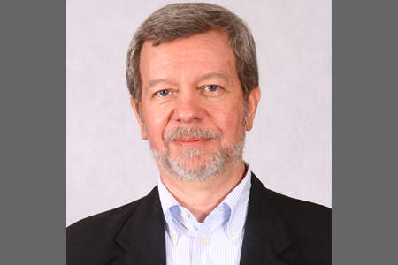
Dick Buchanan
Founder of journal Design Issues
Inventor of term “wicked problem”
Key theoretician of design in the 1990s and the first decade of the 2000s

Slide 23
Richard McKeon
Key 20th century philosopher
Referred to as the “Evil Professor” by Robert Pirsig in Zen and the Art of Motorcycle Maintanance

Slide 24
Buchanan and McKeon’s Framework
HOLISTIC
EXISTENTIALIST
ESSENTIALIST
ENTITATIVE

Slide 25
Buchanan and McKeon’s Framework
HOLISTIC
EXISTENTIALIST
ESSENTIALIST
ENTITATIVE

Slide 26
Buchanan and McKeon’s Framework
HOLISTIC
EXISTENTIALIST
ESSENTIALIST
In education,
called “the Cognitive Approach” by its friends
ENTITATIVE

Slide 27
Buchanan and McKeon’s Framework
HOLISTIC
EXISTENTIALIST
ESSENTIALIST
You can understand things “in themselves”
ENTITATIVE

Slide 28
Buchanan and McKeon’s Framework
HOLISTIC
EXISTENTIALIST
ESSENTIALIST
You can understand things separately from their contexts
ENTITATIVE

Slide 29
Buchanan and McKeon’s Framework
HOLISTIC
EXISTENTIALIST
ESSENTIALIST
Individuals learn skills and concepts
ENTITATIVE

Slide 30
Buchanan and McKeon’s Framework
HOLISTIC
EXISTENTIALIST
ESSENTIALIST
Key method: REDUCTIONISM
ENTITATIVE

Slide 31
What is reductionism?

Slide 32
Buchanan and McKeon’s Framework
HOLISTIC
EXISTENTIALIST
ESSENTIALIST
We can understand complex phenomena by understanding their parts and how those parts interact
ENTITATIVE

Slide 33
Buchanan and McKeon’s Framework
HOLISTIC
EXISTENTIALIST
ESSENTIALIST
Emergent phenomena can be understood by first understanding the motivating factors and processes
ENTITATIVE

Slide 34
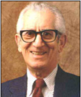
Entitative Thinkers
HOLISTIC
EXISTENTIALIST
ESSENTIALIST
Bloom
ENTITATIVE

Slide 35
Buchanan and McKeon’s Framework
HOLISTIC
EXISTENTIALIST
ESSENTIALIST
ENTITATIVE

Slide 36
Buchanan and McKeon’s Framework
HOLISTIC
Called “the ontological approach” by Buchanan, and Gestalt by others
EXISTENTIALIST
ESSENTIALIST
ENTITATIVE

Slide 37
Buchanan and McKeon’s Framework
HOLISTIC
In education, called “Situationalism” or “Activity Theory” by its friends
EXISTENTIALIST
ESSENTIALIST
ENTITATIVE

Slide 38
Buchanan and McKeon’s Framework
HOLISTIC
Things can only be understood by understanding the systems they operate in
EXISTENTIALIST
ESSENTIALIST
ENTITATIVE

Slide 39
Buchanan and McKeon’s Framework
Learners are enculturated into practices that communities agree are correct
HOLISTIC
EXISTENTIALIST
ESSENTIALIST
ENTITATIVE

Slide 40
Buchanan and McKeon’s Framework
HOLISTIC
Complex phenomena must be
understood as wholes; they can not be
understood in terms of their component parts
EXISTENTIALIST
ESSENTIALIST
ENTITATIVE

Slide 41
Buchanan and McKeon’s Framework
HOLISTIC
Emergent phenomena must be understood in themselves
EXISTENTIALIST
ESSENTIALIST
ENTITATIVE

Slide 42
Buchanan and McKeon’s Framework
HOLISTIC
Key method: DIALECTIC
EXISTENTIALIST
ESSENTIALIST
ENTITATIVE

Slide 43
What is dialectic?

Slide 44
Buchanan and McKeon’s Framework
HOLISTIC
Truth is found through the struggle of opposing hypotheses and their eventual unification in a richer synthesis (Hegelian-Kantian dialectic)
EXISTENTIALIST
ESSENTIALIST
ENTITATIVE

Slide 45
Buchanan and McKeon’s Framework
HOLISTIC
Truth is found through positing overly abstract hypotheses, finding evidence that negates them, and coming to a newer concrete theory (Hegelian dialectic)
EXISTENTIALIST
ESSENTIALIST
ENTITATIVE

Slide 46
Buchanan and McKeon’s Framework
HOLISTIC
Change is governed by historical properties (historicism) where contradictions and states repeat themselves but in continual refinement (material dialectic)
EXISTENTIALIST
ESSENTIALIST
ENTITATIVE

Slide 47
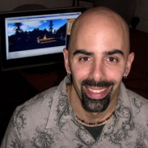
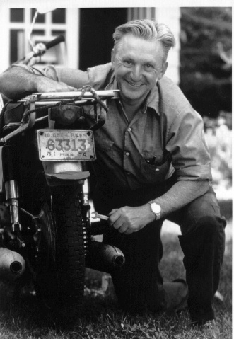
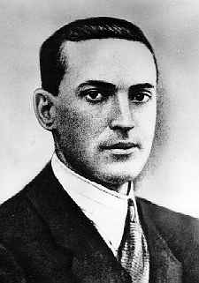
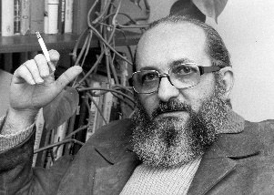
Dialectical Thinkers
HOLISTIC
Barab
Pirsig
Vygotsky Freire
EXISTENTIALIST
ESSENTIALIST
ENTITATIVE

Slide 48
Another key dimension
Is there a reality out there that we want students to learn about?
Are we just teaching cultural practices, or are we teaching real things?

Slide 49
Buchanan and McKeon’s Framework
HOLISTIC
EXISTENTIALIST
ESSENTIALIST
ENTITATIVE

Slide 50
Buchanan and McKeon’s Framework
HOLISTIC
Doesn’t really have a name that its friends call it, in education
EXISTENTIALIST
ESSENTIALIST
ENTITATIVE

Slide 51
Buchanan and McKeon’s Framework
HOLISTIC
Maybe one could call it “The Curricular Approach”
EXISTENTIALIST
ESSENTIALIST
ENTITATIVE

Slide 52
Buchanan and McKeon’s Framework
HOLISTIC
Its enemies used to call it “Instructionism” (cf. Papert, 1981)
EXISTENTIALIST
ESSENTIALIST
ENTITATIVE

Slide 53
Buchanan and McKeon’s Framework
HOLISTIC
EXISTENTIALIST
ESSENTIALIST
There is a real fundamental reality to the universe that students can learn about
ENTITATIVE

Slide 54
Buchanan and McKeon’s Framework
HOLISTIC
EXISTENTIALIST
ESSENTIALIST
Or, in the “Pragmatic Essentialism” form, there are beliefs, skills, and practices that are so core to a specific culture and context as to be real for all practical purposes
ENTITATIVE

Slide 55
Buchanan and McKeon’s Framework
HOLISTIC
EXISTENTIALIST
ESSENTIALIST
Essentialism is implicit in the focus on mathematical skills, scientific skills, and literacy, and the “Common Core”
ENTITATIVE

Slide 56
Buchanan and McKeon’s Framework
HOLISTIC
Knowledge can be measured and compared, because there’s some real reference that two students can be compared according to
EXISTENTIALIST
ESSENTIALIST
ENTITATIVE

Slide 57
Buchanan and McKeon’s Framework
HOLISTIC
EXISTENTIALIST
ESSENTIALIST
If you use the Common Core, NY Regents, or other standardized exams, you’re an essentialist in practice
ENTITATIVE

Slide 58
Buchanan and McKeon’s Framework
HOLISTIC
EXISTENTIALIST
ESSENTIALIST
If you think standardized exams are crap because they don’t measure real math/science skill/knowledge, you’re still an essentialist
ENTITATIVE

Slide 59
Buchanan and McKeon’s Framework
HOLISTIC
EXISTENTIALIST
ESSENTIALIST
Gagne
ENTITATIVE

Slide 60
Buchanan and McKeon’s Framework
HOLISTIC
EXISTENTIALIST
ESSENTIALIST
ENTITATIVE

Slide 61
Buchanan and McKeon’s Framework
HOLISTIC
In education, called “Constructionism” by its friends
EXISTENTIALIST
ESSENTIALIST
ENTITATIVE

Slide 62
Buchanan and McKeon’s Framework
HOLISTIC
“Constructionism” is not the same thing as “Constructivism”
EXISTENTIALIST
ESSENTIALIST
ENTITATIVE

Slide 63
Buchanan and McKeon’s Framework
“Constructivism” argues that students learn actively rather than passively, and learn best by doing. It’s pretty much orthogonal to the dimensions shown below.
HOLISTIC
EXISTENTIALIST
ESSENTIALIST
ENTITATIVE

Slide 64
Buchanan and McKeon’s Framework
HOLISTIC
EXISTENTIALIST
ESSENTIALIST
Everyone defines their own reality in their own individual way
ENTITATIVE

Slide 65
Buchanan and McKeon’s Framework
HOLISTIC
EXISTENTIALIST
ESSENTIALIST
Agreed-upon conventions are simply agreed-upon conventions and reflect no fundamental reality
ENTITATIVE

Slide 66
Buchanan and McKeon’s Framework
HOLISTIC
EXISTENTIALIST
ESSENTIALIST
0, 1, and 42 are social constructions; blue and red are social constructions
ENTITATIVE

Slide 67
Buchanan and McKeon’s Framework
HOLISTIC
And they’re actually not even the same thing in different peoples’ heads
EXISTENTIALIST
ESSENTIALIST
ENTITATIVE

Slide 68
Buchanan and McKeon’s Framework
HOLISTIC
So when you and I think of “42” we’re thinking of different things
EXISTENTIALIST
ESSENTIALIST
ENTITATIVE

Slide 69
Buchanan and McKeon’s Framework
Because of this, measuring learning is fundamentally misguided – there is no real commonality to compare – even if we manifest the same behavior, the cognitive reality is unreduceable
HOLISTIC
EXISTENTIALIST
ESSENTIALIST
ENTITATIVE

Slide 70
Buchanan and McKeon’s Framework
HOLISTIC
EXISTENTIALIST
ESSENTIALIST
If you think that standardized exams are junk, and never can be improved in any way, because tests cannot measure anything that matters, you’re an existentialist in practice
ENTITATIVE

Slide 71
Buchanan and McKeon’s Framework
HOLISTIC
EXISTENTIALIST
ESSENTIALIST
School should not focus on math or literacy skills, it should focus on “learning how to learn” and generating passion for learning, because everyone will be passionate and skilled at different things
ENTITATIVE

Slide 72
Buchanan and McKeon’s Framework
HOLISTIC
EXISTENTIALIST
ESSENTIALIST
So if you want to measure something, measure passion or measure the great things a student can do and the surprising connections they make
ENTITATIVE

Slide 73
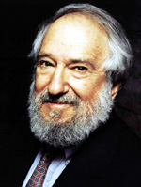
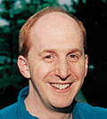
Buchanan and McKeon’s Framework
HOLISTIC
Papert
EXISTENTIALIST
ESSENTIALIST
Edelson
ENTITATIVE

Slide 74
Questions, Comments about this?

Slide 75
Crossing the Center
Many researchers are at the diagonals of this graph rather than the ends
Some researchers do not fit neatly in these categories
e.g. they use both holistic and entitative methods when they seem useful
That said… Buchanan claims that most researchers and designers have a strong preference, and I have generally found that to be true
I *definitely* have preferences
And the only major education theorist I’ve ever seen who wrote in both holistic and entitative ways effectively was Vygotsky

Slide 76
Methods
Most education research methods are tightly identified with one (or at most two, at a diagonal) of these philosophical positions
Analytics/data mining seems to be an exception, as it can be used in ways compatible with each of these perspectives
We’ll discuss examples of this as the semester goes forward

Slide 77
At the extreme
Researchers who are strongly identified with one position tend to find research drawing on the opposite set of assumptions
incomprehensible, outdated, acting in bad faith, or even evil
as with the articles we read today
Another classic example is Papert’s late-1980s claim that “instructionism” is like the Soviet Union and “constructionism” is like glasnost and perestroika for the American educational system

Slide 78
But I’m a big believer that
We can all learn from each other

Slide 79
Where do you fit on this diagram?
HOLISTIC
EXISTENTIALIST
ESSENTIALIST
ENTITATIVE

Slide 80
Other comments, thoughts, questions?

Slide 81
Upcoming Classes
1/29: Optional -- Attend EdLab Seminar at noon by Professor Baker (topic: the Learning Analytics grad program at TC; will indicate where this course falls in overall learning progression)
2/3: Sciences of the Artificial, Part One
2/5: Sciences of the Artificial, Part Two

